Slide 1
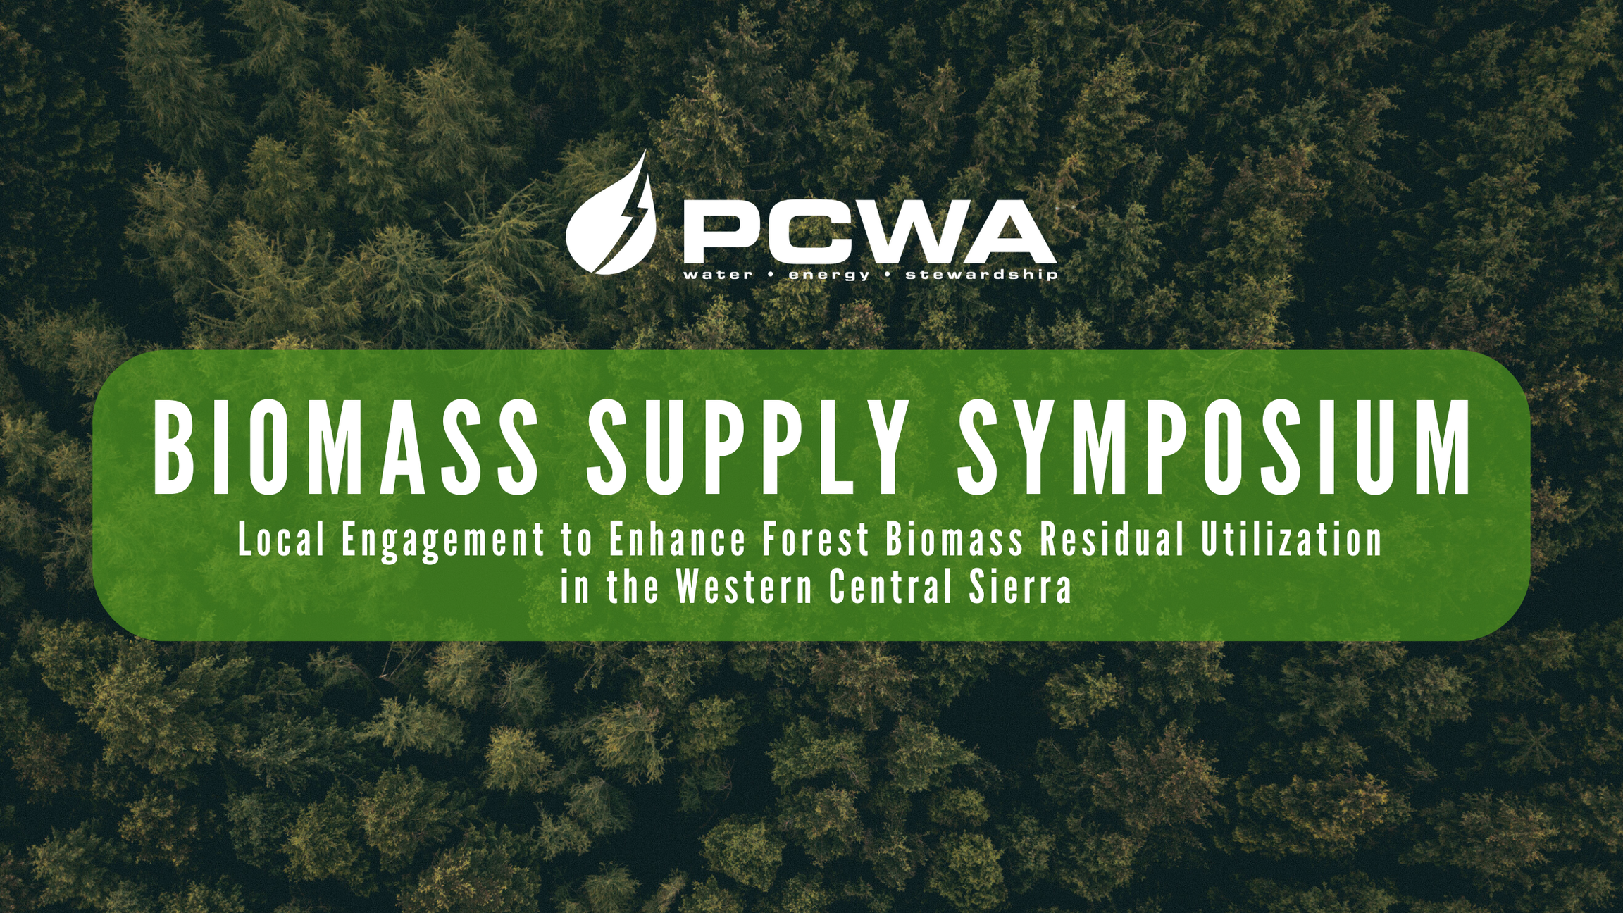

Slide 2

A look ahead for CAL FRAME in the Tahoe-Central Sierra
OPR PCWA Pilot Team
June 26, 2024

Slide 3

Agenda
Study Items
Develop Strong Feedstock Contracts and Associated Processes
Investigate Green Waste Programs for private nonindustrial timberlands
Explore Insurance Products
Consider Other Actions as Described in Community Outreach Report and Water Agency work
The Potential to Create or Adapt Legal Entity to do Desired Work around Biomass

Slide 4
Completion of OPR Studies
As discussed, the bioenergy facility study, and the economic analysis for a potential JPA are to be completed. Formal Outreach to Potential Members will begin
The next work to be completed includes the creation of two BDO zones; one within the Eastern Placer/Nevada County, and the other in Western Placer County.
Form BDO Zone Rating Advisory Committee
Quantify Supply-Side and Utilization Data
Develop Feedstock Supply Chain Risk Assessment
Promote Bio-Based Business Development Opportunities
Track Impact of BDO Zone Rating
2024
A look Ahead for cal frame in the TCS Region

Slide 5

Long Term Feedstock Contracts for Biomass Residual Utilization
Investors, bankers, developers and others in the industry confirm that the difficulty in obtaining long term feedstock contracts is a significant barrier to developing new businesses that use biomass residuals. Solutions for this problem are complex and challenging, but solutions are in sight, and they do not rely on changing US Forest Service contracting.

Slide 6
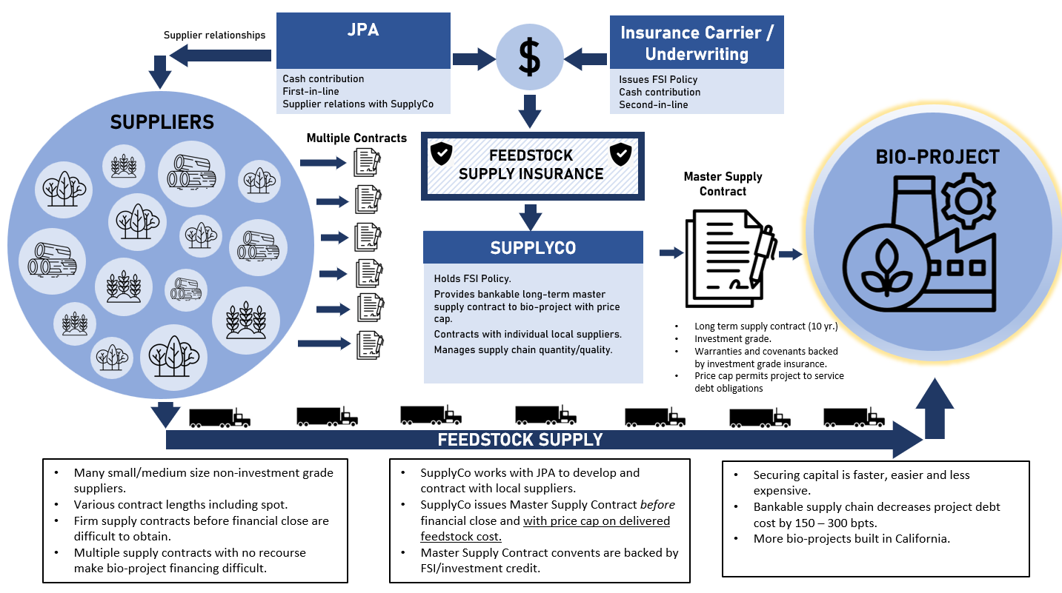

Slide 7

Potential JPA Services
Collaborative Report Findings related to forest management
Collaborative Report Findings related to Biomass
Consolidated environmental review and permitting to improve procurement efficiencies and facilitate large-scale projects.
Coordinated grant pursuit and administration to increase regional funding, reduce competition, and optimize resources for large projects.
Workforce training and development programs to address forest health and wildfire resilience workforce needs, leveraging community colleges and existing networks.
Mapping software for estimating material volumes and facilitating project bundling on private lands.
Businesses streamline biomass supply chains to reduce transportation and handling costs.
Joint marketing efforts promote biomass utilization and address public misconceptions.
Companies collaborate on R&D to develop new biomass-based products.
Businesses adopt sustainable practices and obtain certifications for market credibility.
Market Aggregation: Aggregation hubs consolidate biomass from small producers to supply larger buyers.
Financial tools like carbon credits and subsidies support market development.
Shared services help businesses navigate and comply with environmental regulations.

Slide 8
Green Waste Management on Non-Industrial Timberlands
Private Land Owner Challenges
Lessons from the Urban Waste Sector
Opportunities
Demographics of landowners
Access to forestry professionals
Extreme fire risk
Road networks/geographical constraints
Residents pay for waste pick-up;
Waste is regulated
Waste hauling is tightly controlled
Landfills are stressed, composting forest waste is not the answer
State is motivated to help with education and outreach
Wildfires bring attention to need
Exciting potential for insurance to reflect work on the ground

Slide 9
Insurance Products
The Insurance Playbook developed by the North State Pilot
Insurance for Businesses
Alternative Insurance Models
Contract Insurance Research
Traditional insurance approaches: Supply bonds
State policy incentives include Public claims funds, State-funded reinsurance
Select a project in the TCS Region as a case study to assess viability and cost ranges of Insurance
Develop a customized Insurance instrument for feedstock and investment capital requirements, and obtain feedback from underwriters on viability and premium costs.
Basic insurance training, understanding credit ratings, risk modeling.
Key Actors include Biofuels producers, biomass power generation, forest landowners, trucking, forestry services, public entities, sawmills, wildfire mitigation
Incentives include higher safety standards, equipment maintenance, risk management to lower costs.
The term parametric insurance describes a type of insurance contract that insures a policyholder against the occurrence of a specific event by paying a set amount based on the magnitude of the event, as opposed to the magnitude of the losses in a traditional indemnity policy.
A group captive is an insurance company that is owned and operated by multiple member companies to insure the risks of participating businesses. Group captives are an alternative to traditional insurance, where organizations form their own licensed insurance company instead of buying insurance from a third party.

Slide 10

The Nature of the Biomass Themed JPA
JPA will manage a “Feedstock Contract Guarantee Fund” and support long term contracts,
And it may or may not:
own biomass
fund fuel reduction projects
own infrastructure
have independent staff, whether employees or contractors
Offer green waste management, insurance products, or other services

Slide 11
Model Options Pros and Cons
Options | Feedstock Contract Fund Management | Local Green Waste Program | Insurance Products | Produce or Own Biomass
Water Agency JPA | 4 | 2 | 2 | 3
State/ Local JPA | 5 | 2 | 5 | 3
County/City JPA | 4 | 5 | 3 | 3
Wildfire Prevention Authority | 2 | 4 | 2 | 5

Slide 12
Other Model Options Pros and Cons
Options | Need for ballot measure related funding | Strong local control | Infrastructure ownership options | Potential Good Neighbor Authority accounting benefits
Water Agency JPA | Maybe | Yes | Yes | No
State/ Local JPA | No | No | Maybe | Yes
County/City JPA | Maybe | Yes | Yes | No
Wildfire Prevention Authority | Yes | Yes | Maybe | No

Slide 13
The Steps to Creation of JPA
RESEARCH
Prepare myriad of analysis on partners, finance, feedstock supply, community inclusion and business.
OUTREACH
DEVELOP VISION
Determine which of the services should be emphasized and prioritize mission.
CREATE FOUNDATION
Develop agreement around processes and procedures for implementing mission; seek funding from the state
LAUNCH
File all documents needed with state and LAFCO
Conduct meaningful discussion with potential members of JPA entity
1
2
3
4
5

Slide 14
Timeline
OPR Program is Complete
Summer 2024
Outreach and vision development
Spring 2025
Summer 2025
Preliminary commitment by members of new JPA; begin document review
January 2026
Launch JPA
March 2026
Completion of research work
Seek state funding for new entity

Slide 15

Summary
There are thousands of JPAs at workin California today. Working with local agencies and potentially the State could bring new solutions to the biomass supply chain challenge. A JPA is essentially a collaborative with more power to get things done. JPA’s can hold players accountable and ensure more access to job markets, information, and public funding. JPA entity development warrants significant consideration in the TCS region.

Slide 16
Thank you
Christiana Darlington
CLERE Inc
530-305-4433 Christiana@clereinc.net

