Slide 1
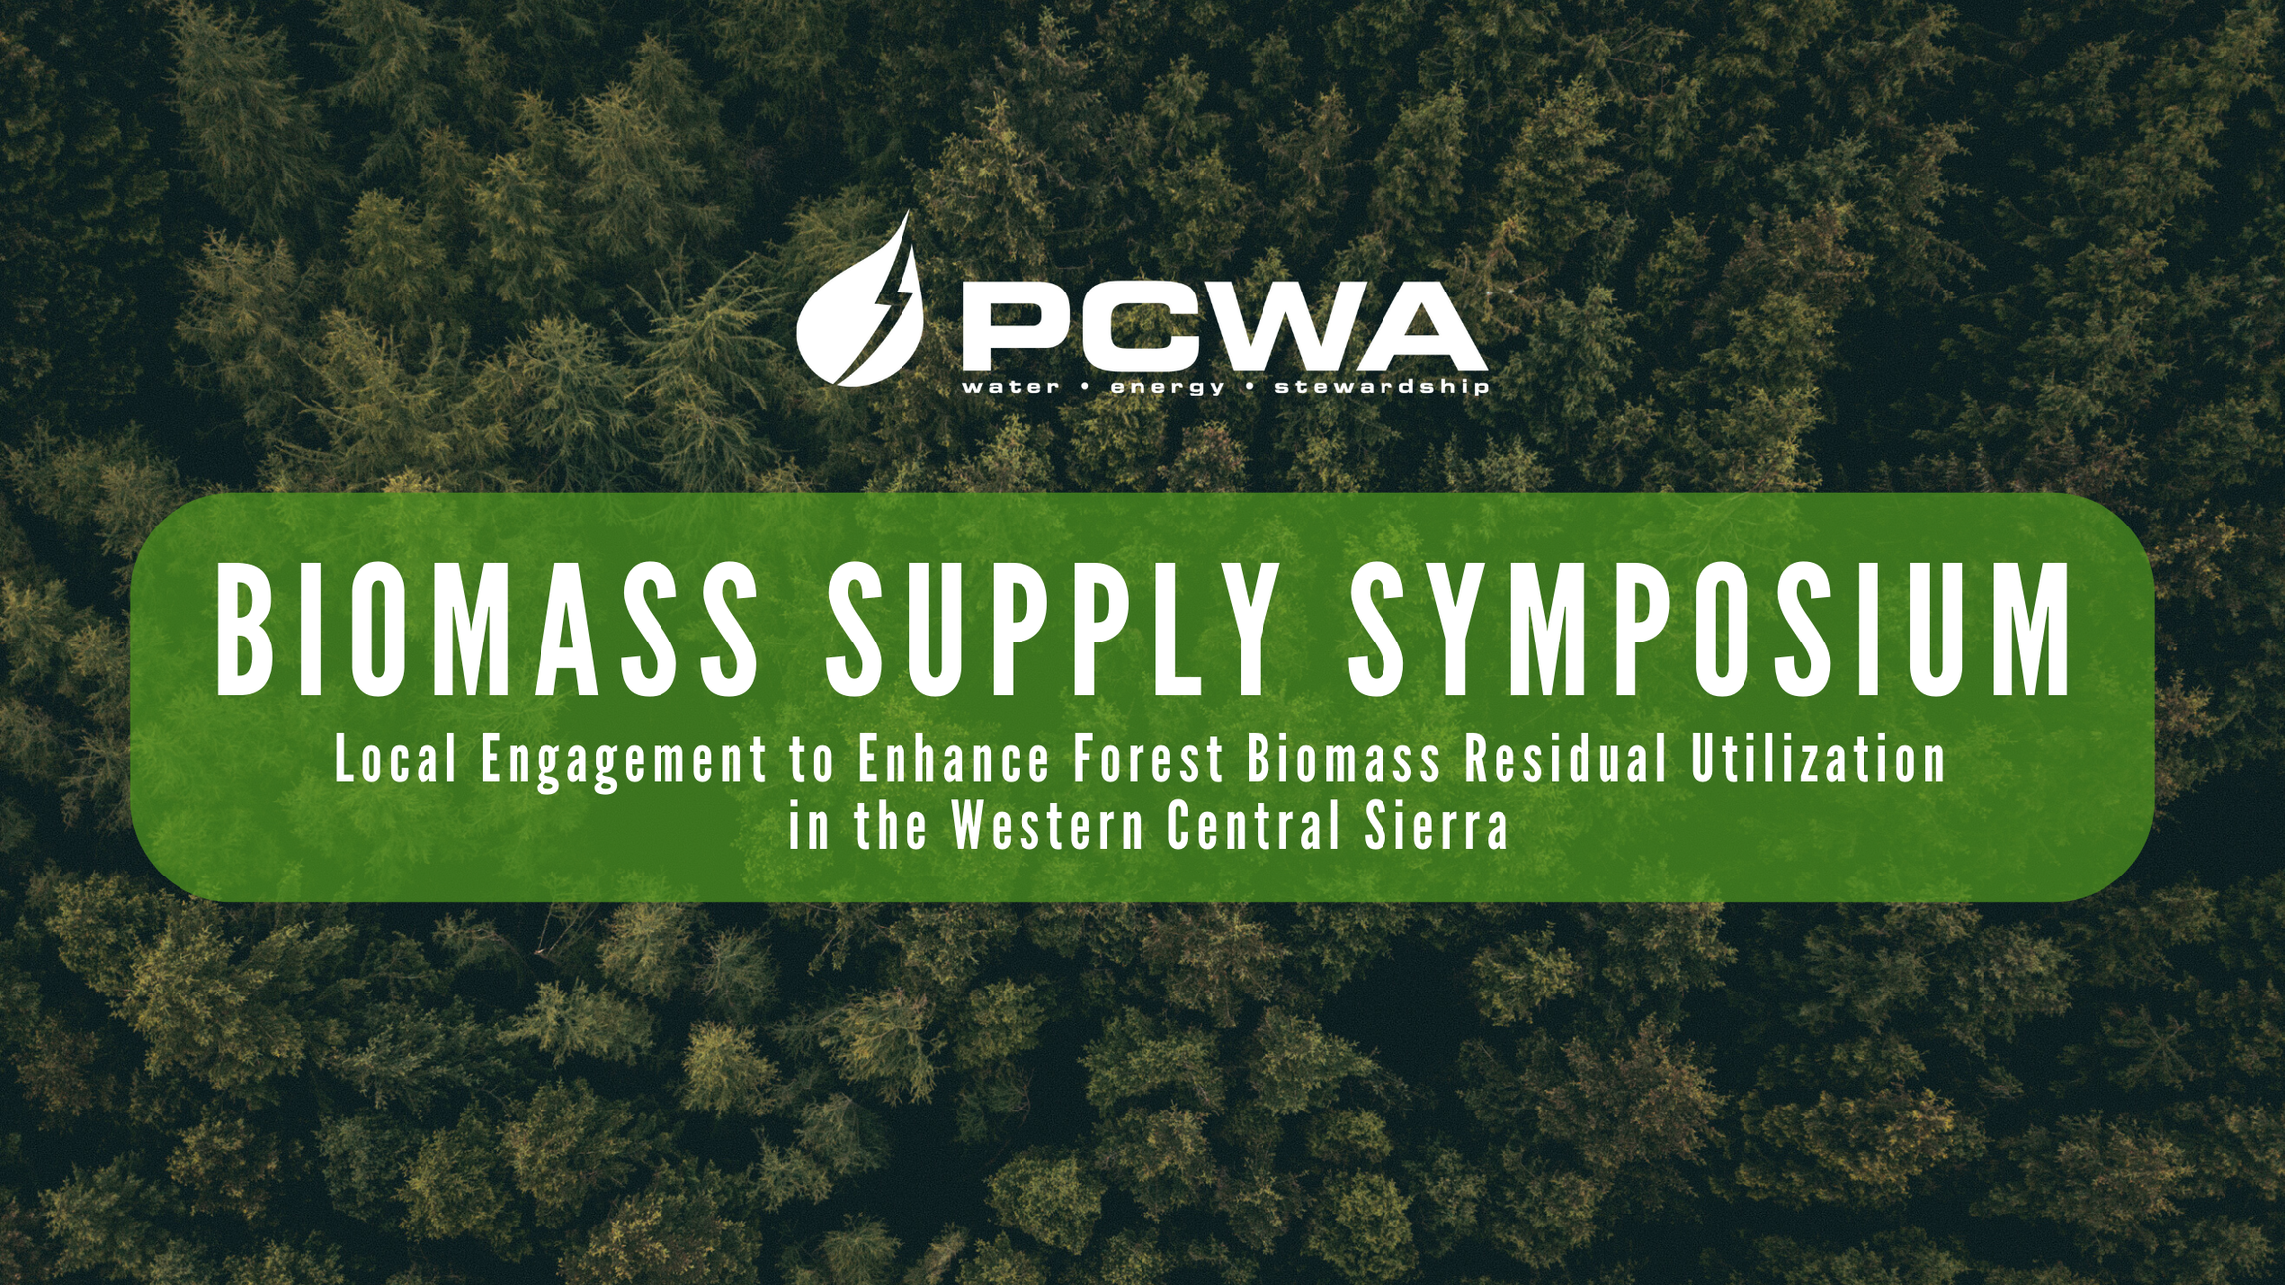

Slide 2

Woody Feedstock Aggregation Pilot Program
Cal FRAME Overview
FISCAL YEAR 2023-2024

Slide 3
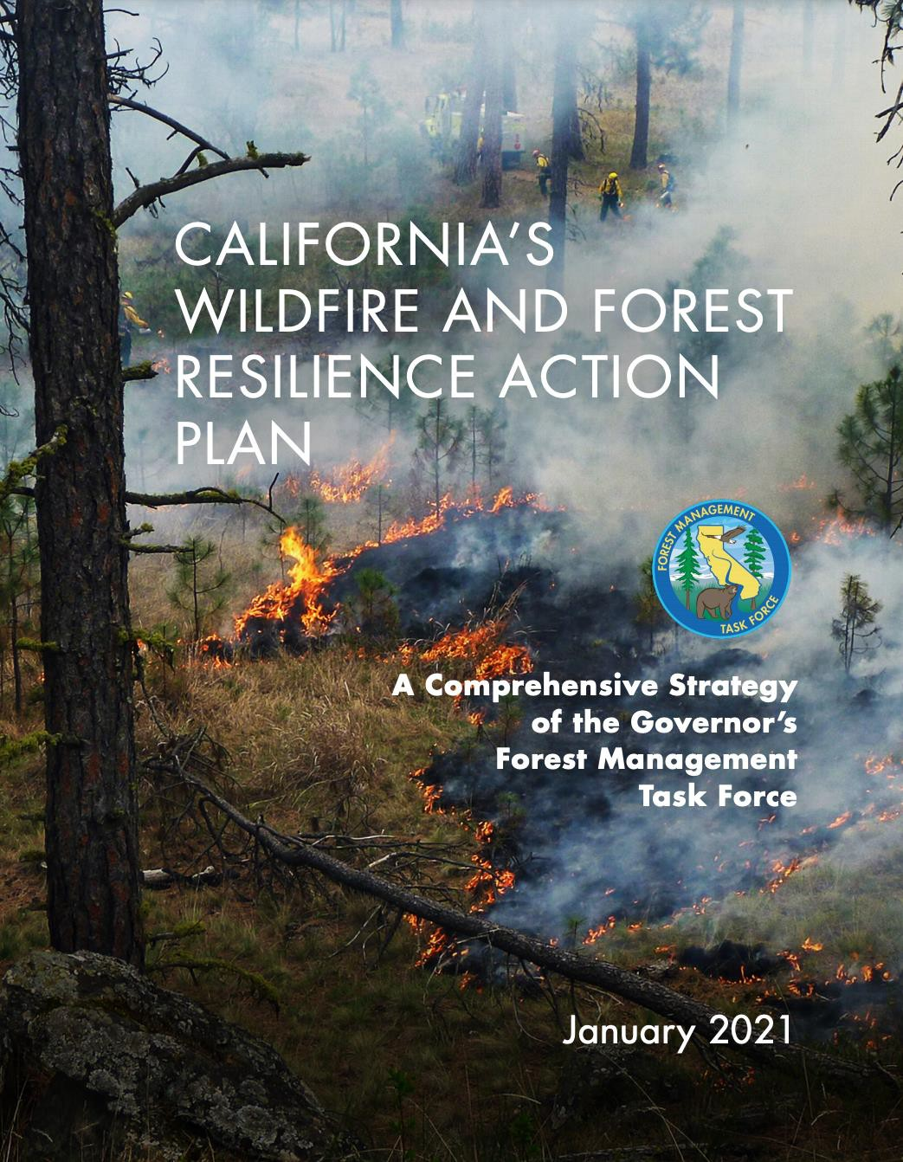
OPR's Key Actions
GOAL 3: MANAGE FORESTS TO ACHIEVE THE STATE’S ECONOMIC AND ENVIRONMENTAL GOALS
Task: Create a Sustainable Wood Products Market in California
3.05, 3.07, 3.09, 3.10

Slide 4
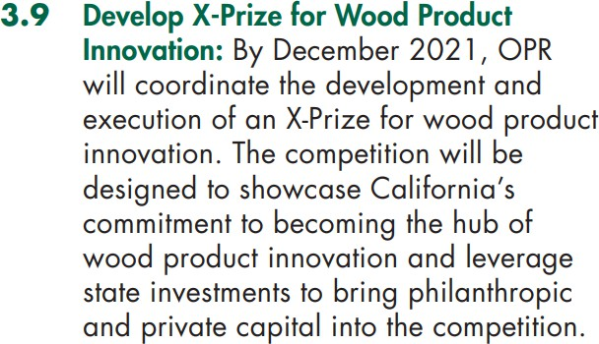
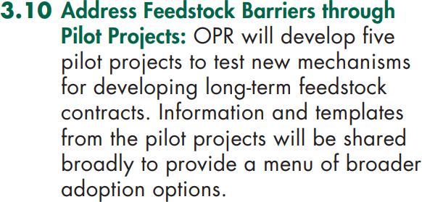
OPR’s Key Actions

Slide 5
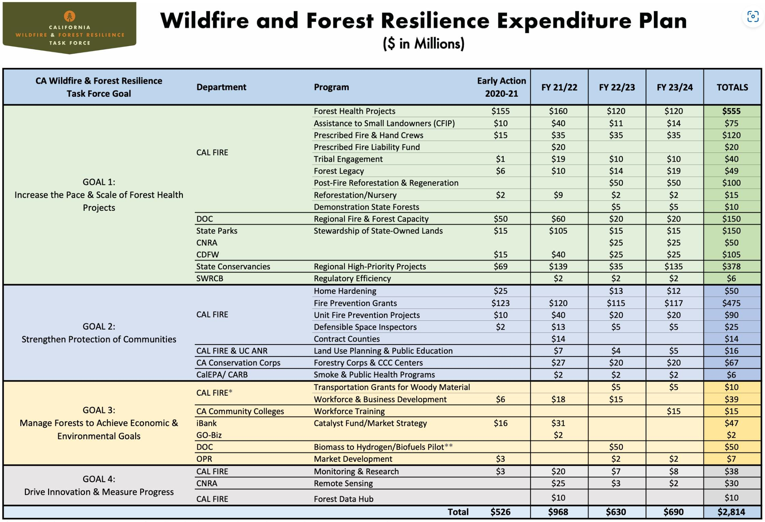

Slide 6
Deliverables Completed to Date
In previous rounds, the pilots investigated how to build the institutional capacity to unlock the biomass supply chain bottleneck and establish reliable access to forest biomass.
To date, the pilot have conducted the following research:
Evaluated regional governance models, public entity financing pathways, feedstock availability, and at scale biomass aggregation mechanisms in 17 counties throughout Northern California;
Evaluated biomass utilization recovery pathways, evaluated the economic feasibility and economic development potential of each recovery pathway, assessed the relative carbon impacts of each recovery pathway, including GHG emissions and sequestration potential;
Designed a biomass pricing mechanism and feedstock supply contract templates, designed and constructed a digital marketplace for forest biomass, assessed infrastructure needs including bioenergy, biofuels, biochar and hydrogen production facilities; and
Investigated insurance gaps for forest landowners, licensed timber operators and biomass off-
takers.

Slide 7
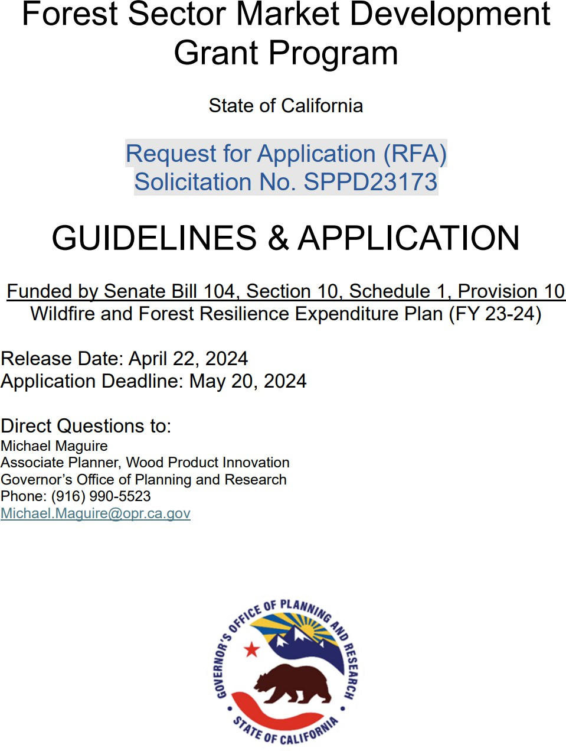
Round 3 Awards
Funding: $2 million via Senate Bill 104 (FY 2023-2024)
Goal: Create forest resilience authorities to manage forest biomass supplies at the local and regional level.
Awards Range: $125,000.00 to $500,000.00 per project
Awardees: Fall River RCD, Lake County RCD, Marin RCD, Mariposa County RCD, Placer County Water Agency, Shasta Valley RCD
Grant Term: June 30, 2024 – March 31, 2026

Slide 8
Program Objective and Project Deliverables
Program Objective
Establish reliable access to woody feedstock through the deployment of a new public entity with the
authority and resources to aggregate biomass at scale and facilitate long-term feedstock contracts
Project Deliverables (Round 3)
Draft governance structure implementation plans, entity action plans, long-term objectives plans, feedstock acquisition plans and entity financing plans;
Draft the foundational documents to formally create and launch a new public entity and/or public-
private partnership to facilitate the mobilization of biomass on the behalf of participating member
counties, cities, water agencies, fire districts, resource conservation districts, and other special districts
in each project region;
Where applicable, modify the foundational documents of an existing public entity to facilitate the mobilization of biomass on behalf of their membership;
Conduct a series of Bioeconomy Development Opportunity Zone studies to evaluate the business,
workforce and infrastructure readiness of the biomass industry in a project region;
Establish a sustainable financing mechanism for each public entity;
Develop a feedstock supply insurance framework for long-term feedstock contracting; and
Support development and modifications to OPR’s digital marketplace for forest biomass.

Slide 9

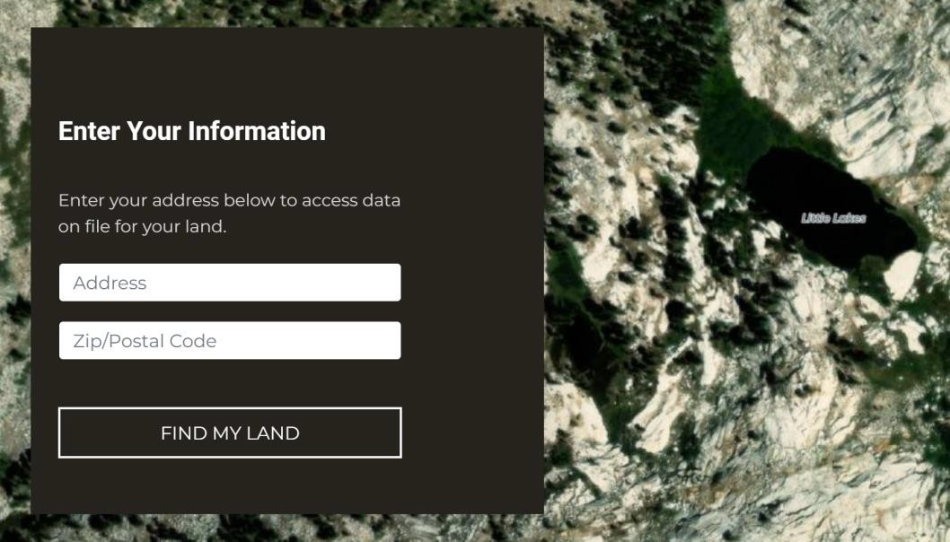
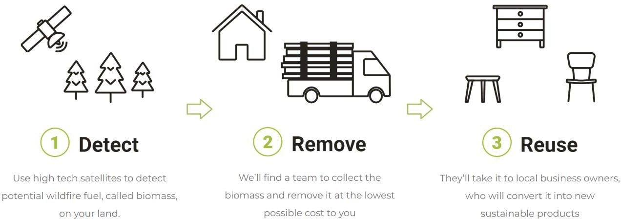
Digital Marketplace for Forest Biomass

Slide 10
Program Timeline
Action | Target Dates | Status
Round 1: Issue Grant Guidelines | September 1, 2021 | COMPLETE
Round 1: Awards Announced | January 31, 2022 | COMPLETE
Round 1: Funds Encumbered | June 30, 2022 | COMPLETE
Round 2: Contract Amendments | January - May 2023 | COMPLETE
Round 2: Funds Encumbered | June 30, 2023 | COMPLETE
Round 3: Issue Grant Guidelines | April 22, 2024 | COMPLETE
Round 3: Awards Announced | June 19, 2024 | COMPLETE
Round 3: Funds Encumbered | June 30, 2024 | IN PROGRESS
End of Grant Term (Rounds 1 and 2) | March 31, 2025 | INCOMPLETE
End of Grant Term (Round 3) | March 31, 2026 | INCOMPLETE

Slide 11
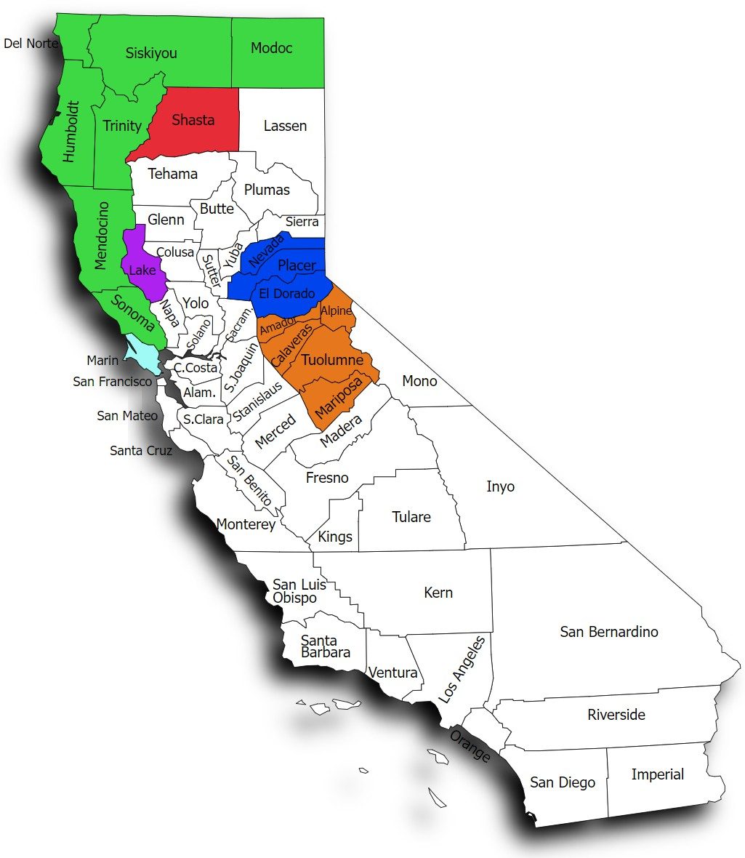
Pilot Project Regions
Central Sierra Project
  Grantee: Mariposa County RCD
  Counties: Alpine, Amador, Calaveras, Mariposa and Tuolumne
Marin Biomass Project
  Grantee: Marin RCD
  County: Marin
North Coast Resource Partnership
  Grantees: Humboldt County (Rounds 1 and 2), Shasta Valley RCD (Round 3)
  Counties: Del Norte, Humboldt, Mendocino, Modoc, Siskiyou, Sonoma, and Trinity
Northeast California Project
  Grantee: Fall River RCD
  County: Shasta
Tahoe Central Sierra Project
  Grantee: Placer County Water Agency
  Counties: Nevada, El Dorado and Placer
Lake County Project
  Grantee: Lake County RCD
  County: Lake

Slide 12
Contact Information
Michael Maguire
Associate Planner, Wood Product Innovation Governor’s Office of Planning and Research 1400 10th Street
Sacramento, CA 95814
(916)990-5523
Michael.Maguire@opr.ca.gov

