Slide 1

“Biomass Collection Carried out by Local Government”

Slide 2







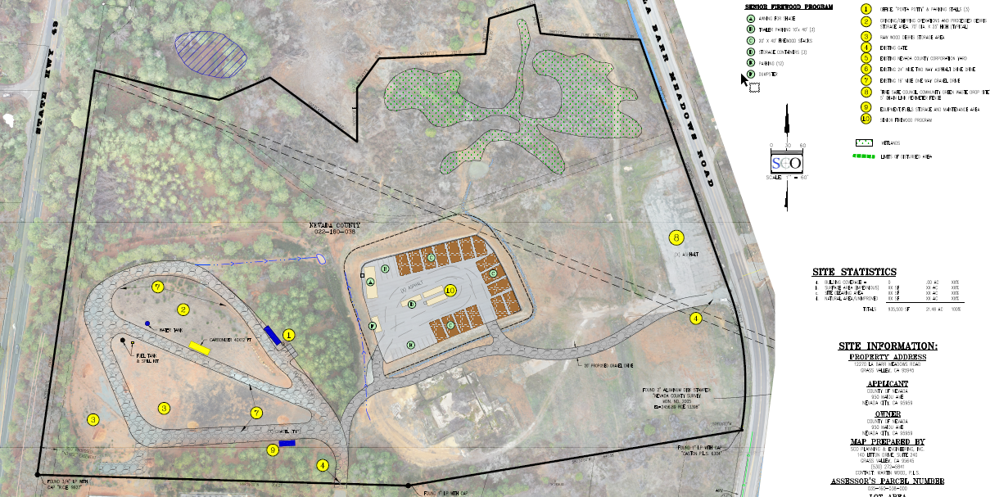
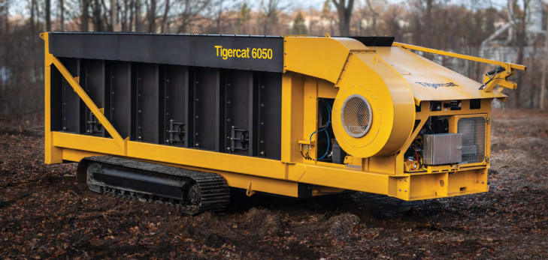
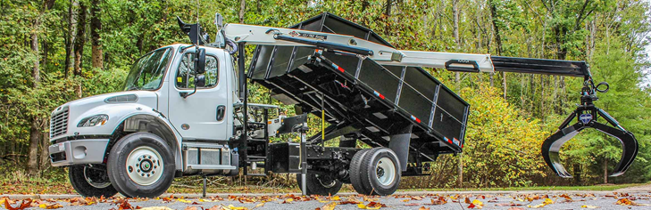
Biomass Pilot Project
Nov. 2024

Slide 3
El Dorado & Georgetown Divide Resource Conservation Districts

Slide 4
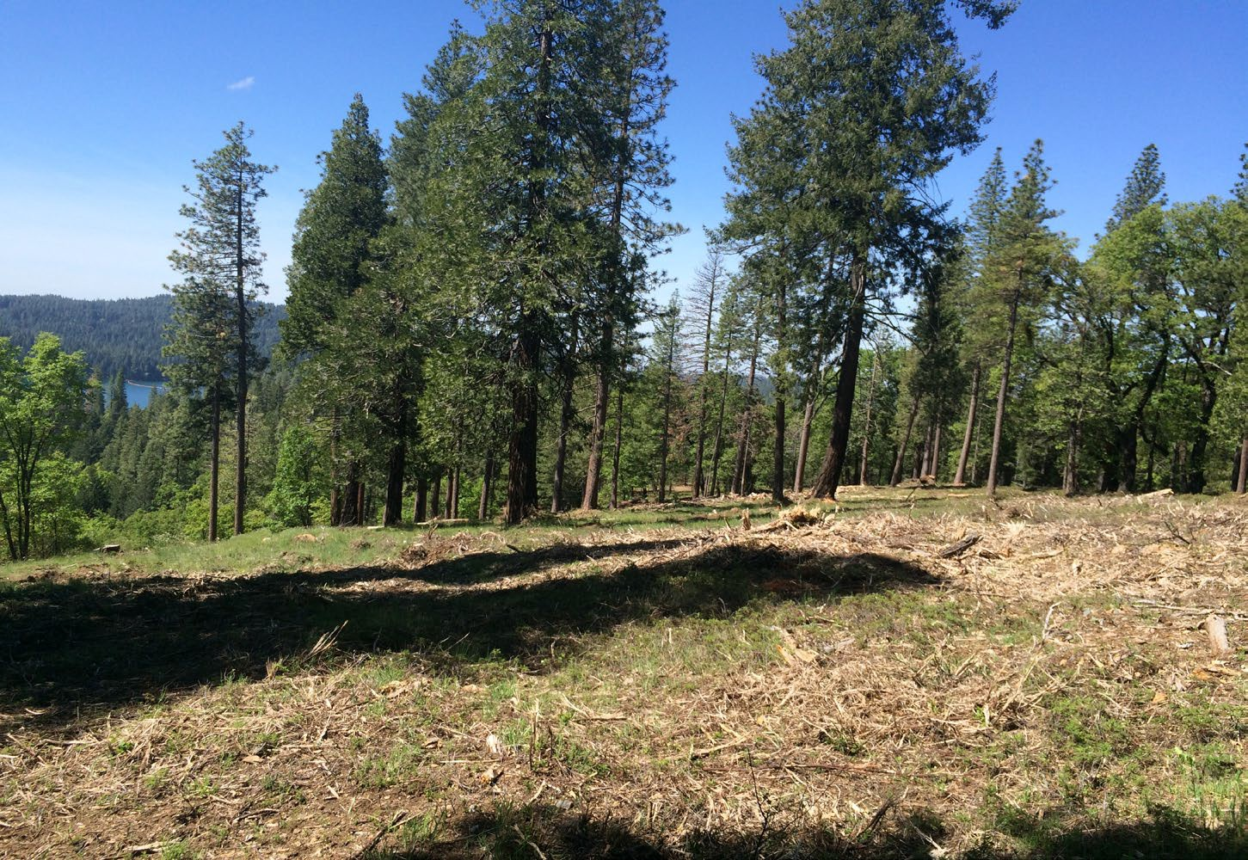
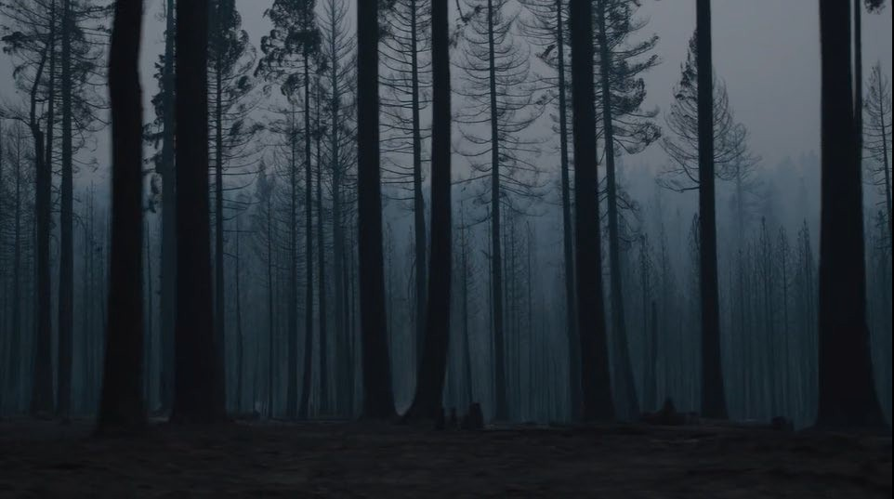



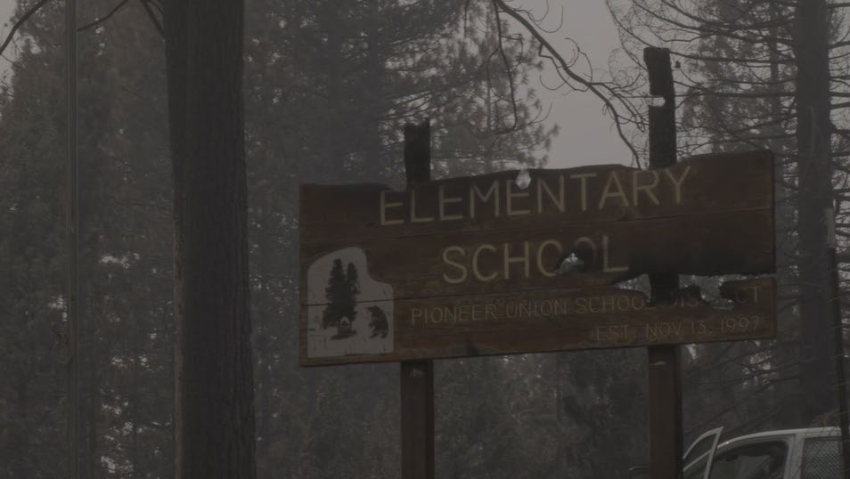

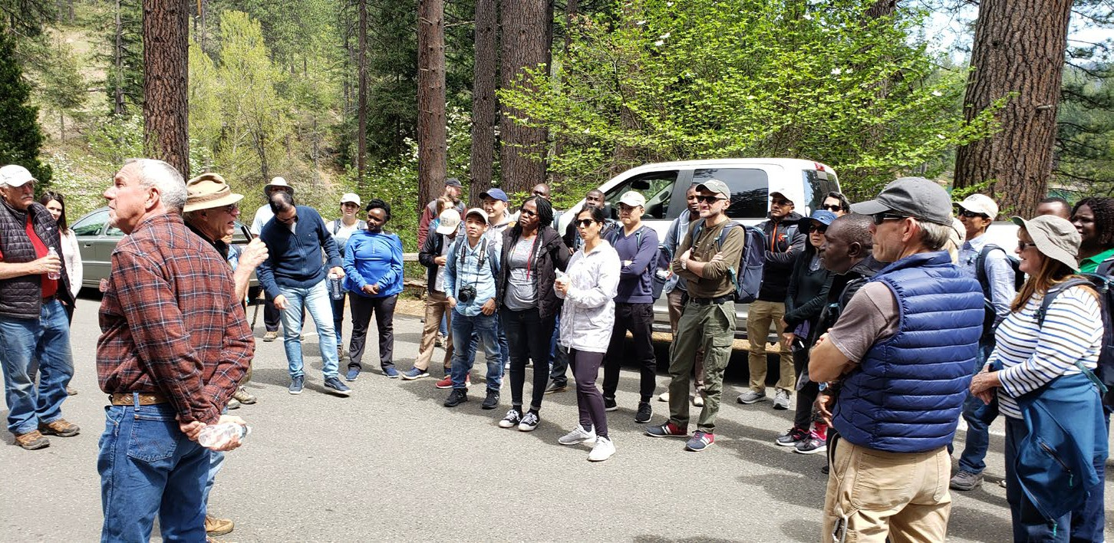

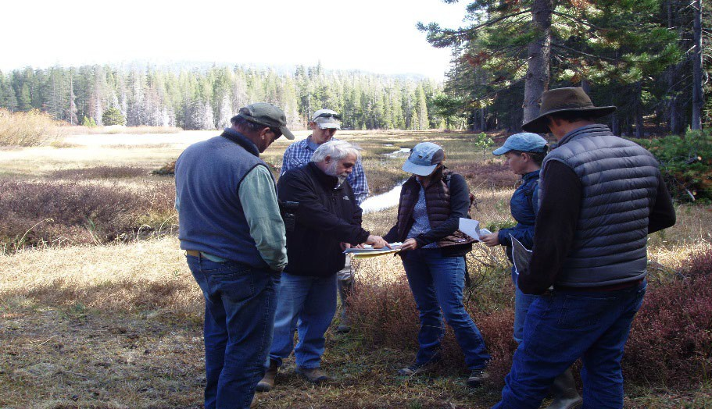
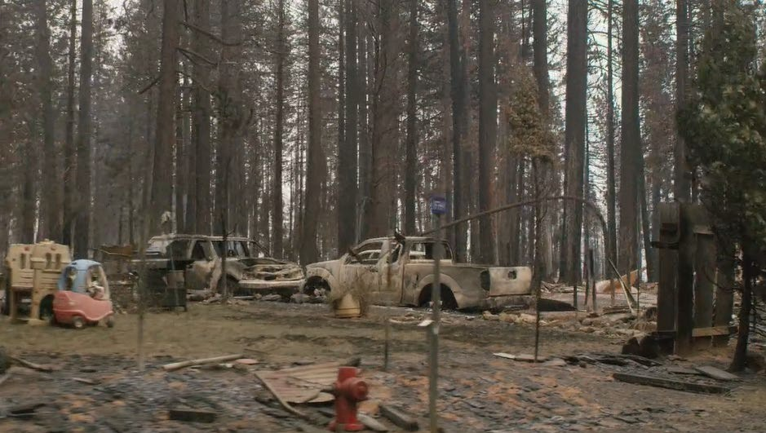
Landscape
Community
Individual Landowner

Slide 5
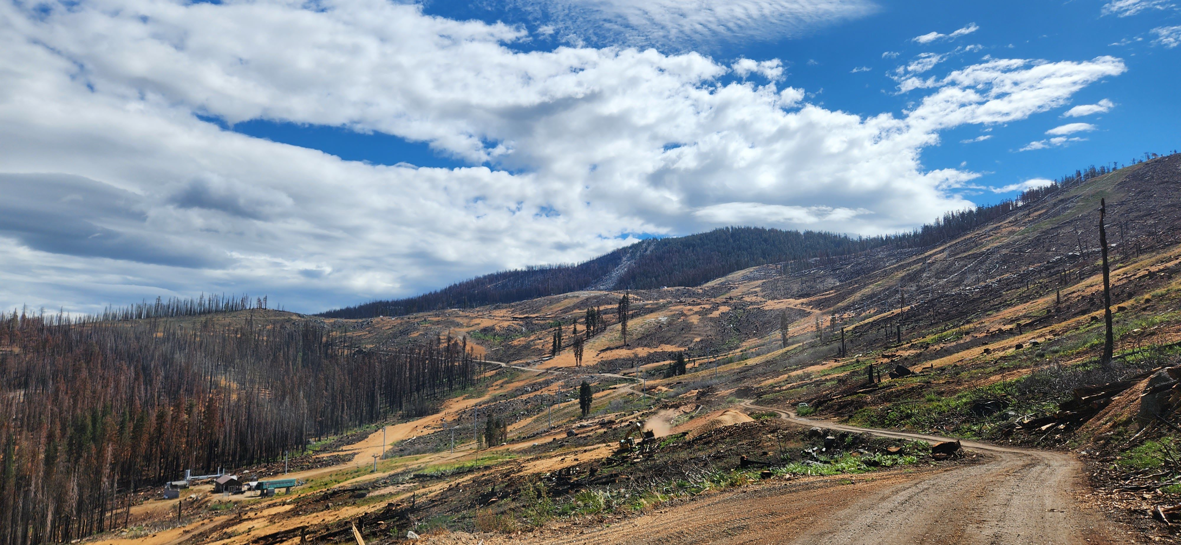
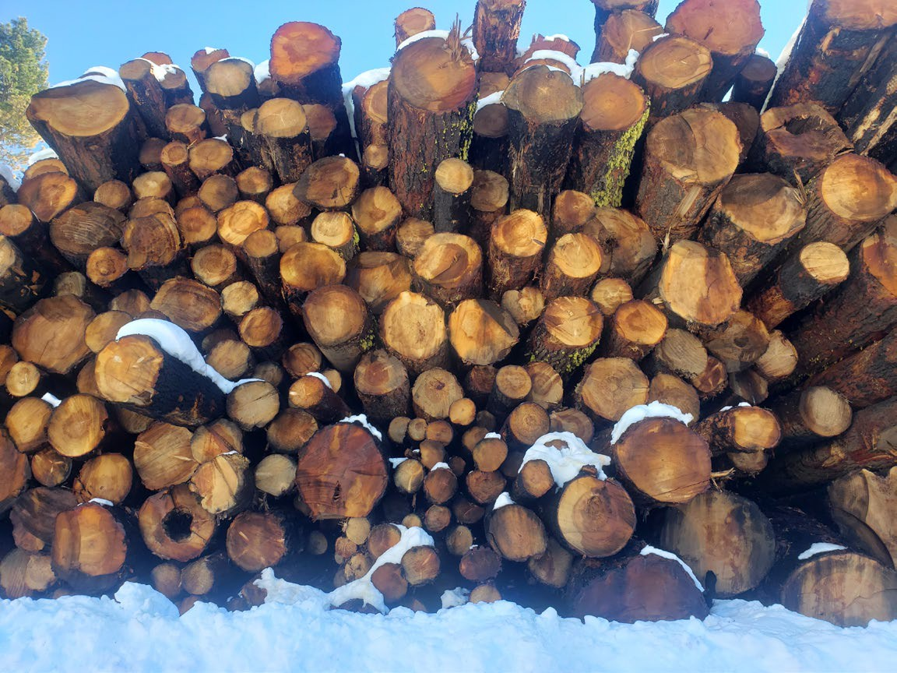
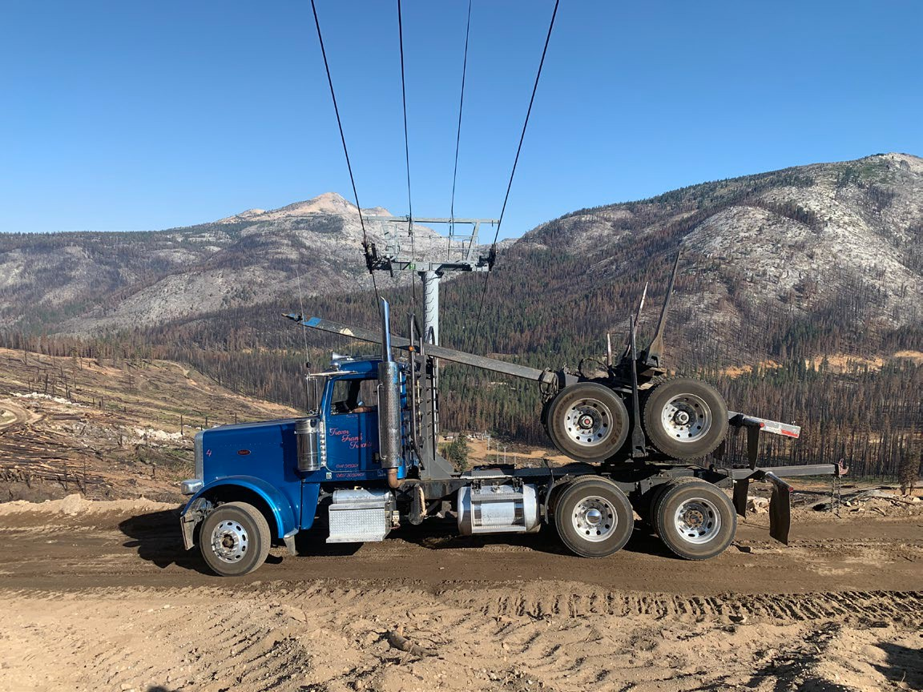
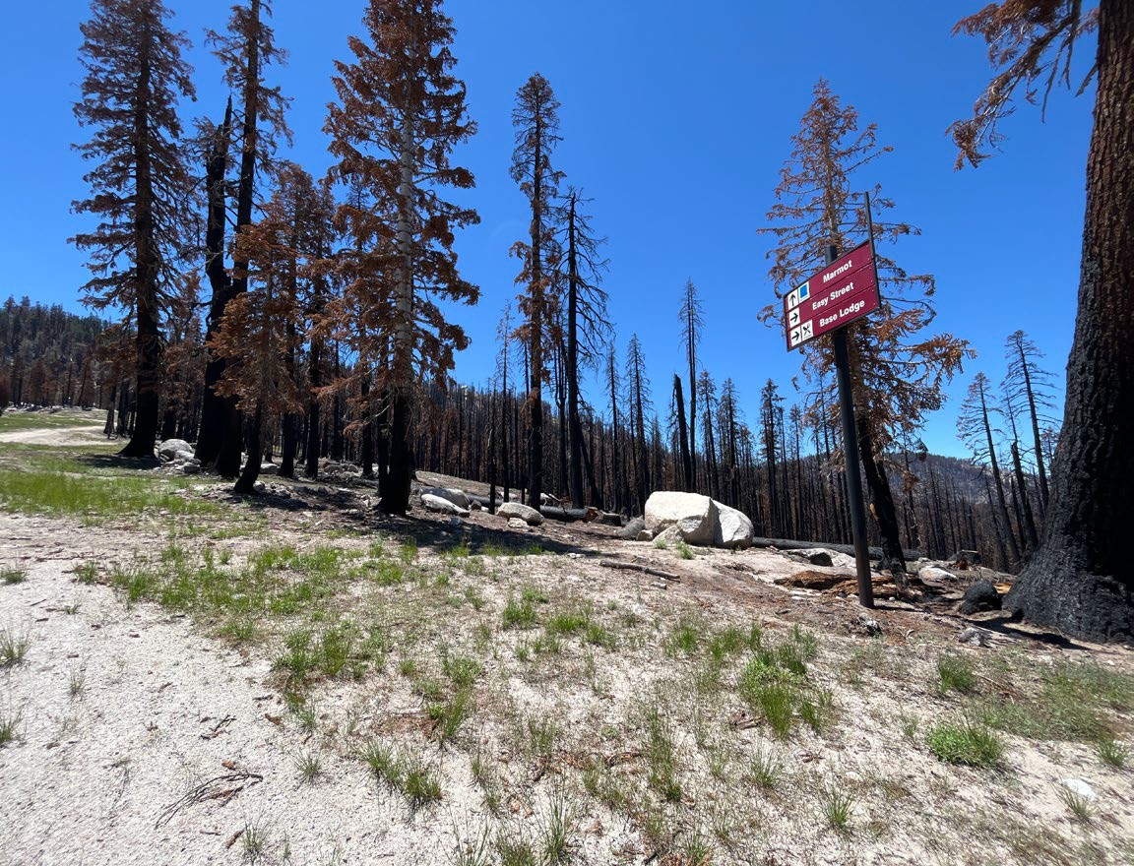

Slide 6
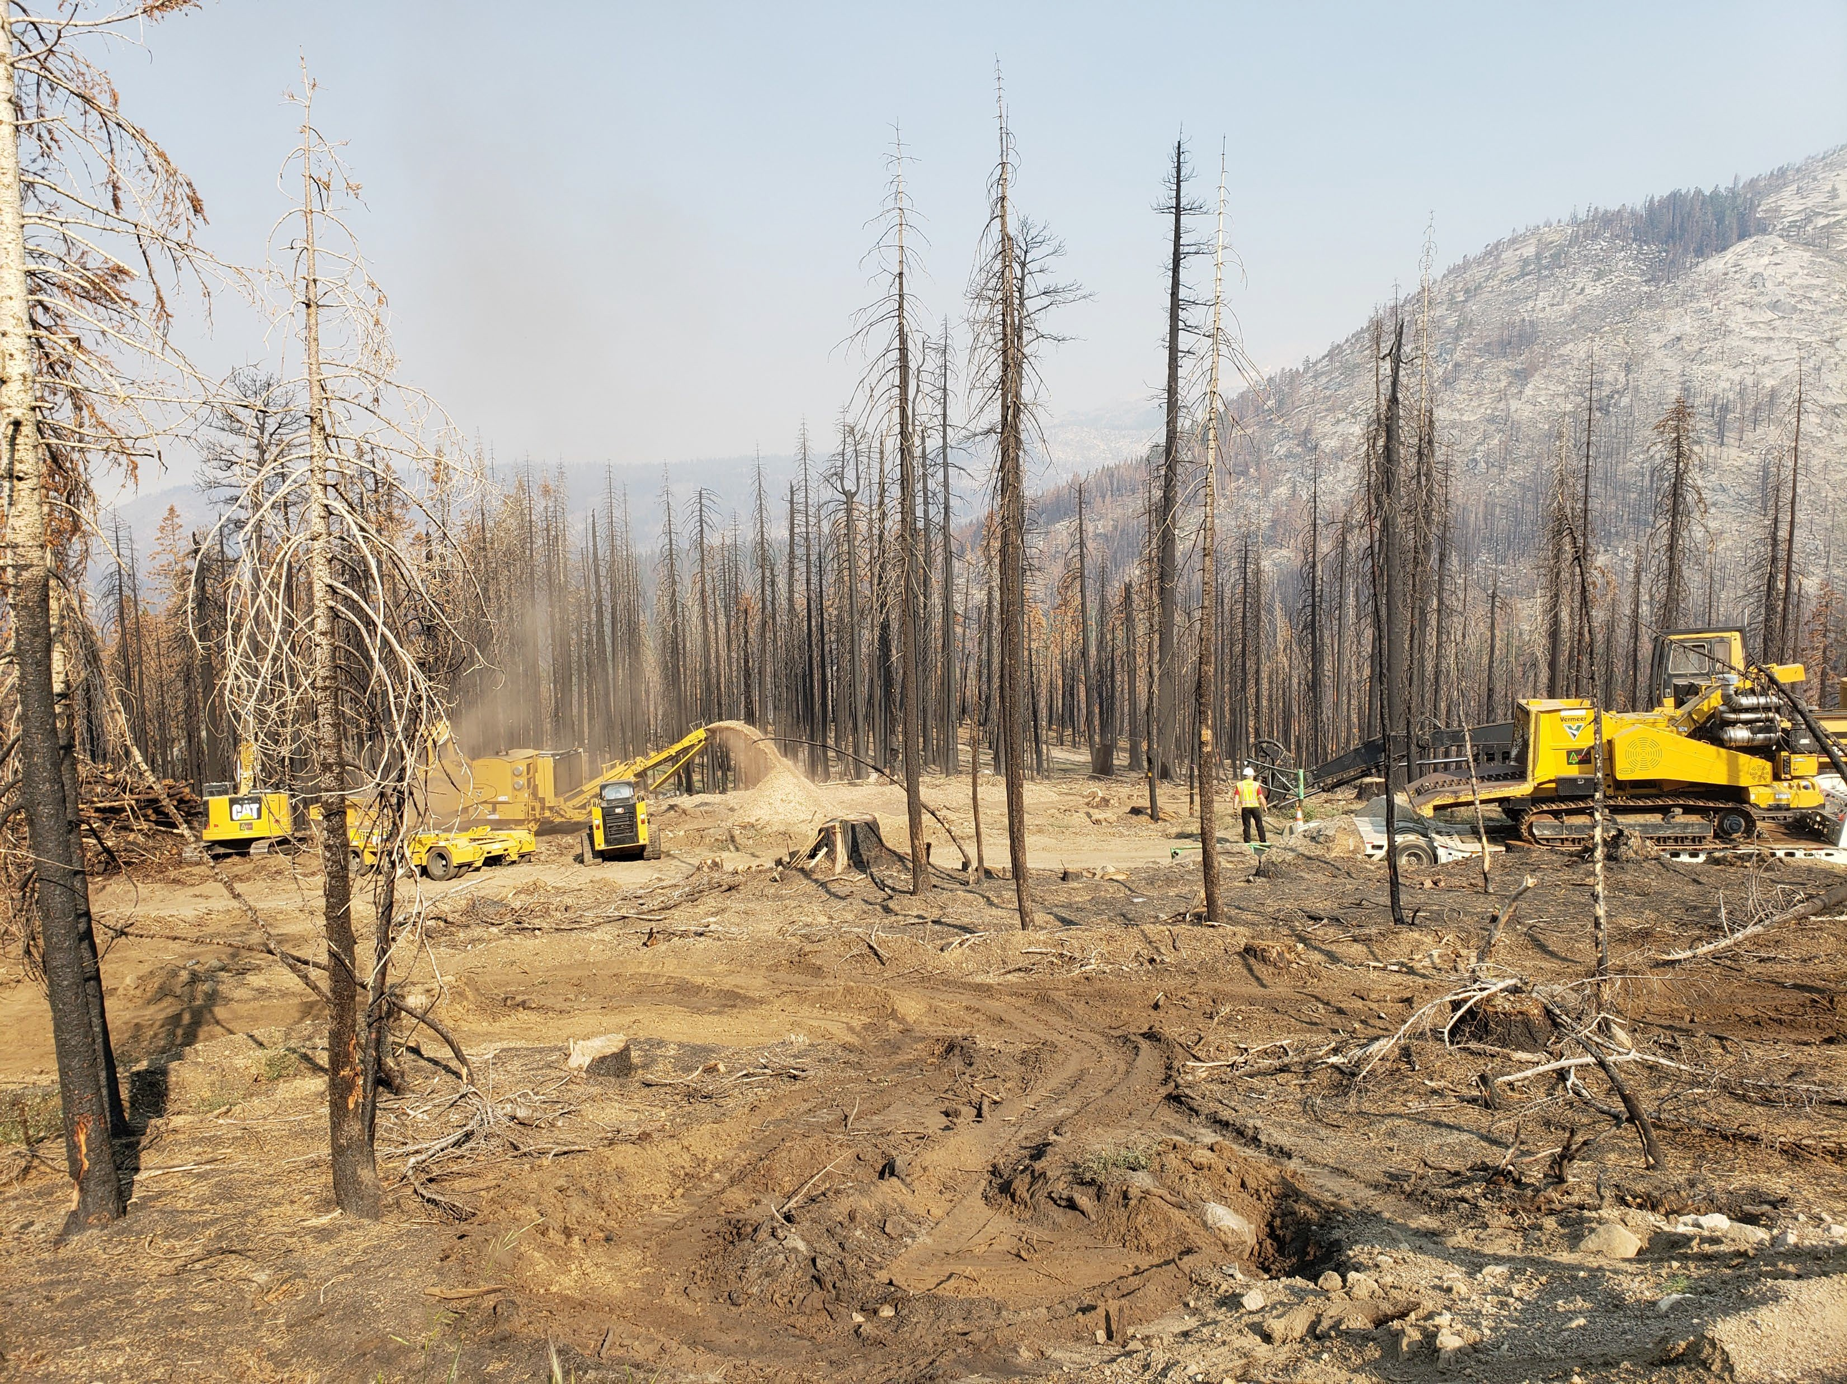

Slide 7
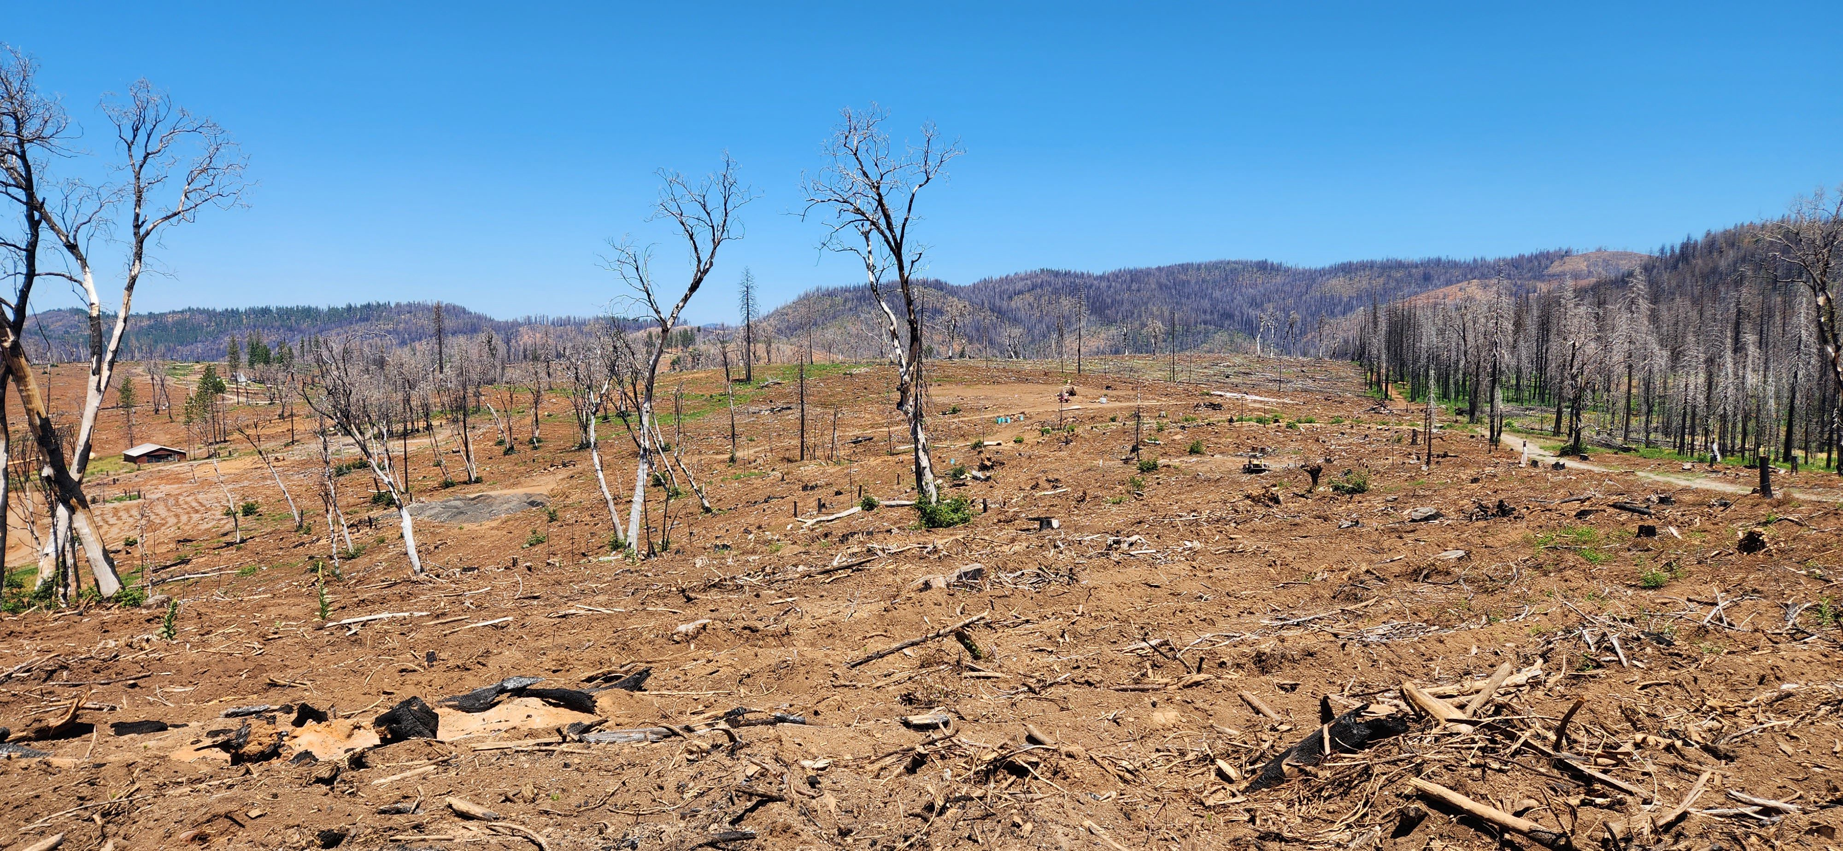

Slide 8
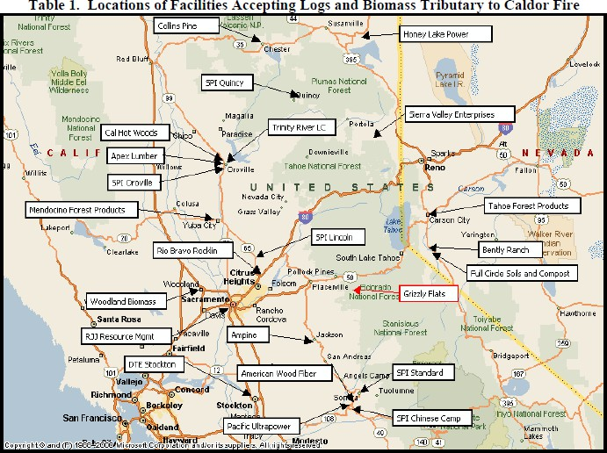
Logs scaled in to TFP from July 25 through October 30, 2022.
Gross scale - 14,442.656 mbf Total loads - 2,094
Load Average Gr. - 6,897 bf

Slide 9
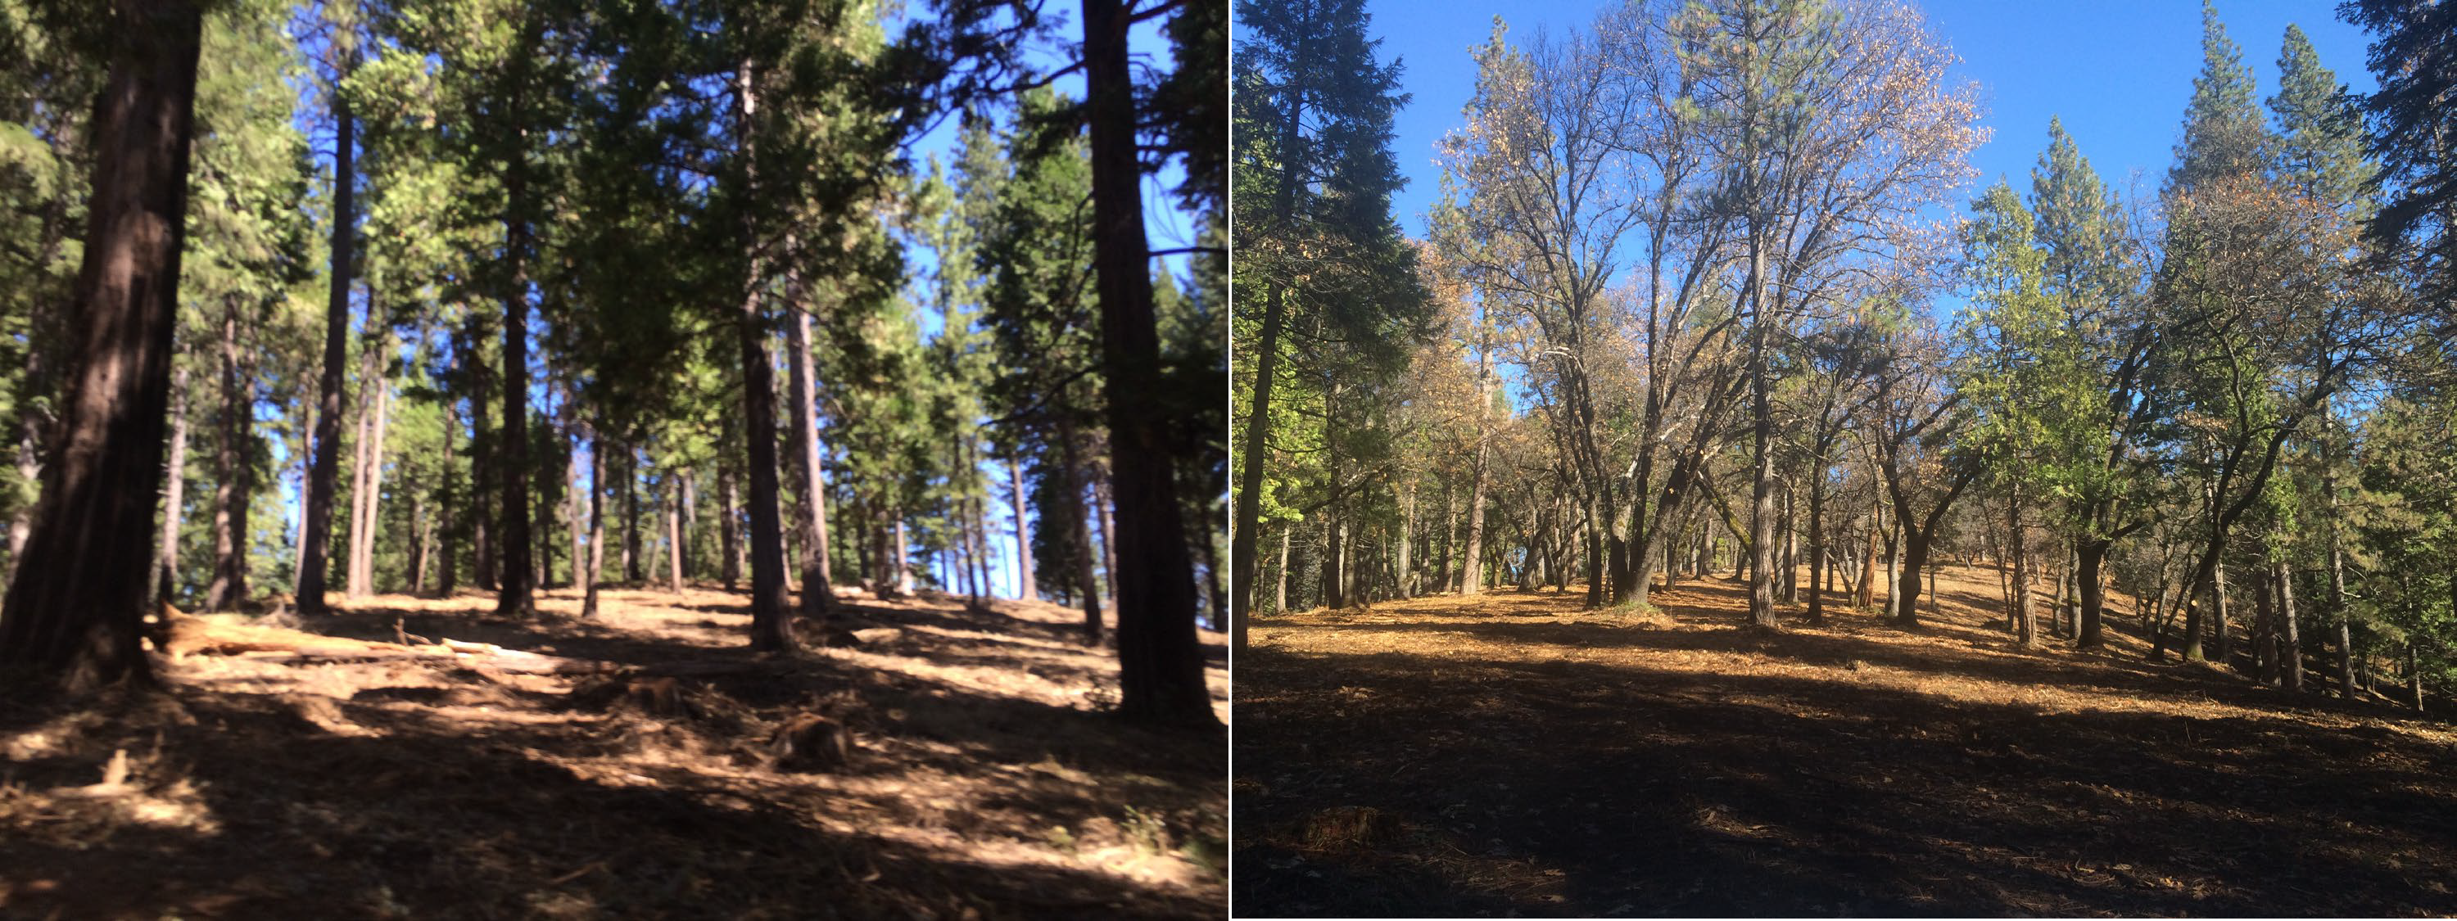
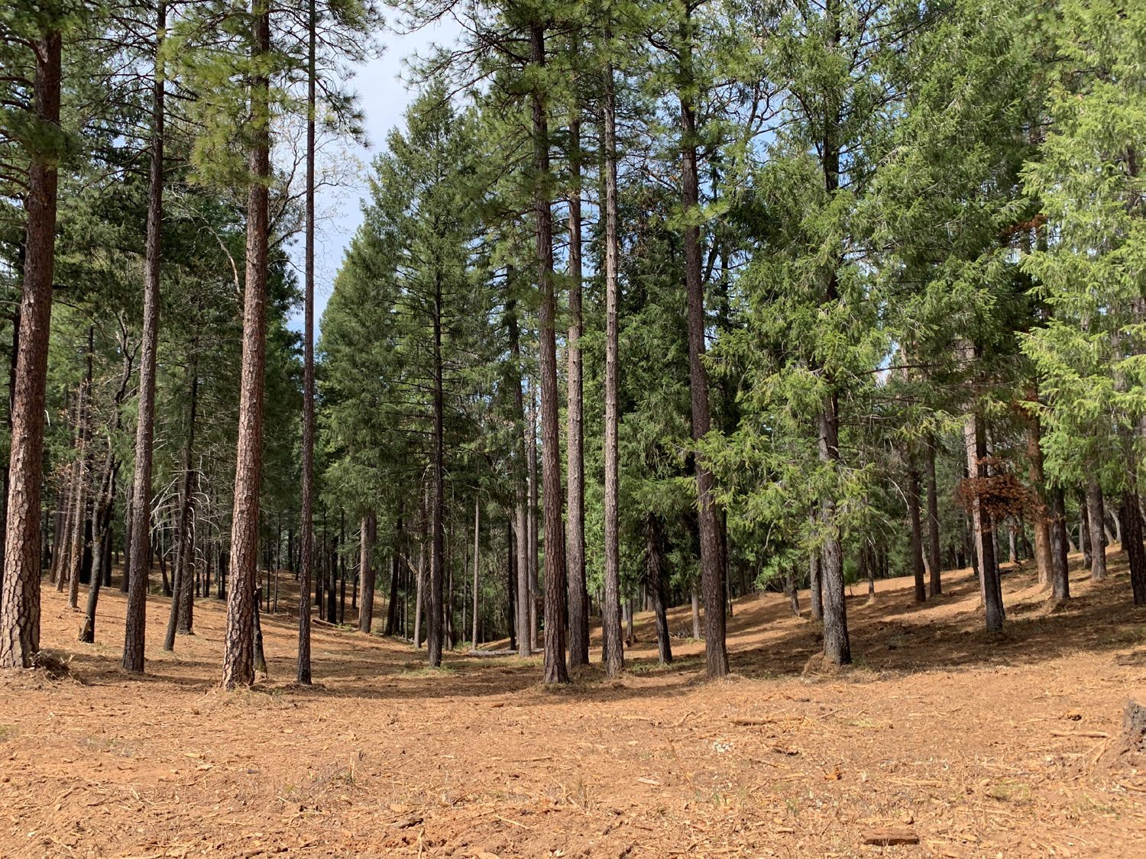

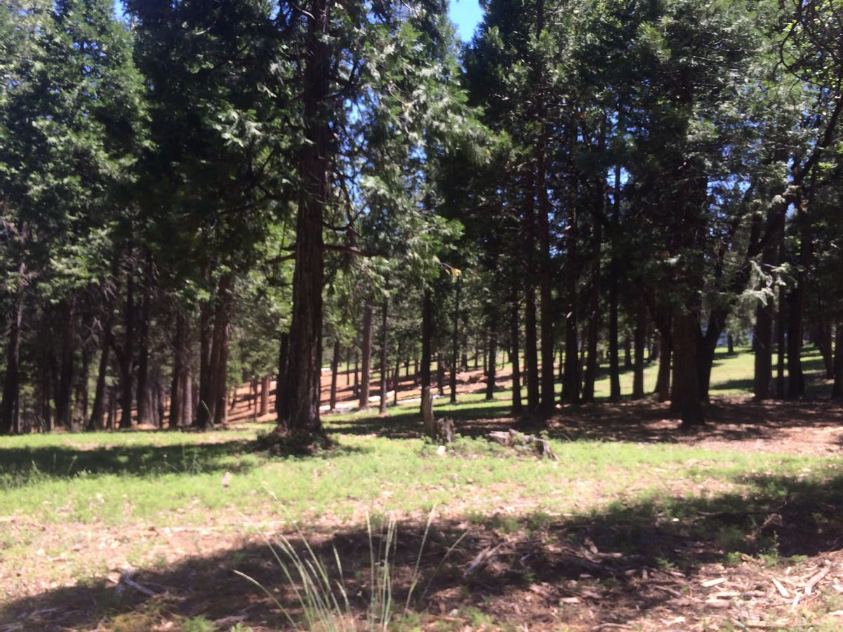

Slide 10
Mark Egbert District Manager
El Dorado & Georgetown Divide RCD’s
100 Forni Road, Suite A Placerville, CA 95667 Mark.Egbert@ca.usda.gov Office: 530-303-5328
Cell: 530-957-3472
www.eldoradorcd.org www.georgetowndividercd.org

Slide 11
“Biomass Collection Carried out by Local Government”

