Slide 1

“Bring the Biomass out of the Forest, and Outlook for Future Prospects”

Slide 2


Slide 3


Grant Funded Fuel Reduction Projects and Biomass Programs (2018-2024)
Green Waste Collection Events
Fuel Reduction Projects
Defensible Space Clearing Programs
Funding Source: CAL FIRE, Northern Sierra Air Quality Management District, California Fire Safe Council
Program Participants: 30,000
Acres Treated: 45,000
Biomass Tonnage Collected: 20,000+
Grant Dollars: $2.3 Million
Forest Health Projects
Funding Source: FEMA/Cal OES & Private Landowner Participants
Acres Treated: 2,500
Grant Dollars: $12 Million
Funding Source: CAL FIRE Forest Health, Sierra Nevada Conservancy, National Fish & Wildlife Foundation
Acres Treated: 5,700
Grant Dollars: $13 Million
Funding Source: CAL FIRE Wildfire Prevention Grants, FEMA/CAL OES Hazard Mitigation Assistance, PG&E Foundation
Acres Treated: 7,800
Grant Dollars: $30 Million

Slide 4














PARTNERSHIPS

Slide 5
Workforce Development
Full Time Fuels Crew
Recruitment
Training
Paid Internships
IQCS/USFS Partnership
Workforce Development
Community College Curriculum
Forestry Field
Fuels Field
Heavy Equipment Operators/Class A Licensing

Slide 6

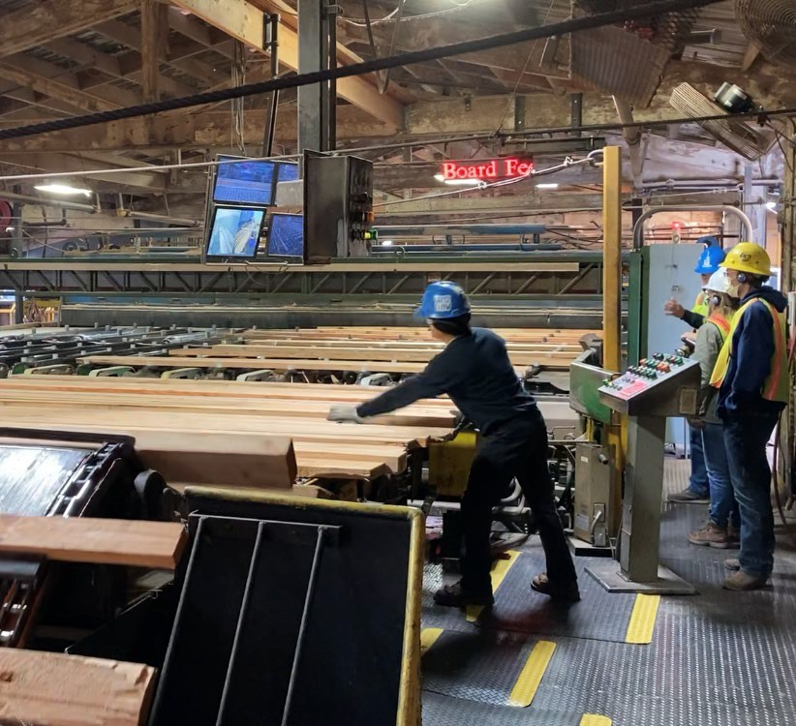
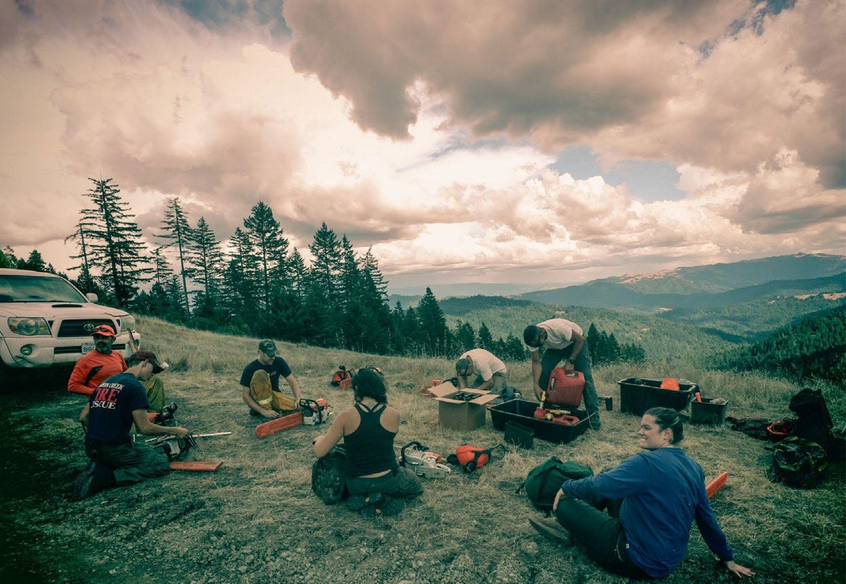
John McCarthy Forester, CAL FIRE
JUNE 26, 2024| ROSEVILLE

Slide 7
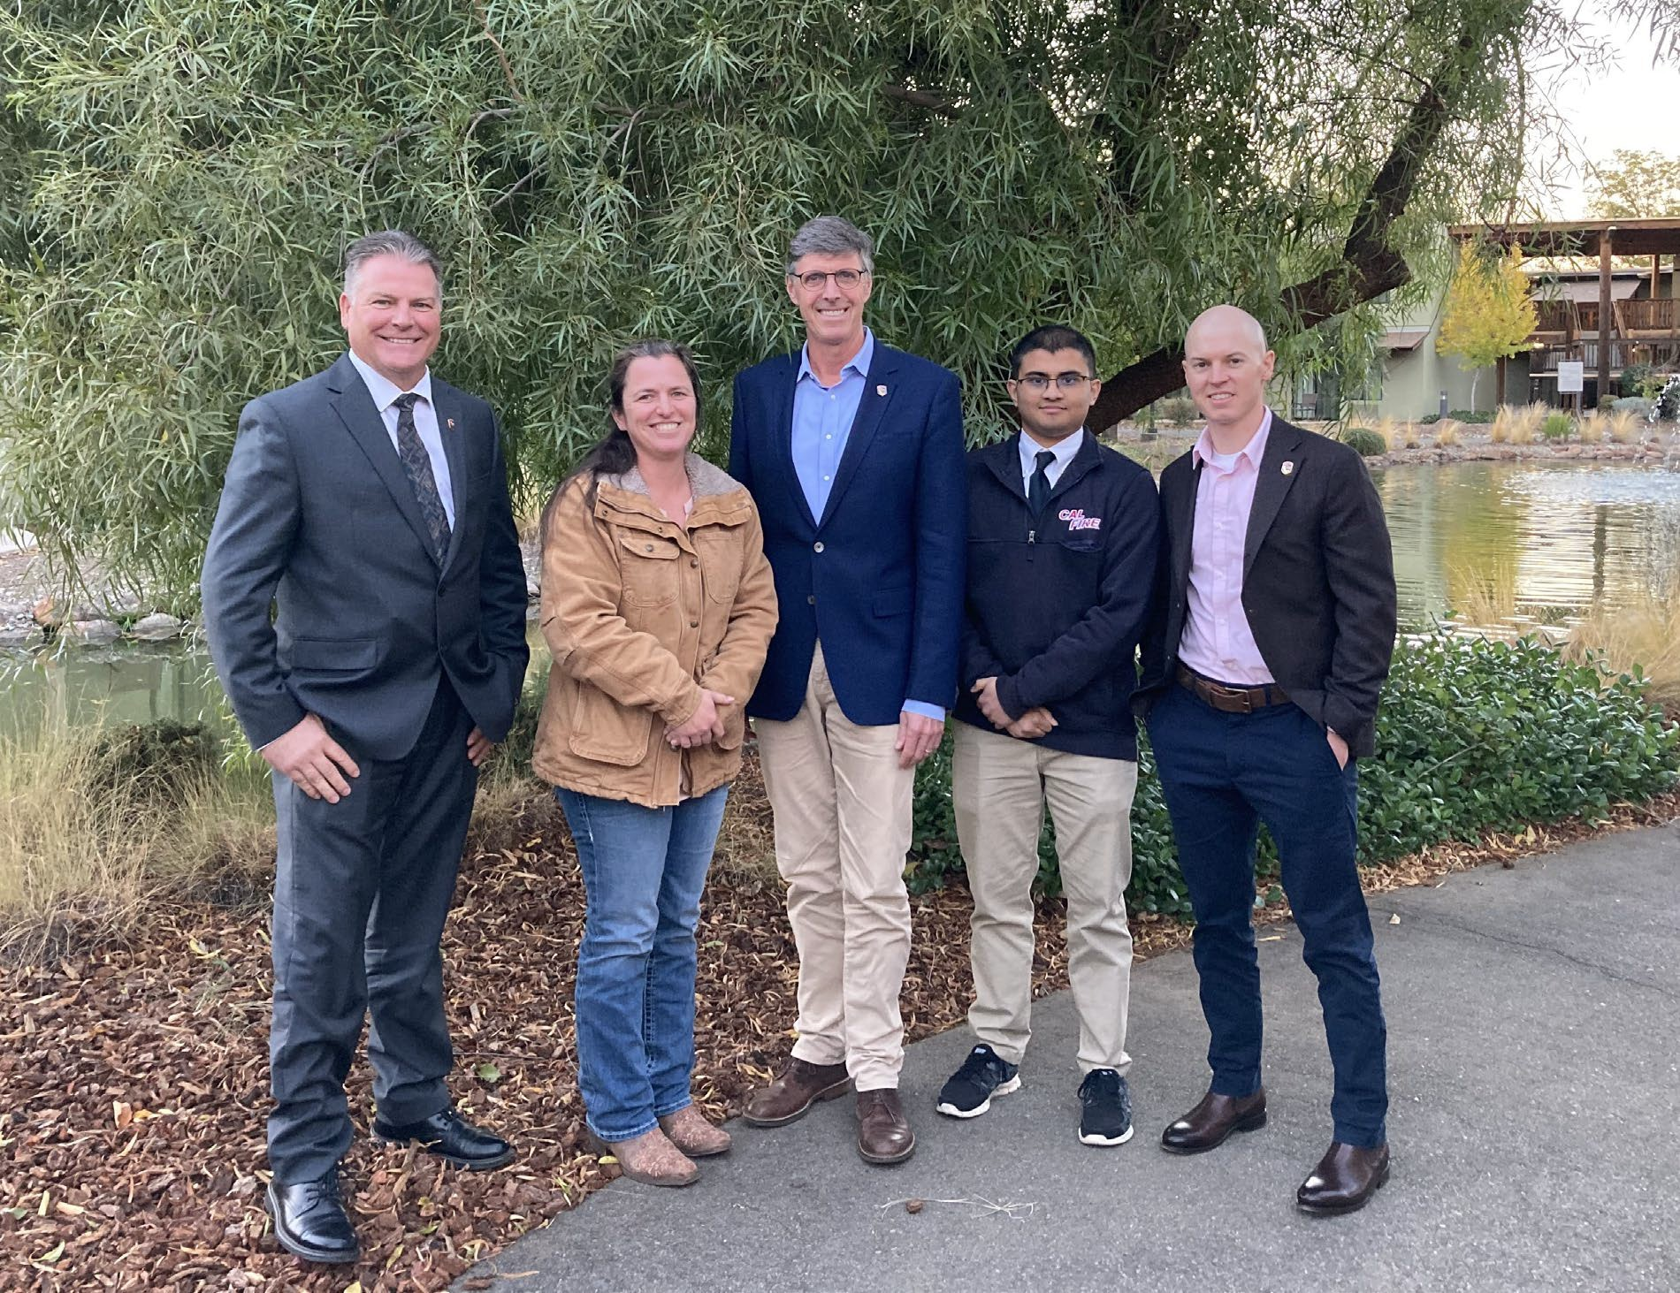
Wood Products & Bioenergy Team
Climate and Energy Program
Department of Forestry and Fire Protection (CAL FIRE)

Slide 8
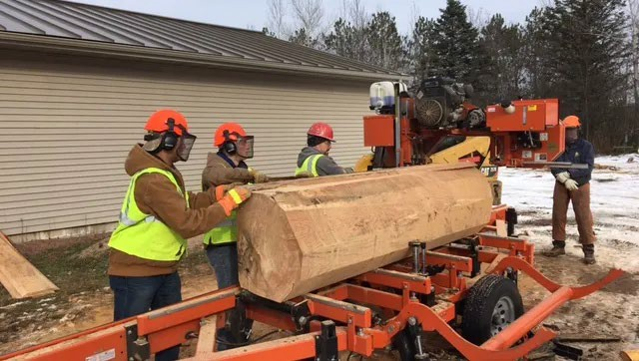
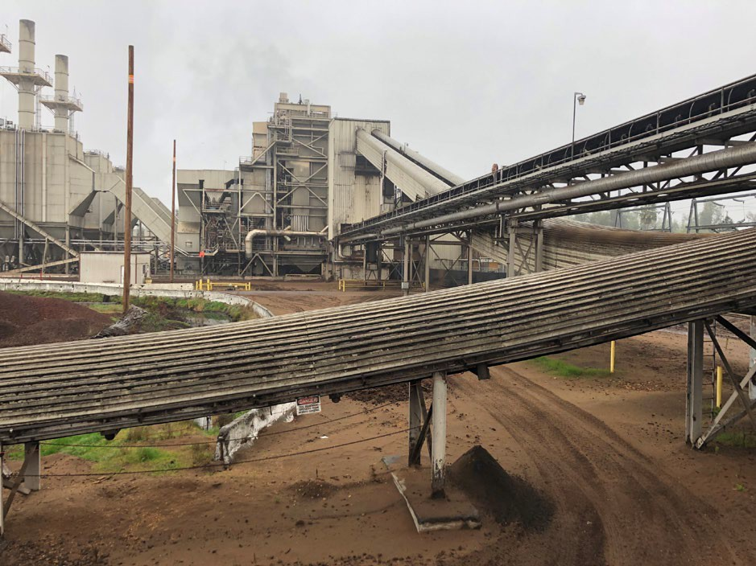
Awards to date:
$122 million to 110 Grantees
Workforce Development
$48 million awarded
  Community colleges
  Prescribed fire training
  Mentor programs
  Training for formerly incarcerated
Business Development
$74 million awarded
  Wood processing facilities
  Bioenergy
  In-woods operations
  Research and Development
    Biomass fuels
    Biochar marketing
    Feasibility studies
  Tree Nurseries
  Cone Collection

Slide 9
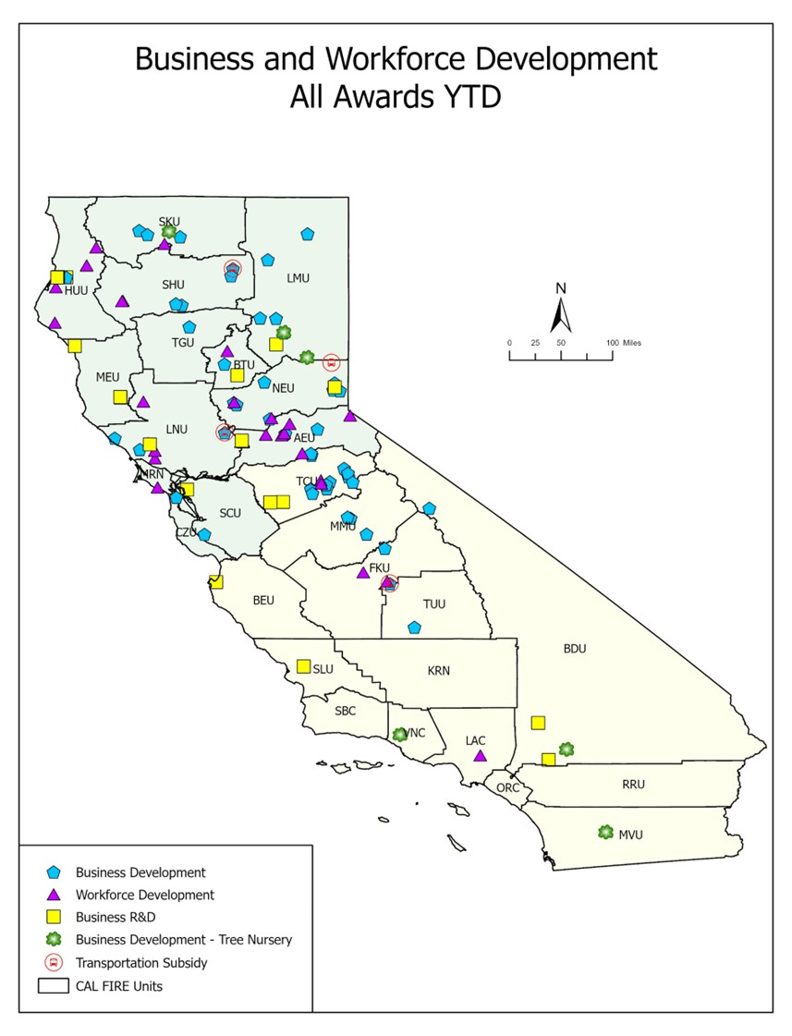
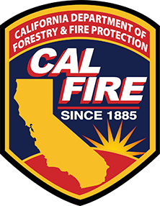
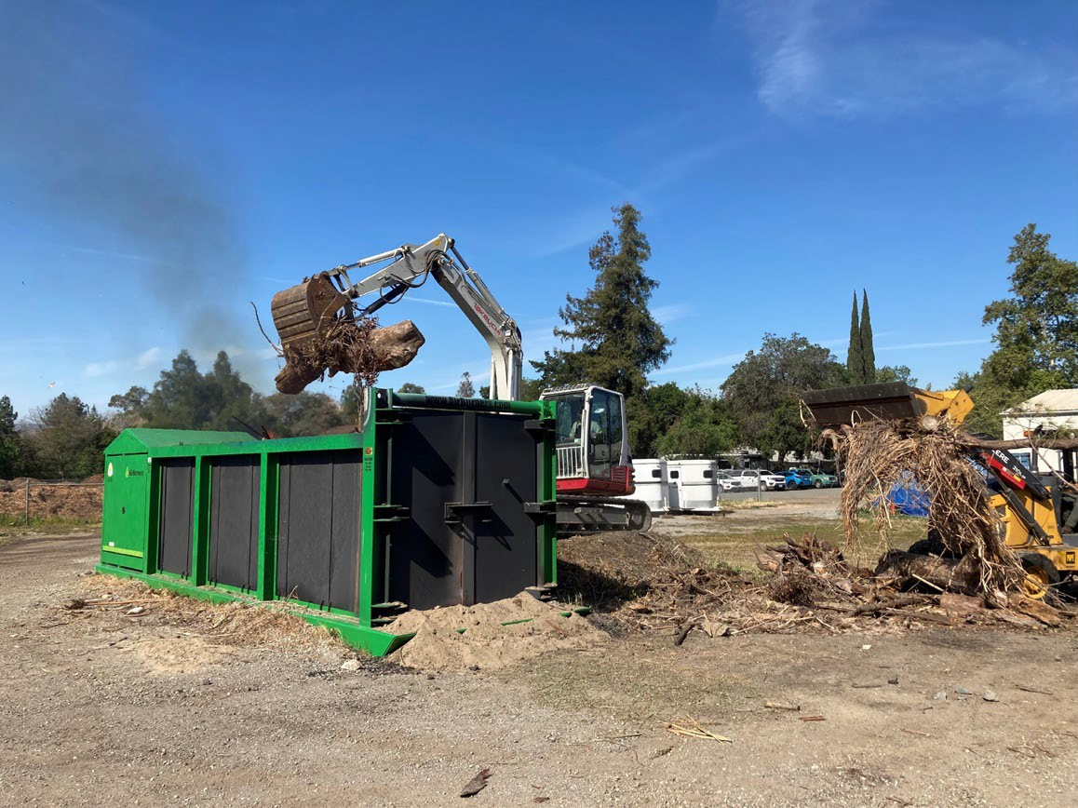
Business and Workforce Grants Program to Date

