Slide 1
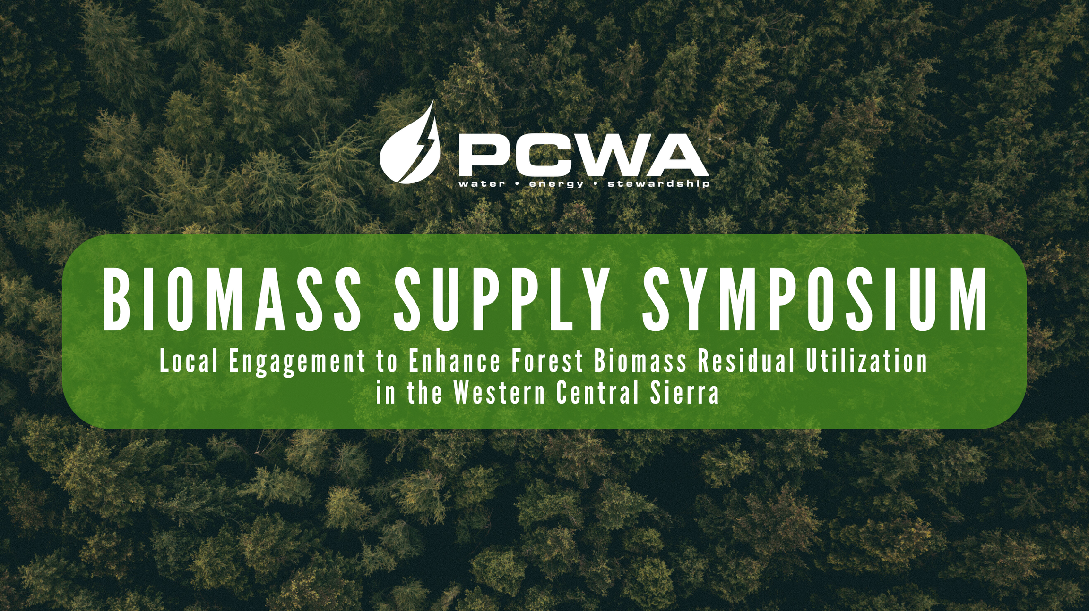
“Commercial Biomass Utilization Today”

Slide 2
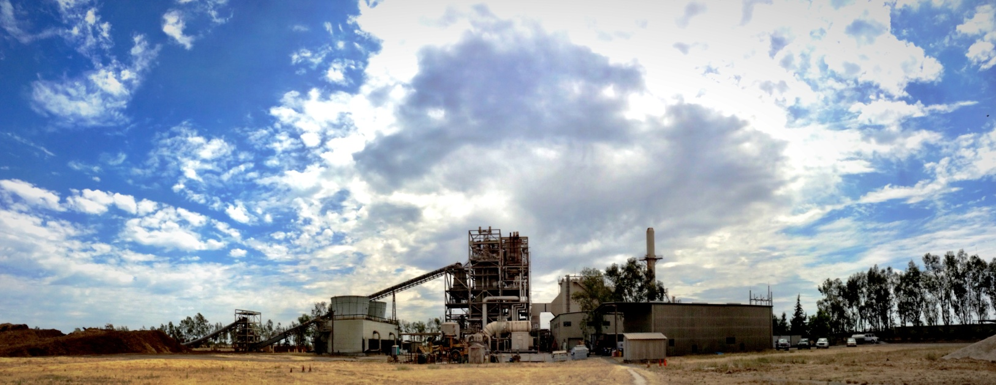

Rio Bravo Rocklin
Total | Weekly Avg.
$39,472.00 | $4,934.00
June 26, 2024
Notes:
Welcome. Introductions.

Slide 3

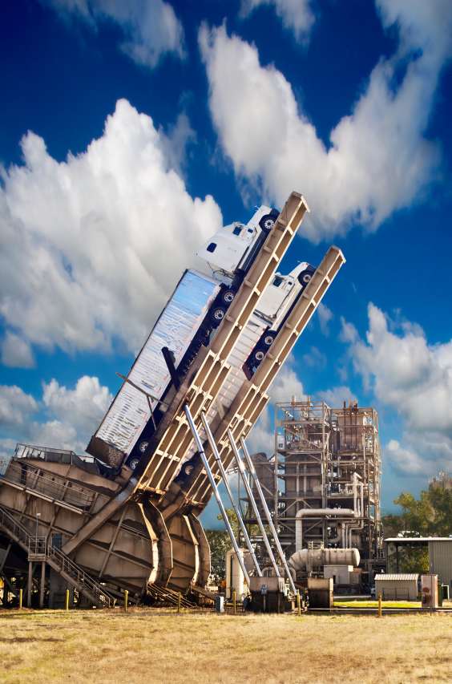
  Location: Lincoln, CA (near Sacramento)
  Technology:CE/Lurgi Circulating Fluidized Bed Boiler, MHI turbine, Brush Electric Machines generator
  Fuel(s): Biomass: 20% urban/agricultural wood, 80% agricultural/forestry wood (2017-2027 HHZ)
  In-Service Date: May 1989
  Capacity: 24.4 MW
  Output: 5-year Power Purchase Agreement with SCE, 5-year extension expires 2027
  Ownership: IHI Power Generation Corp. 50% North American Power Group 50%
  Operator: IHI Power Services Corp.
Rio Bravo Rocklin
Contact Information:
Jared Pate, Plant Manager
Alana Hodges, Admin.
(916) 645-3383
Address:
3100 Thunder Valley Court
Lincoln, CA 95648
Notes:
Rio Bravo Rocklin. Our current PPA runs to 2027.

Slide 4

Notes:
How we compare to the other renewables. Compare to solar and wind. Compare to other biomass plants.

Slide 5
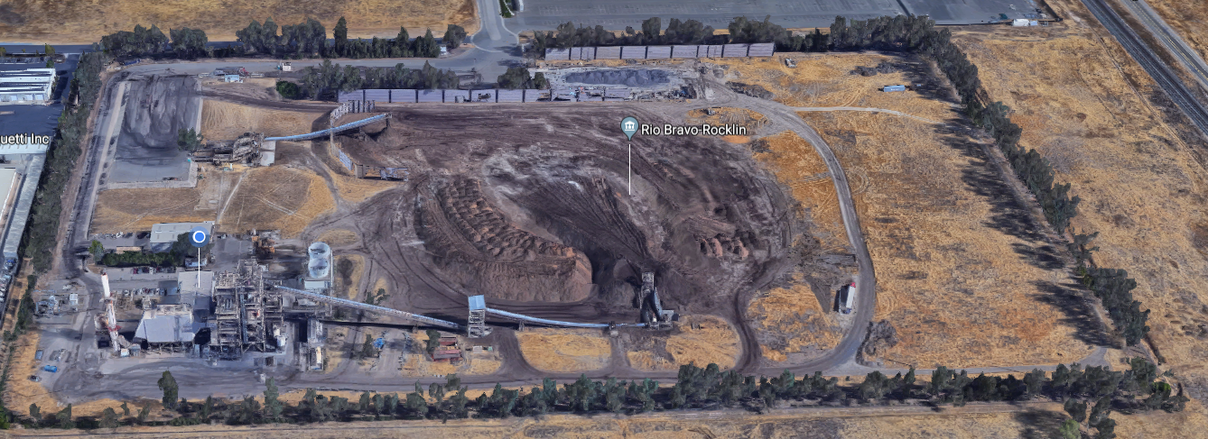
Rio Bravo Rocklin
Fuel Receiving
Fuel Storage
Fuel Reclaim
Boiler
Notes:
Aerial view of the plant.

Slide 6




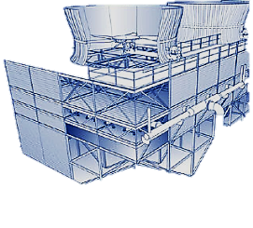


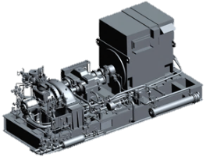
Biomass Power Plant System

Slide 7
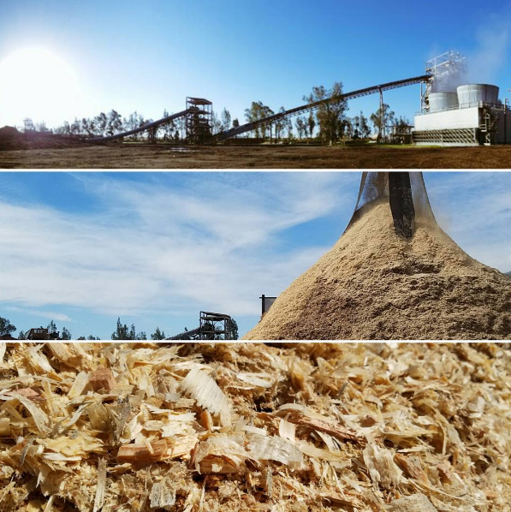
Biomass Power – A Green Energy Source
Biomass power plants combust low-value wood material to produce electricity
Biomass Fuels are sustainable
  Forest waste such as saw mill residue, small trees and undergrowth cleared from forests for fire suppression and growth enhancement
  Agricultural wood such as orchard pruning / removals, rice hulls, fruit pits, etc.
  Urban “secondary material” wood such as construction wood scraps, broken pallets, clean used wood from factories and tree trimmings
Notes:
What is biomass? Biomass to us is low-value wood material that has no other real use.

Slide 8
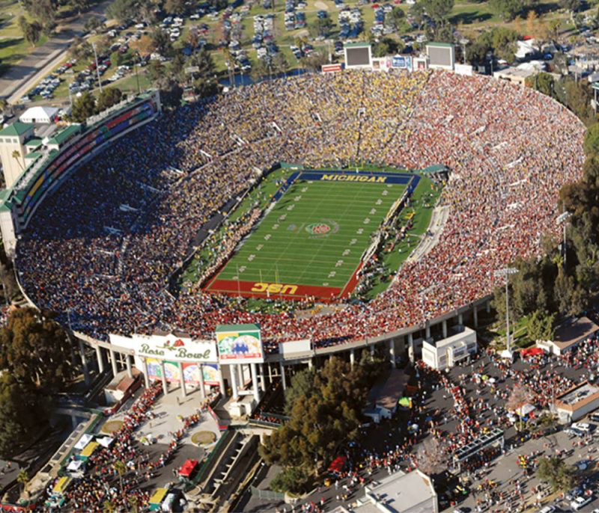
Rio Bravo Rocklin
220,000 tons annually
Notes:
One plant utilizes enough material in a year to fill the Rose Bowl. Overall, CA biomass utilizes 25 Rose Bowls. CA has an excess organics problem and biomass power is part of the solution.

Slide 9
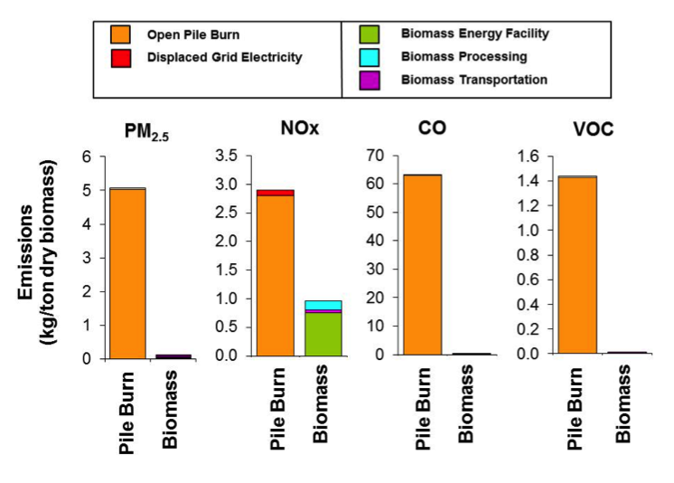
EMISSIONS REDUCED ANNUALLY FROM BIOMASS FACILITIES
Springsteen B, Christofk T, York R, Mason T, Baker D, et al. 2015. Forest biomass diversion in the Sierra Nevada: Energy, economics and emissions. California Agriculture Journal July-September 142-149.
Notes:
The Placer County Air Pollution Control District participated in a study that compared the emissions from open pile burning and biomass energy
Open pile burning of biomass waste adversely impacts regional air quality and human health through release of various air pollutants – including:
fine particulate matter (PM2.5)
carbon monoxide (CO)
nitrogen oxides (NOx)
volatile organic compounds (VOCs)
air toxics
greenhouse gases of carbon dioxide (CO2)
short-lived climate pollutants of methane and black carbon.
As an alternative to open pile burning, use in existing biomass power plants results in reductions of greater than 99% for PM2.5 and black carbon, 95-99% for CO and VOCs (including methane), 40-70% for NOx, and 30% for CO2(e).
These benefits have been conclusively demonstrated in numerous peer-reviewed comprehensive lifecycle assessments (Springsteen et al. 2015, Springsteen et al. 2011, Lee et al. 2010, Jones et al. 2010, Moyer and Pont 1997).
Reductions result from a combination of:
utilization of wastes in power plants with efficient emissions control technology;
negligible emissions from well controlled and efficient processing and transport equipment and engines; and
production of renewable energy from wastes and that replace nonrenewable fossil fuel-generated energy.

Slide 10



3100 Thunder Valley Ct.
Lincoln, CA 95648
Chris Quijano
cquijano@rbrocklin.com
Notes:
Thank you. Proceed with tour, come back for questions.

Slide 11
HL Power / Honey Lake Power
Placer County Water Agency
Biomass Supply Symposium
June 26,2024

Slide 12
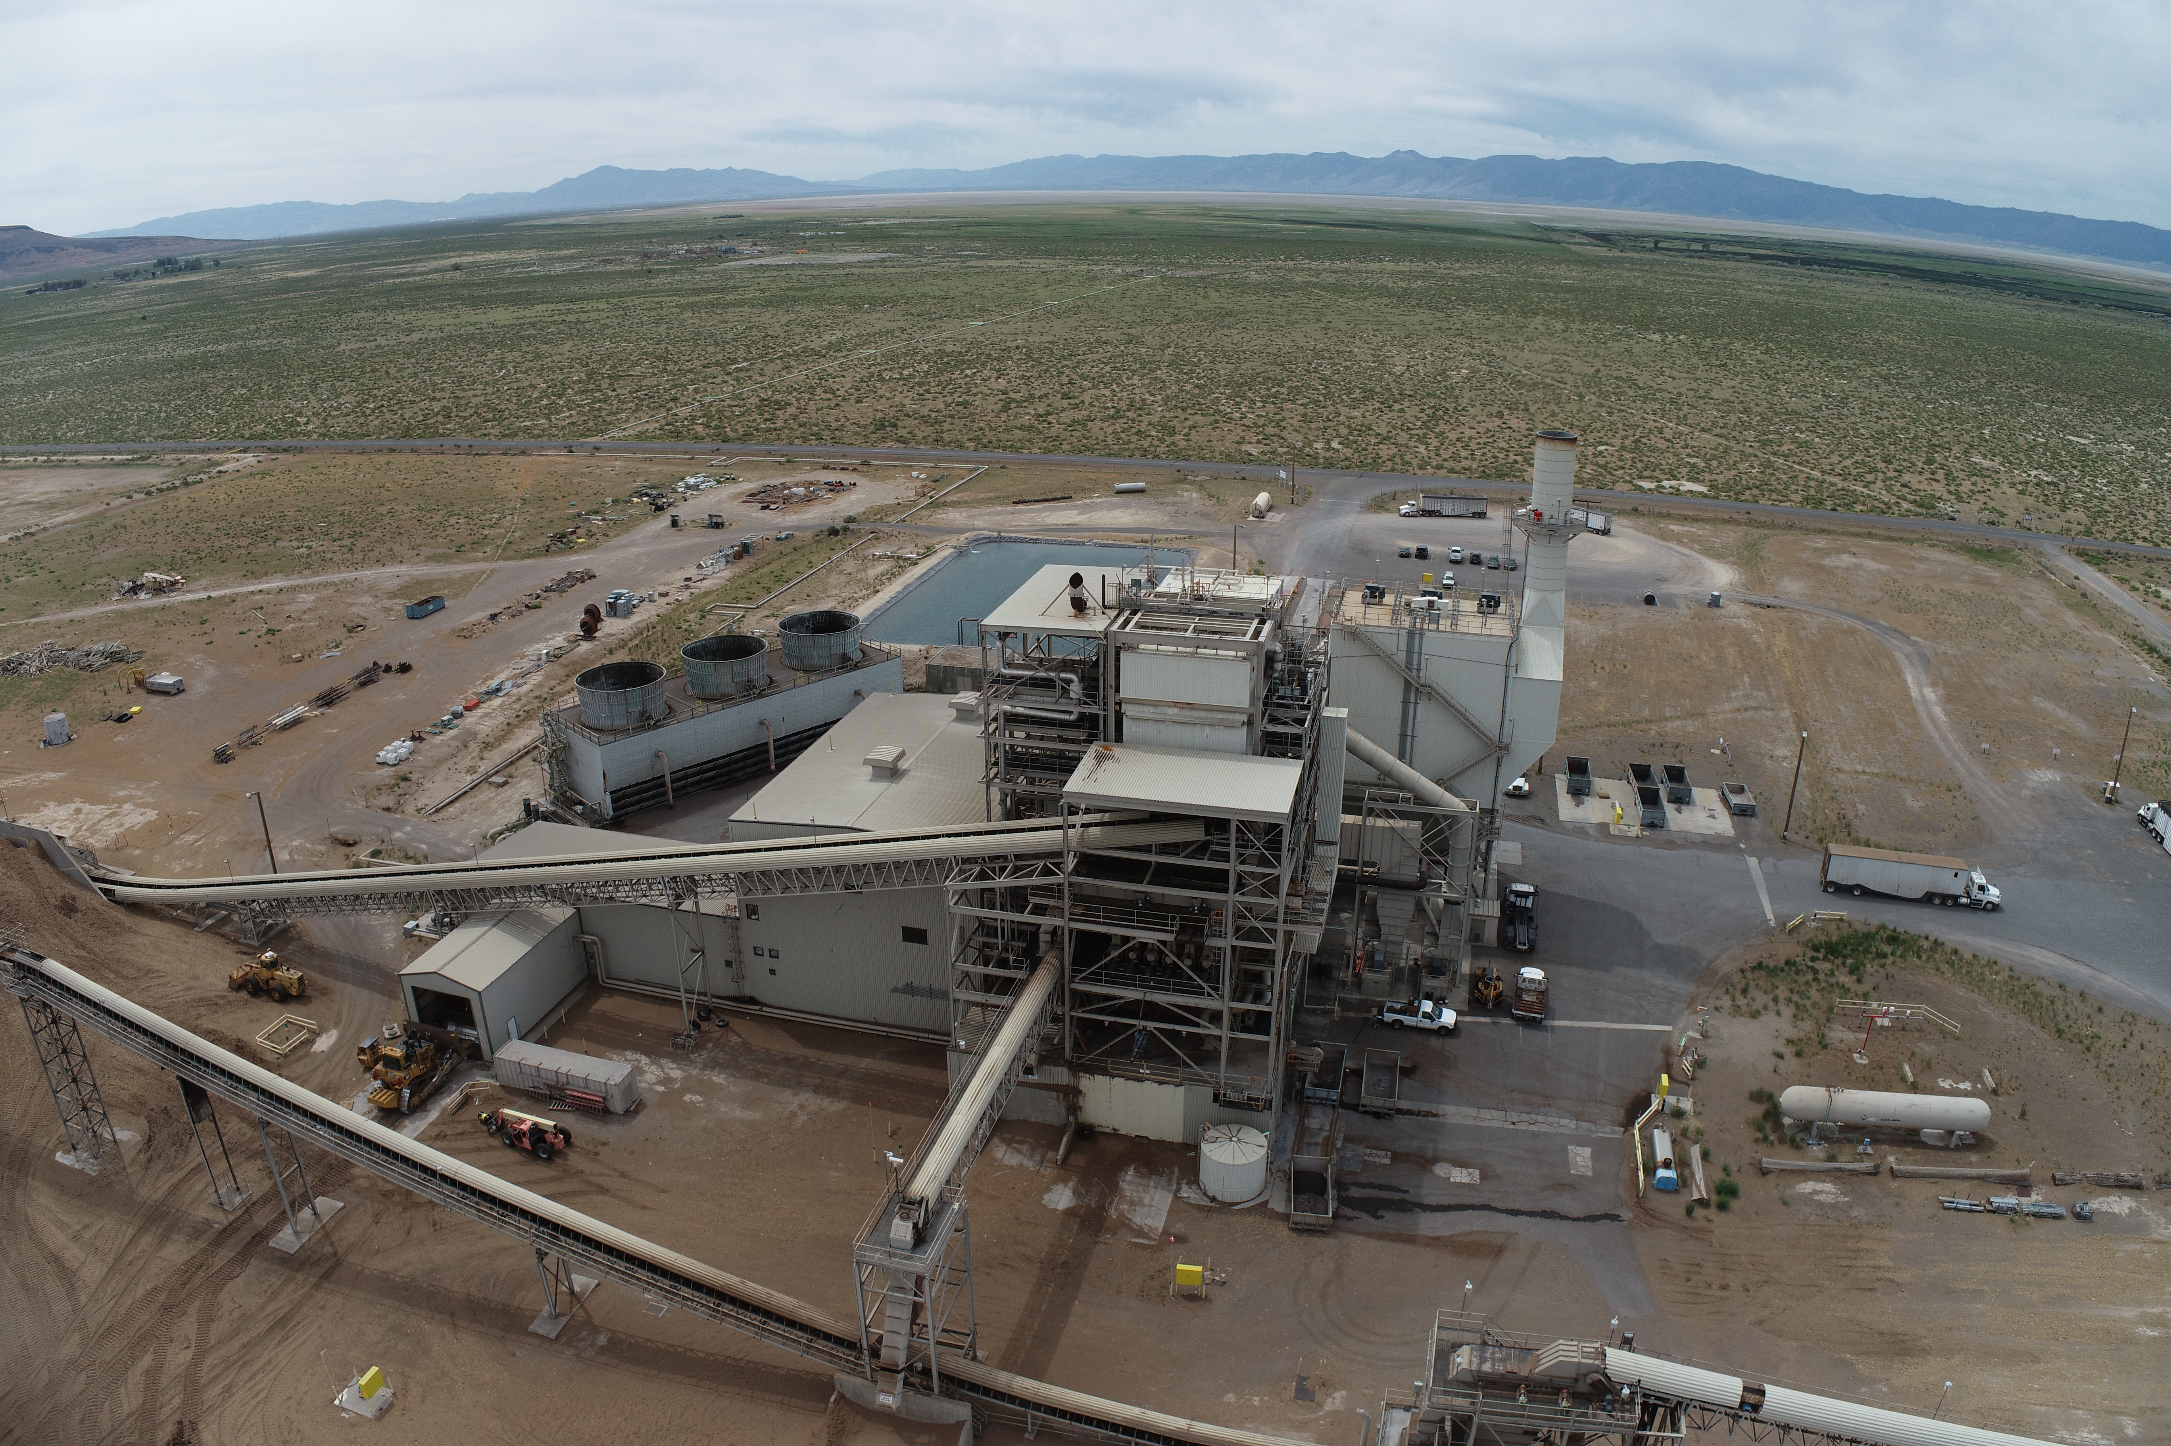
HL Power / Honey Lake Power

Slide 13
Plant Overview - Personnel
  28 Greenleaf Power / HL Power Personnel
  1 Plant Manager
  1 Operations Supervisor
  1 Maintenance Supervisor
  1 Fuel Manager
  1 Operations and Maintenance Coordinator (OMC)
  4 operations teams on 12 hour rotating shifts—1 Supervisor, 1 Control Room Operator, 1 Auxiliary Operator, 1 Dozer Operator
  5 Team Members - 2 Millwrights, 1 IC/E, 1 Diesel Mechanic, 1 Ash Truck Driver / Utility Maintenance
  1 Scalehouse Weighmaster
  1 Administrative Assistant

Slide 14
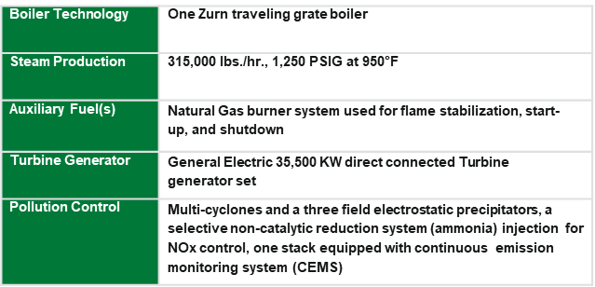
Plant Overview – Equipment (Motorhead Slide)

Slide 15
Plant Overview - Production
In Service Since 1989
Production Capacity – 35.5 MW Gross / 30 MW Net
Parasitic Load – 2.5 MW
Geothermal Supplement
  5,000 Foot Deep Geothermal Well / BLM Lease
  Reinjection Well – Zero Drawdown to Resource, 35 Years
  Pre-Heats Steam-Water to 273 Degrees

Slide 16
Fuel Procurement
  BioRAM Power Purchase Agreement
    26 MW Contract Production
    80% Sustainable Forest Management Sourced Fuel
    60% High Hazard Zone Sourced Fuel
  Plant Requirements
    Approximately 180,000 BDT / Year
    580 BDT / Day
    13,850 Chip Trucks / Year
    55 Chip Trucks / Business Day
    90 to 120 Days of Inventory at Year End (Winter Period)

Slide 17
Fuel Procurement – Landowners / Suppliers
  Industrial Timberland Owners
    Collins Pine Company / TWC
    W.M. Beaty & Associates Managed Lands
    Sierra Pacific Industries
  Federally Managed Timberlands
    US Forest Service
    Bureau of Land Management
    National Park Service
  Various Non-Industrial Timberland Owners
  20-25 Timber Operators on a Yearly Basis
  30-40 Chip Trucks on a Yearly Basis

Slide 18
Fuel Procurement – Facilitators
  Cal Fire
  US Forest Service
  Natural Resource Conservation Service
  Fire Safe Councils
    Lassen Fire Safe Council
    Plumas County Fire Safe Council
  Resource Conservation Districts
    Honey Lake Valley Resource Conservation District
    Pit Resource Conservation District
    Feather River Resource Conservation District

Slide 19
Fuel Procurement – Treated Acres
Biomass Fuel Sources
  Processed Urban / Greenwaste – 8%
  Agricultural Residuals – 8%
  Sawmill Residuals – 10%
  Forest Biomass – 74% = 133,000 BDT
Approximate Treated Acres Facilitated
  Hazardous Fuel Reduction Projects
    80% of Forest Biomass = 106,000 BDT @ 10 BDT / Acre
      10,600 Acres Treated
  Timber Harvest Operations – Tops and Some Biomass Removal
    20% of Forest Biomass = 26,600 BDT @ 5 BDT / Acre
      5,320 Acres Treated
  Total Yearly Acres Treated = Approximately 16,000 Acres

Slide 20
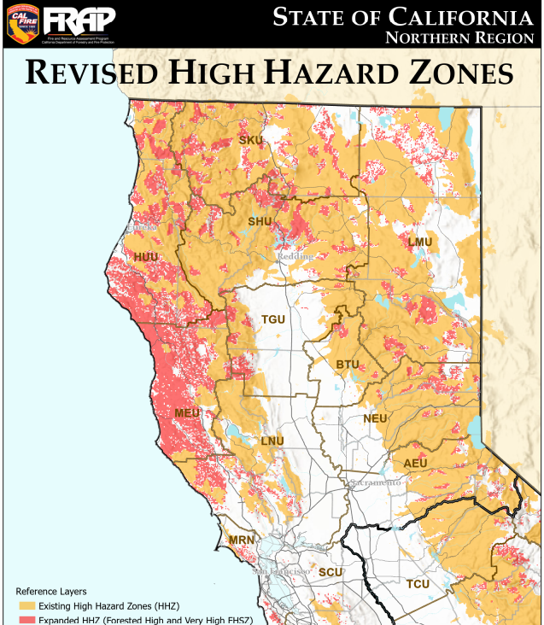
Fuel Procurement – High Hazard Zones

Slide 21
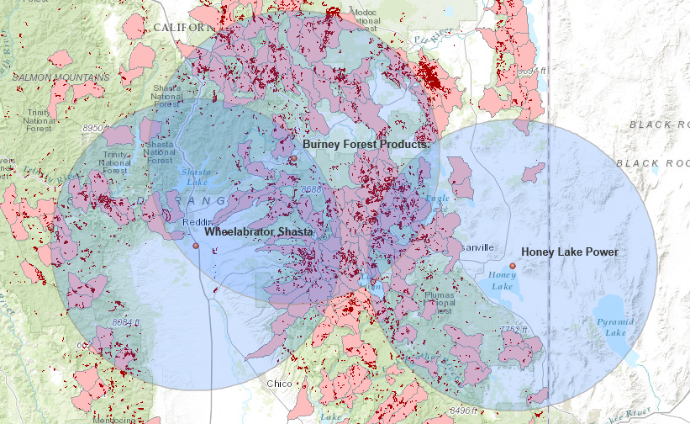
Fuel Procurement – 50 Mile Radius
SRM

Slide 22
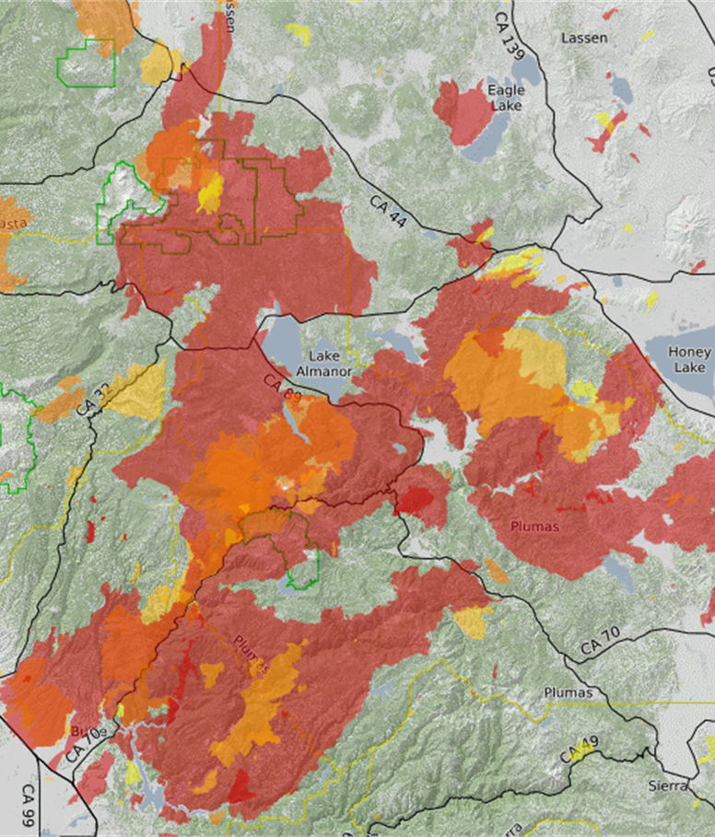
Fuel Procurement – Hog, Sheep and Dixie Fires

Slide 23
Fuel Procurement – Opportunities
  Grants for Landowner Assistance
  Grants for Transportation Assistance
  Grants for Facility Assistance
  Landscape Scale Projects
  Cull Logs

Slide 24

Family Procurement – Opportunities

Slide 25


Jim Turner
Director of Operations
Phone: (530) 355-9377
TahoeForestProducts.com
jturner@TahoeForestProducts.com
3736 Vista Grande Blvd., Carson City, NV 89705

Slide 26
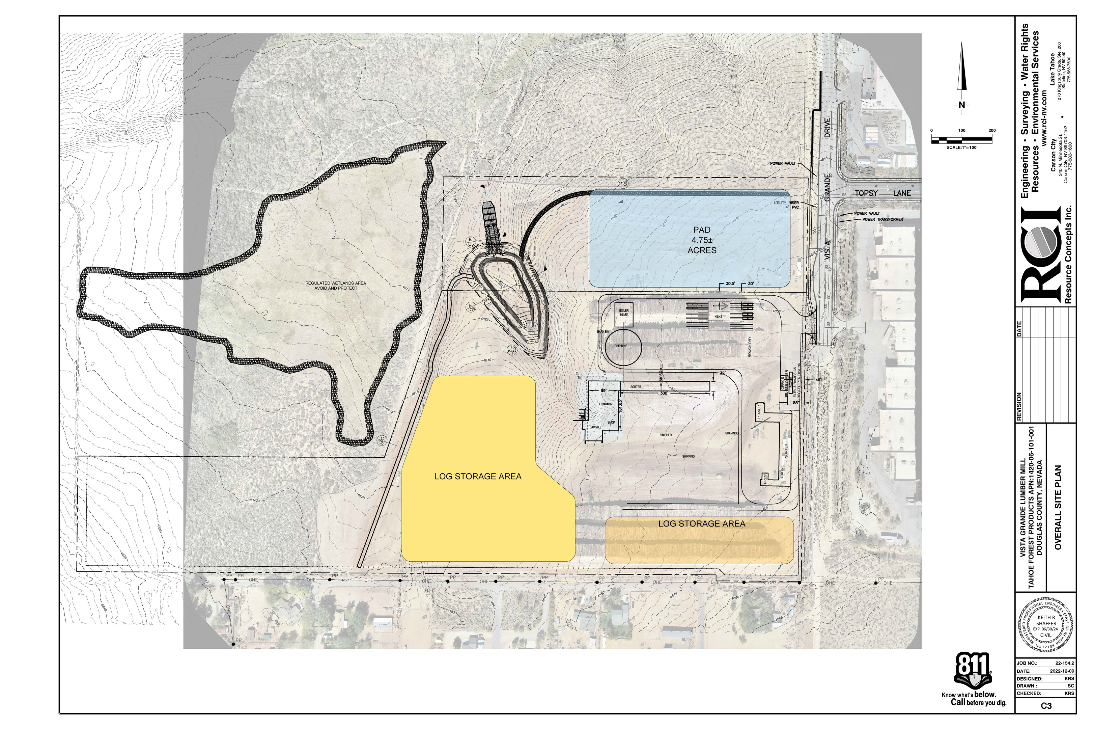

Slide 27
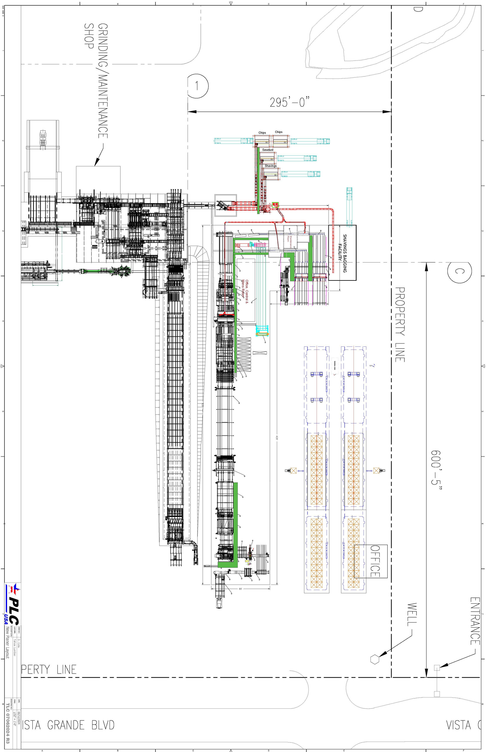

Slide 28
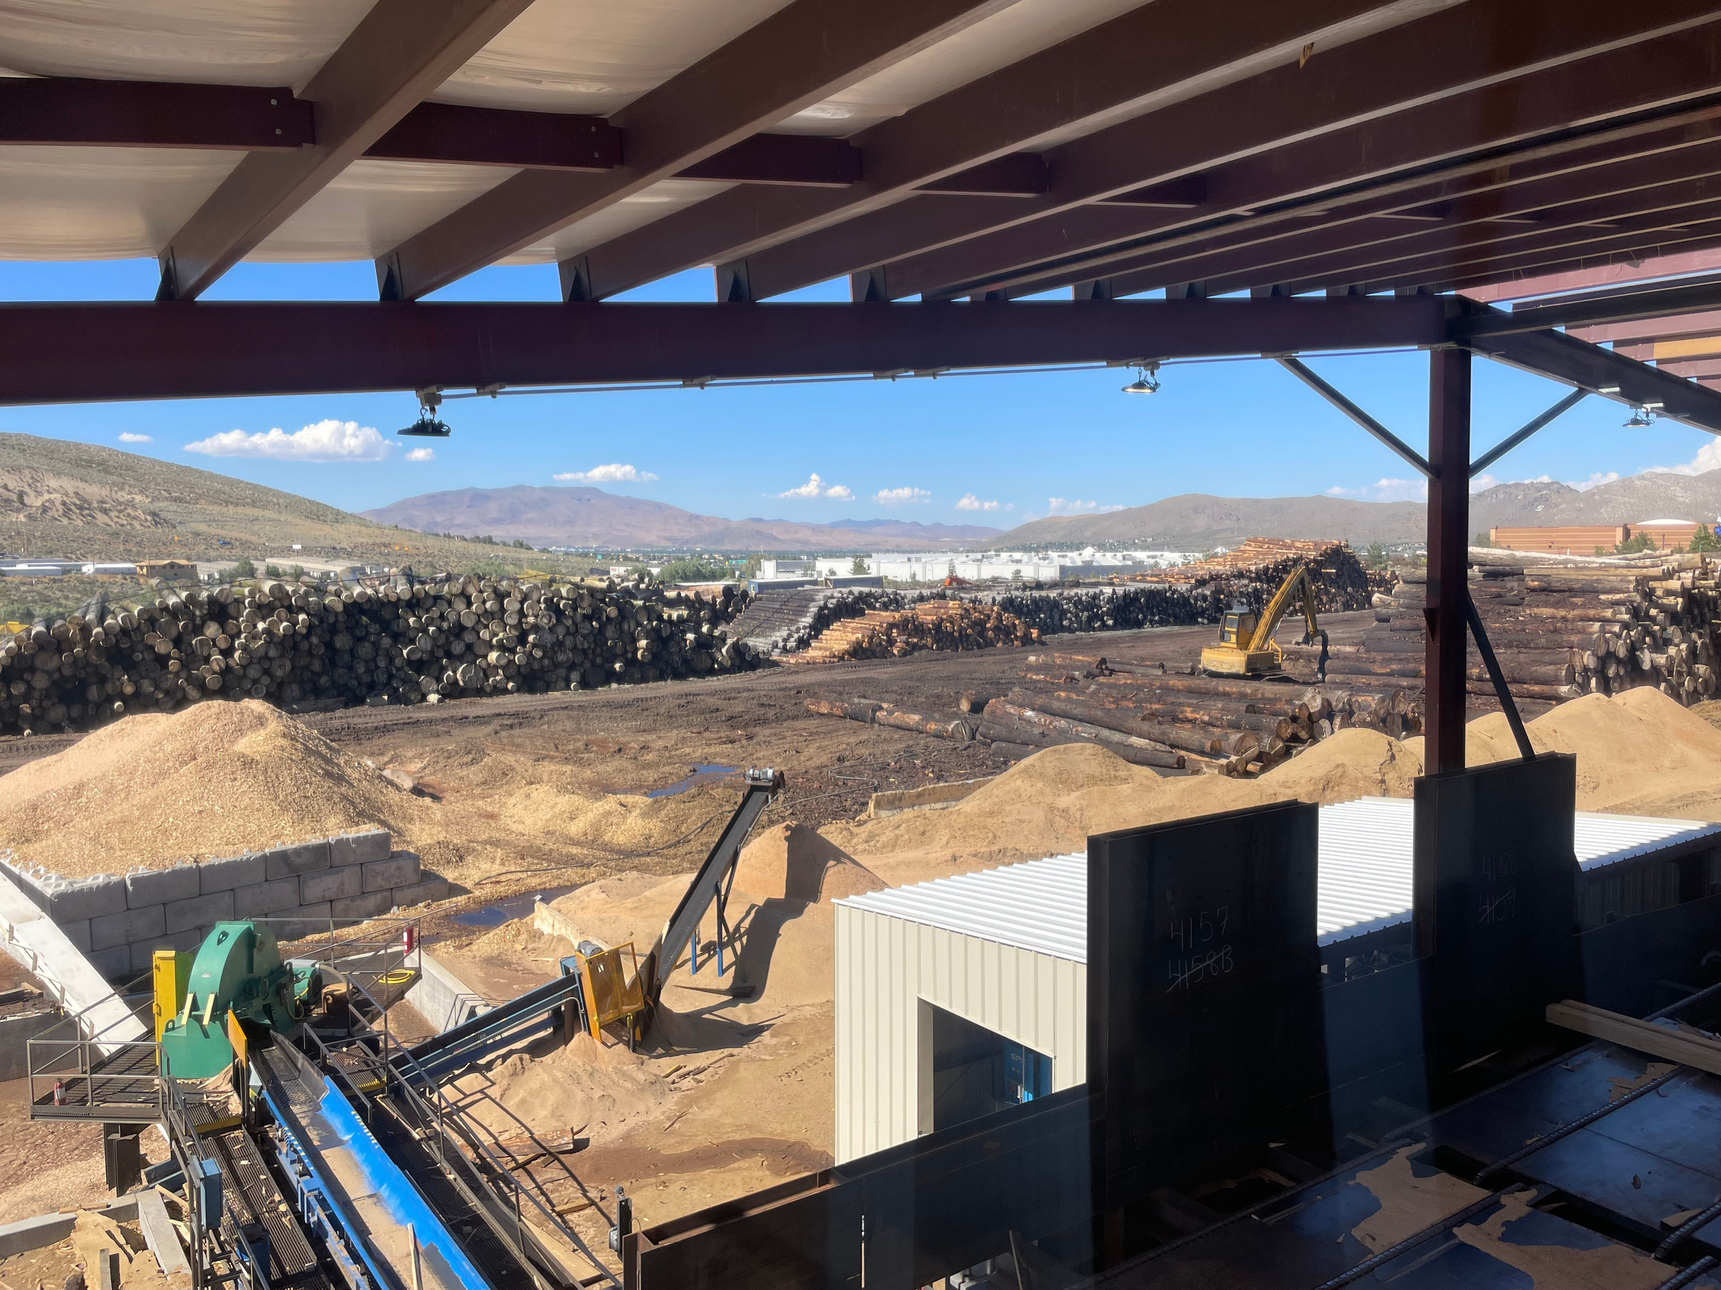

Slide 29
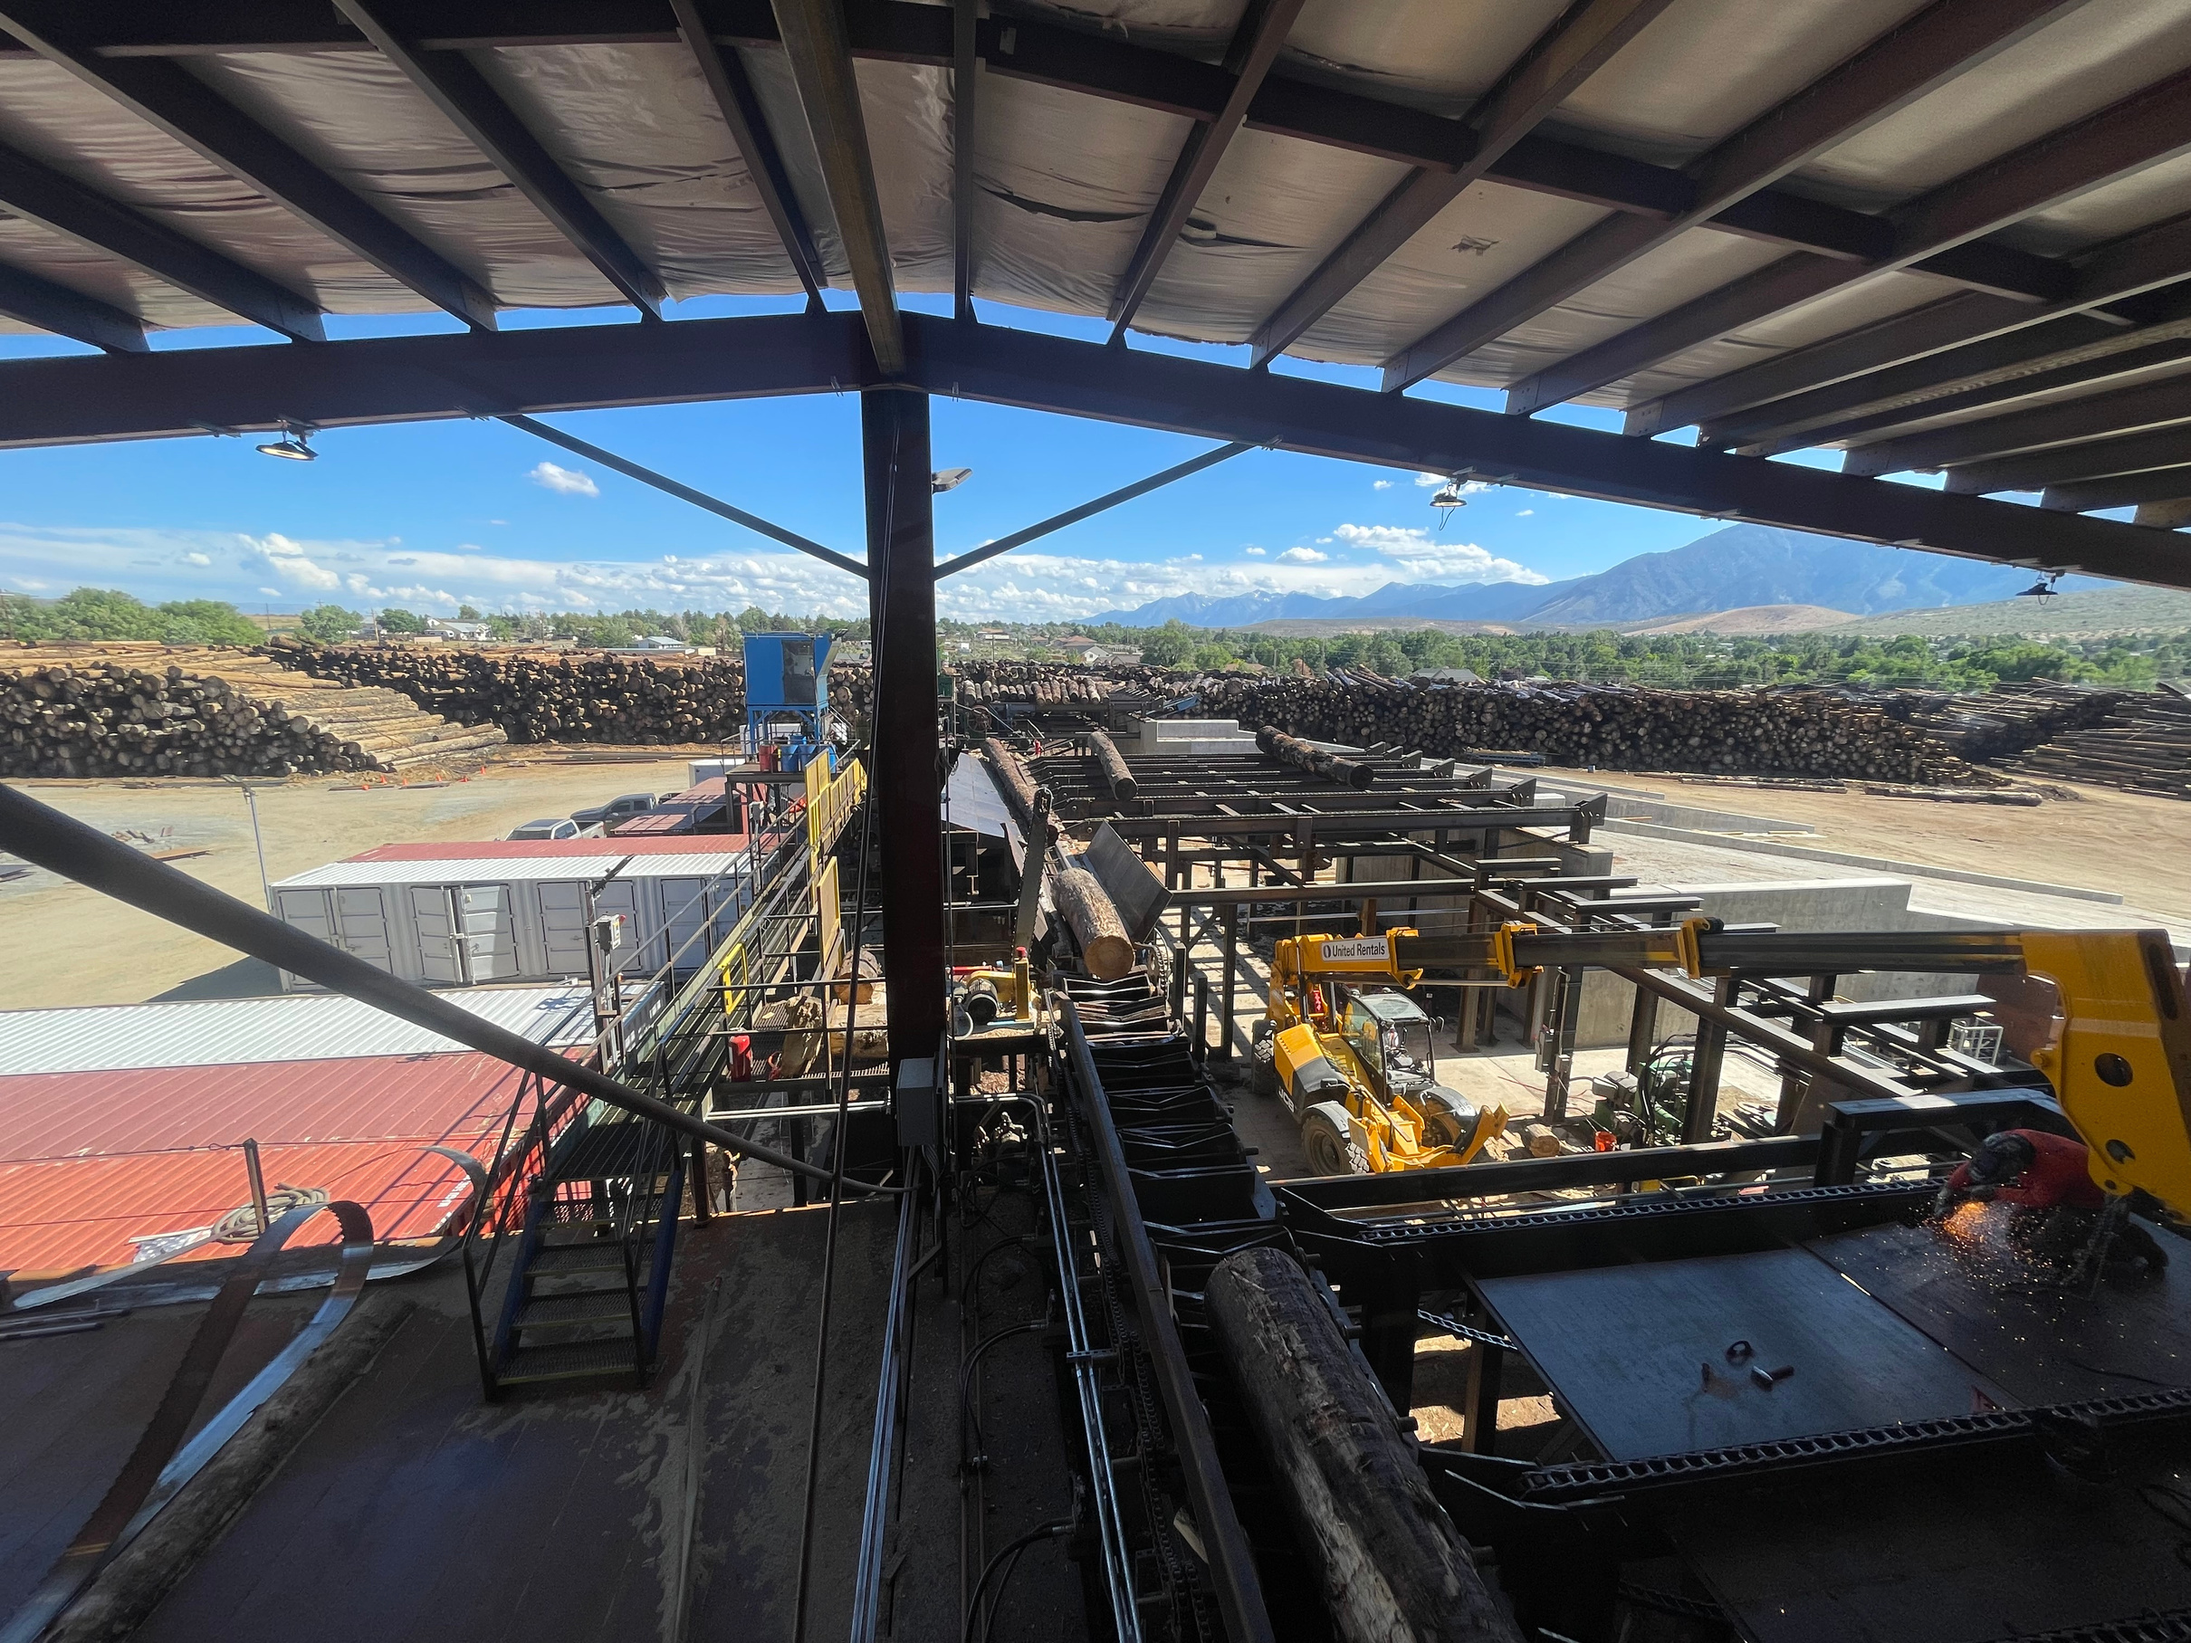

Slide 30
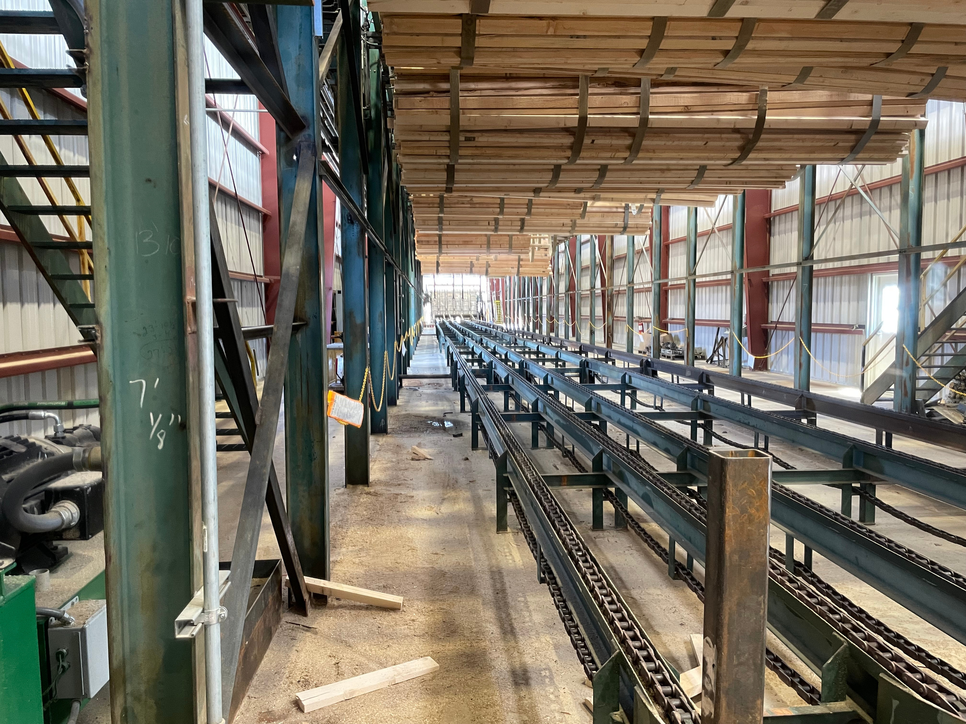

Slide 31
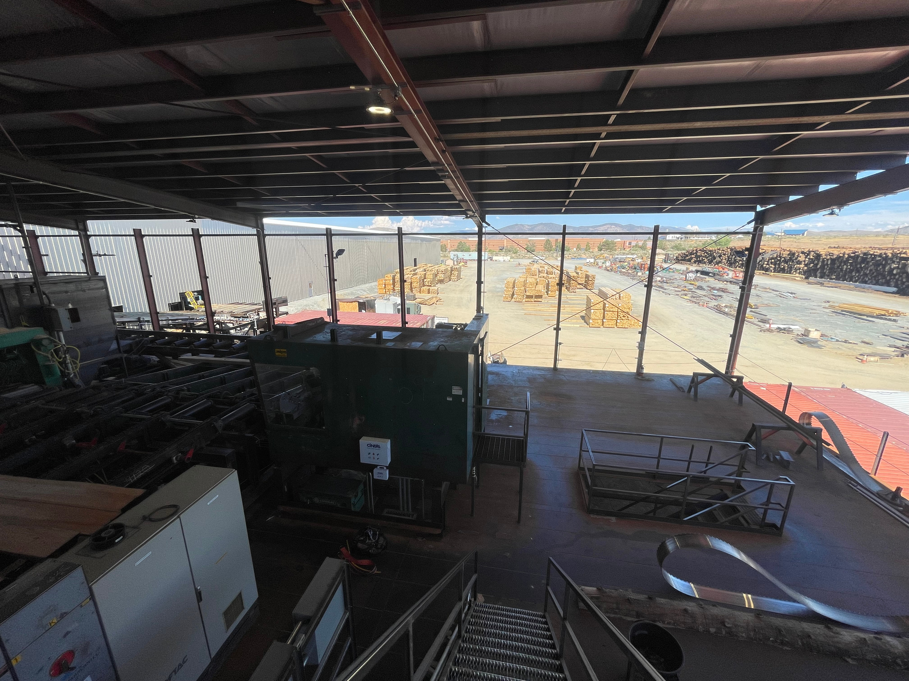

Slide 32



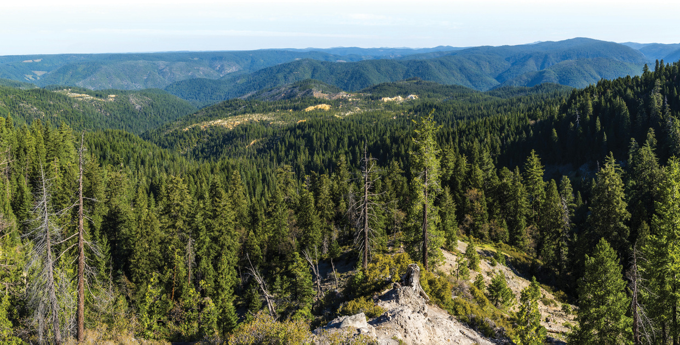
Promoting Healthy Forests
Tahoe Forest Products is constructing a commercial sawmill in Carson City, NV to provide responsible processing of harvested and salvaged local timber.
SCAN THE QR CODE TO LEARN MORE

