Slide 1

“Commercial Timber and Line Clearance Work”

Slide 2

Biomass Challenges & Opportunities for MFE
Hollis (Les) W. Day
June 26, 2024
Mountain F. Enterprises, Inc.

Slide 3
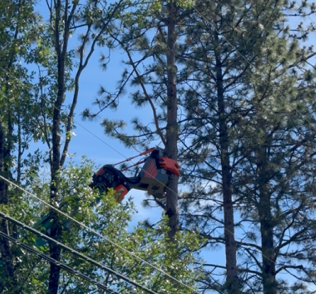
Introduction
Mountain F. Enterprises, Inc., a leader in utility line clearance, has been at the forefront of integrating sustainable practices into our operations.
Today, we'll explore the unique challenges and opportunities in the biomass sector, how MFE leverages its business to support sustainable forestry, and strategies to enhance forest management along utility ROWs.

Slide 4
Challenges for MFE
Market Tightness
Logistical Issues
Economic Viability
Notes:
High Production Costs: Biomass power in California is the most expensive energy source, with a levelized cost of $166 per megawatt-hour (MWh) in 2018. This is significantly higher than photovoltaic solar ($49/MWh) and wind power ($57/MWh). The high costs are attributed to the inefficiency of using forest biomass to generate electricity and the reliance on regulatory incentives and subsidies.

Slide 5
Opportunities for MFE
Innovative Technologies
Partnerships
Policy Incentives
Community Engagement

Slide 6
MFE Business Overview
Services Offered
Sustainability Practices
Impact

Slide 7
Engaging Small Landowners
Challenges:
High Costs and Low Value of Biomass
Bureaucratic Hurdles
Lack of Infrastructure
Market Access
Environmental and Regulatory Constraints
Strategies:
Public-Private Partnerships
Financial Incentives & Subsidies
Developing Local Infrastructure
Regulatory Support

Slide 8
Conclusion
Recap
Importance of Collaboration

Slide 9
Contact Information
For further information or to discuss potential collaborations, please contact me. Thank you for your attention.
  Hollis (Les) W. Day
  Mountain F. Enterprises, Inc.
  les.day@mtfent.com

Slide 10
“Commercial Timber and Line Clearance Work”

Slide 11


Slide 12
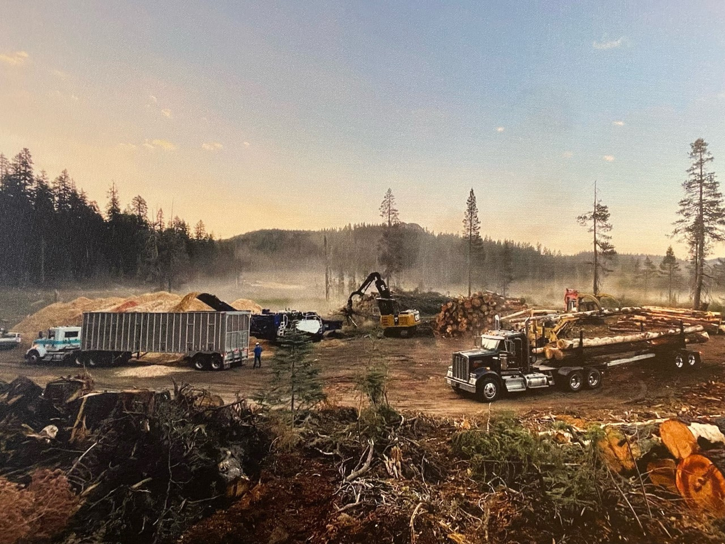

Slide 13
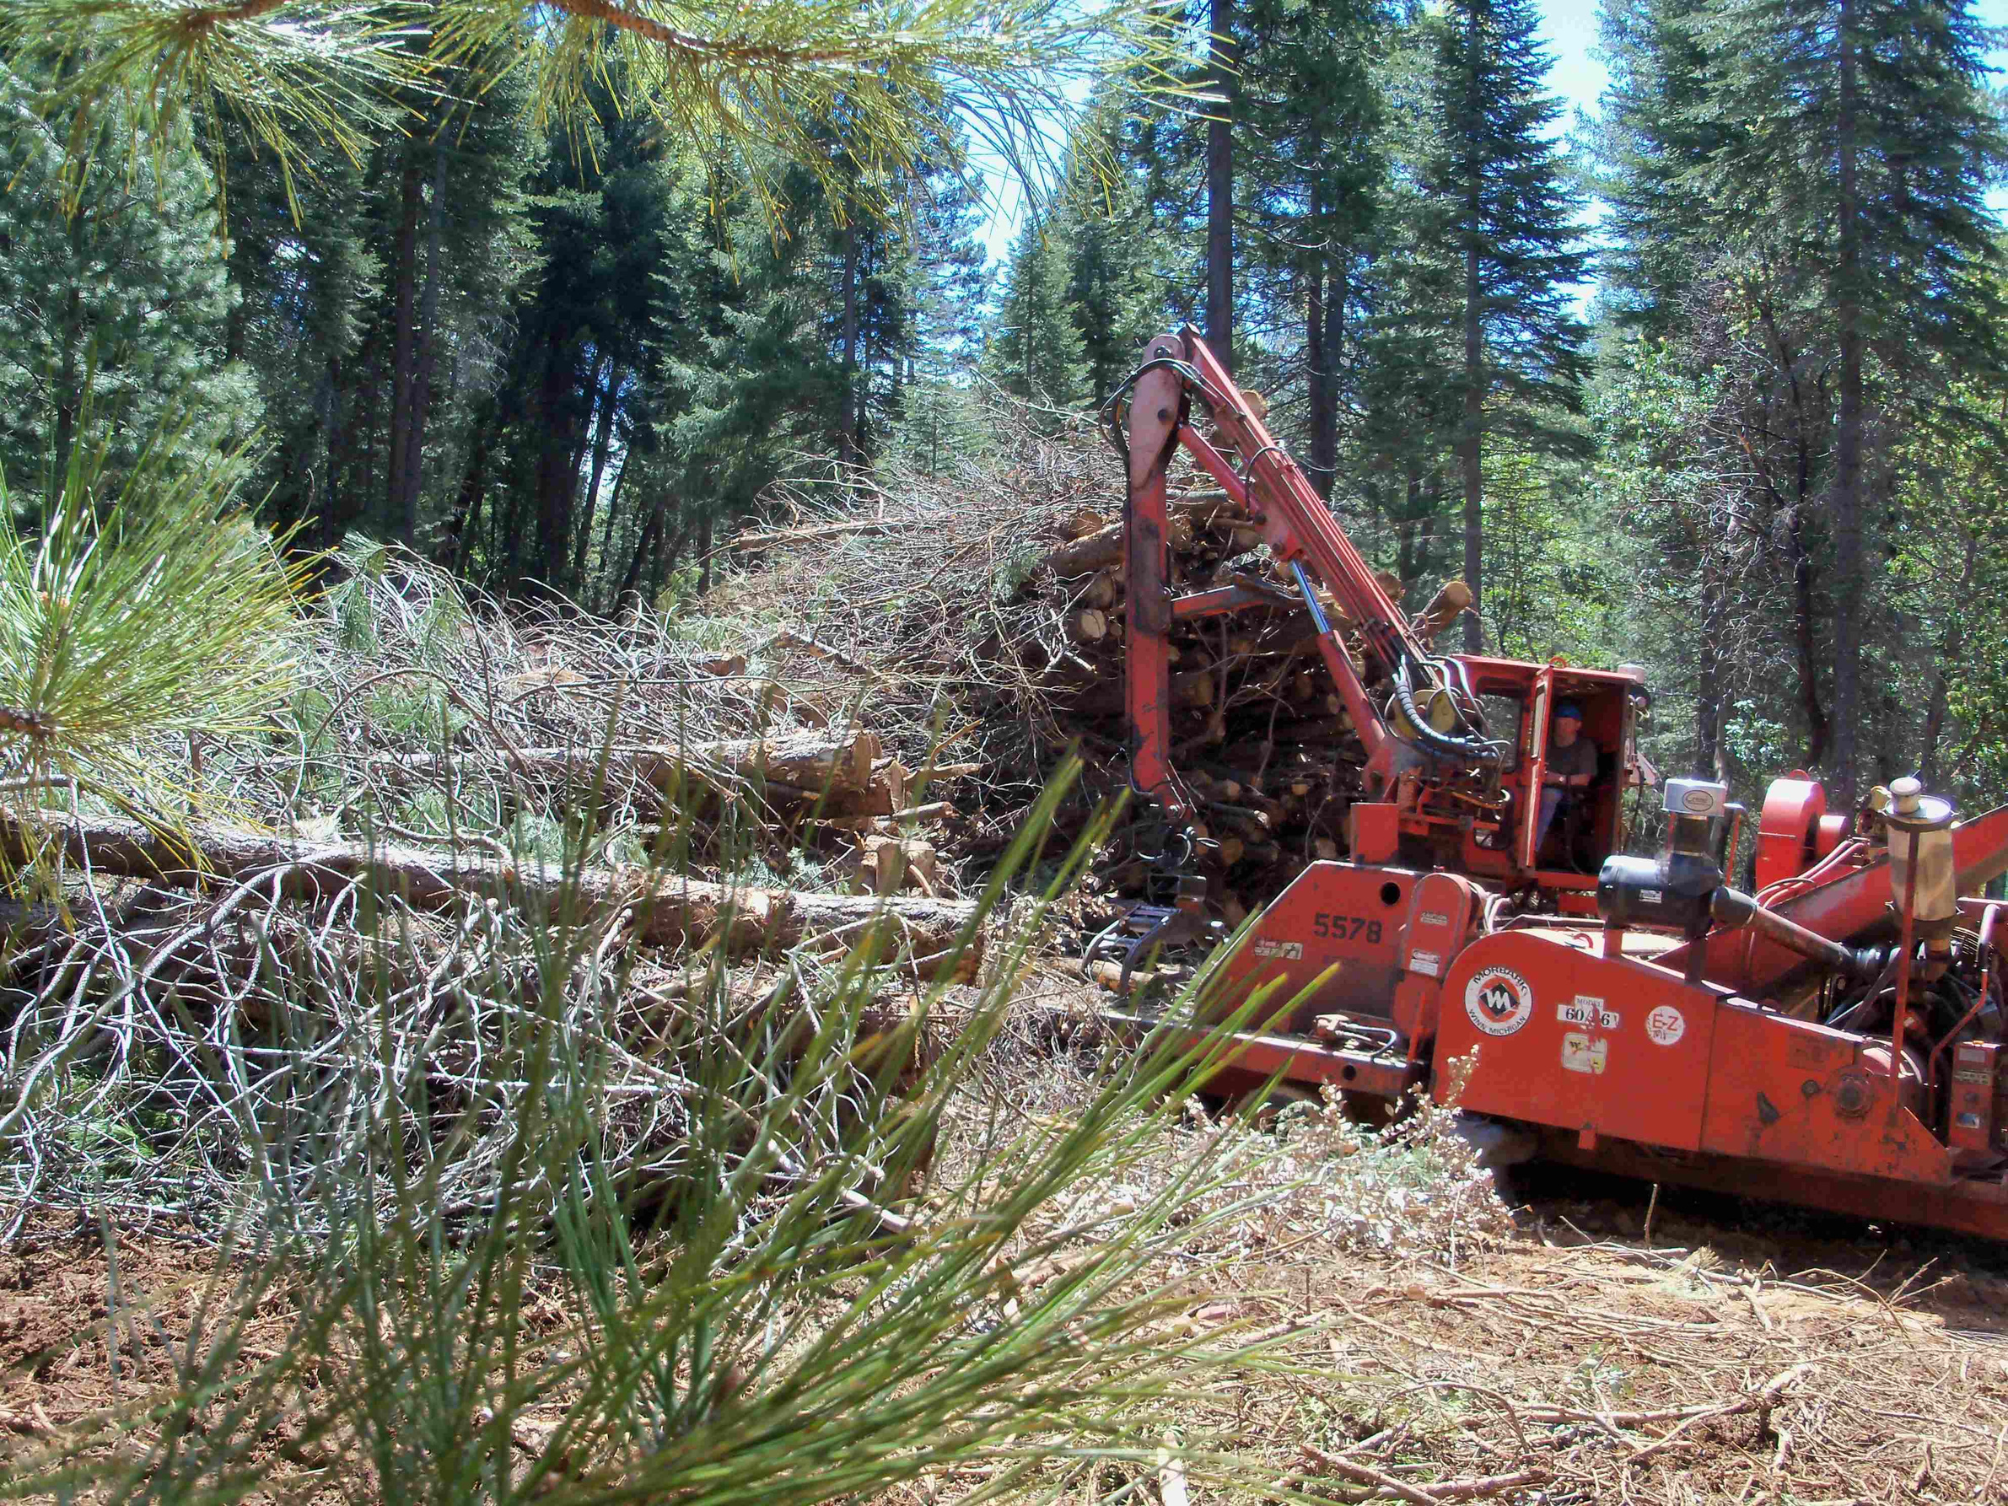

Slide 14
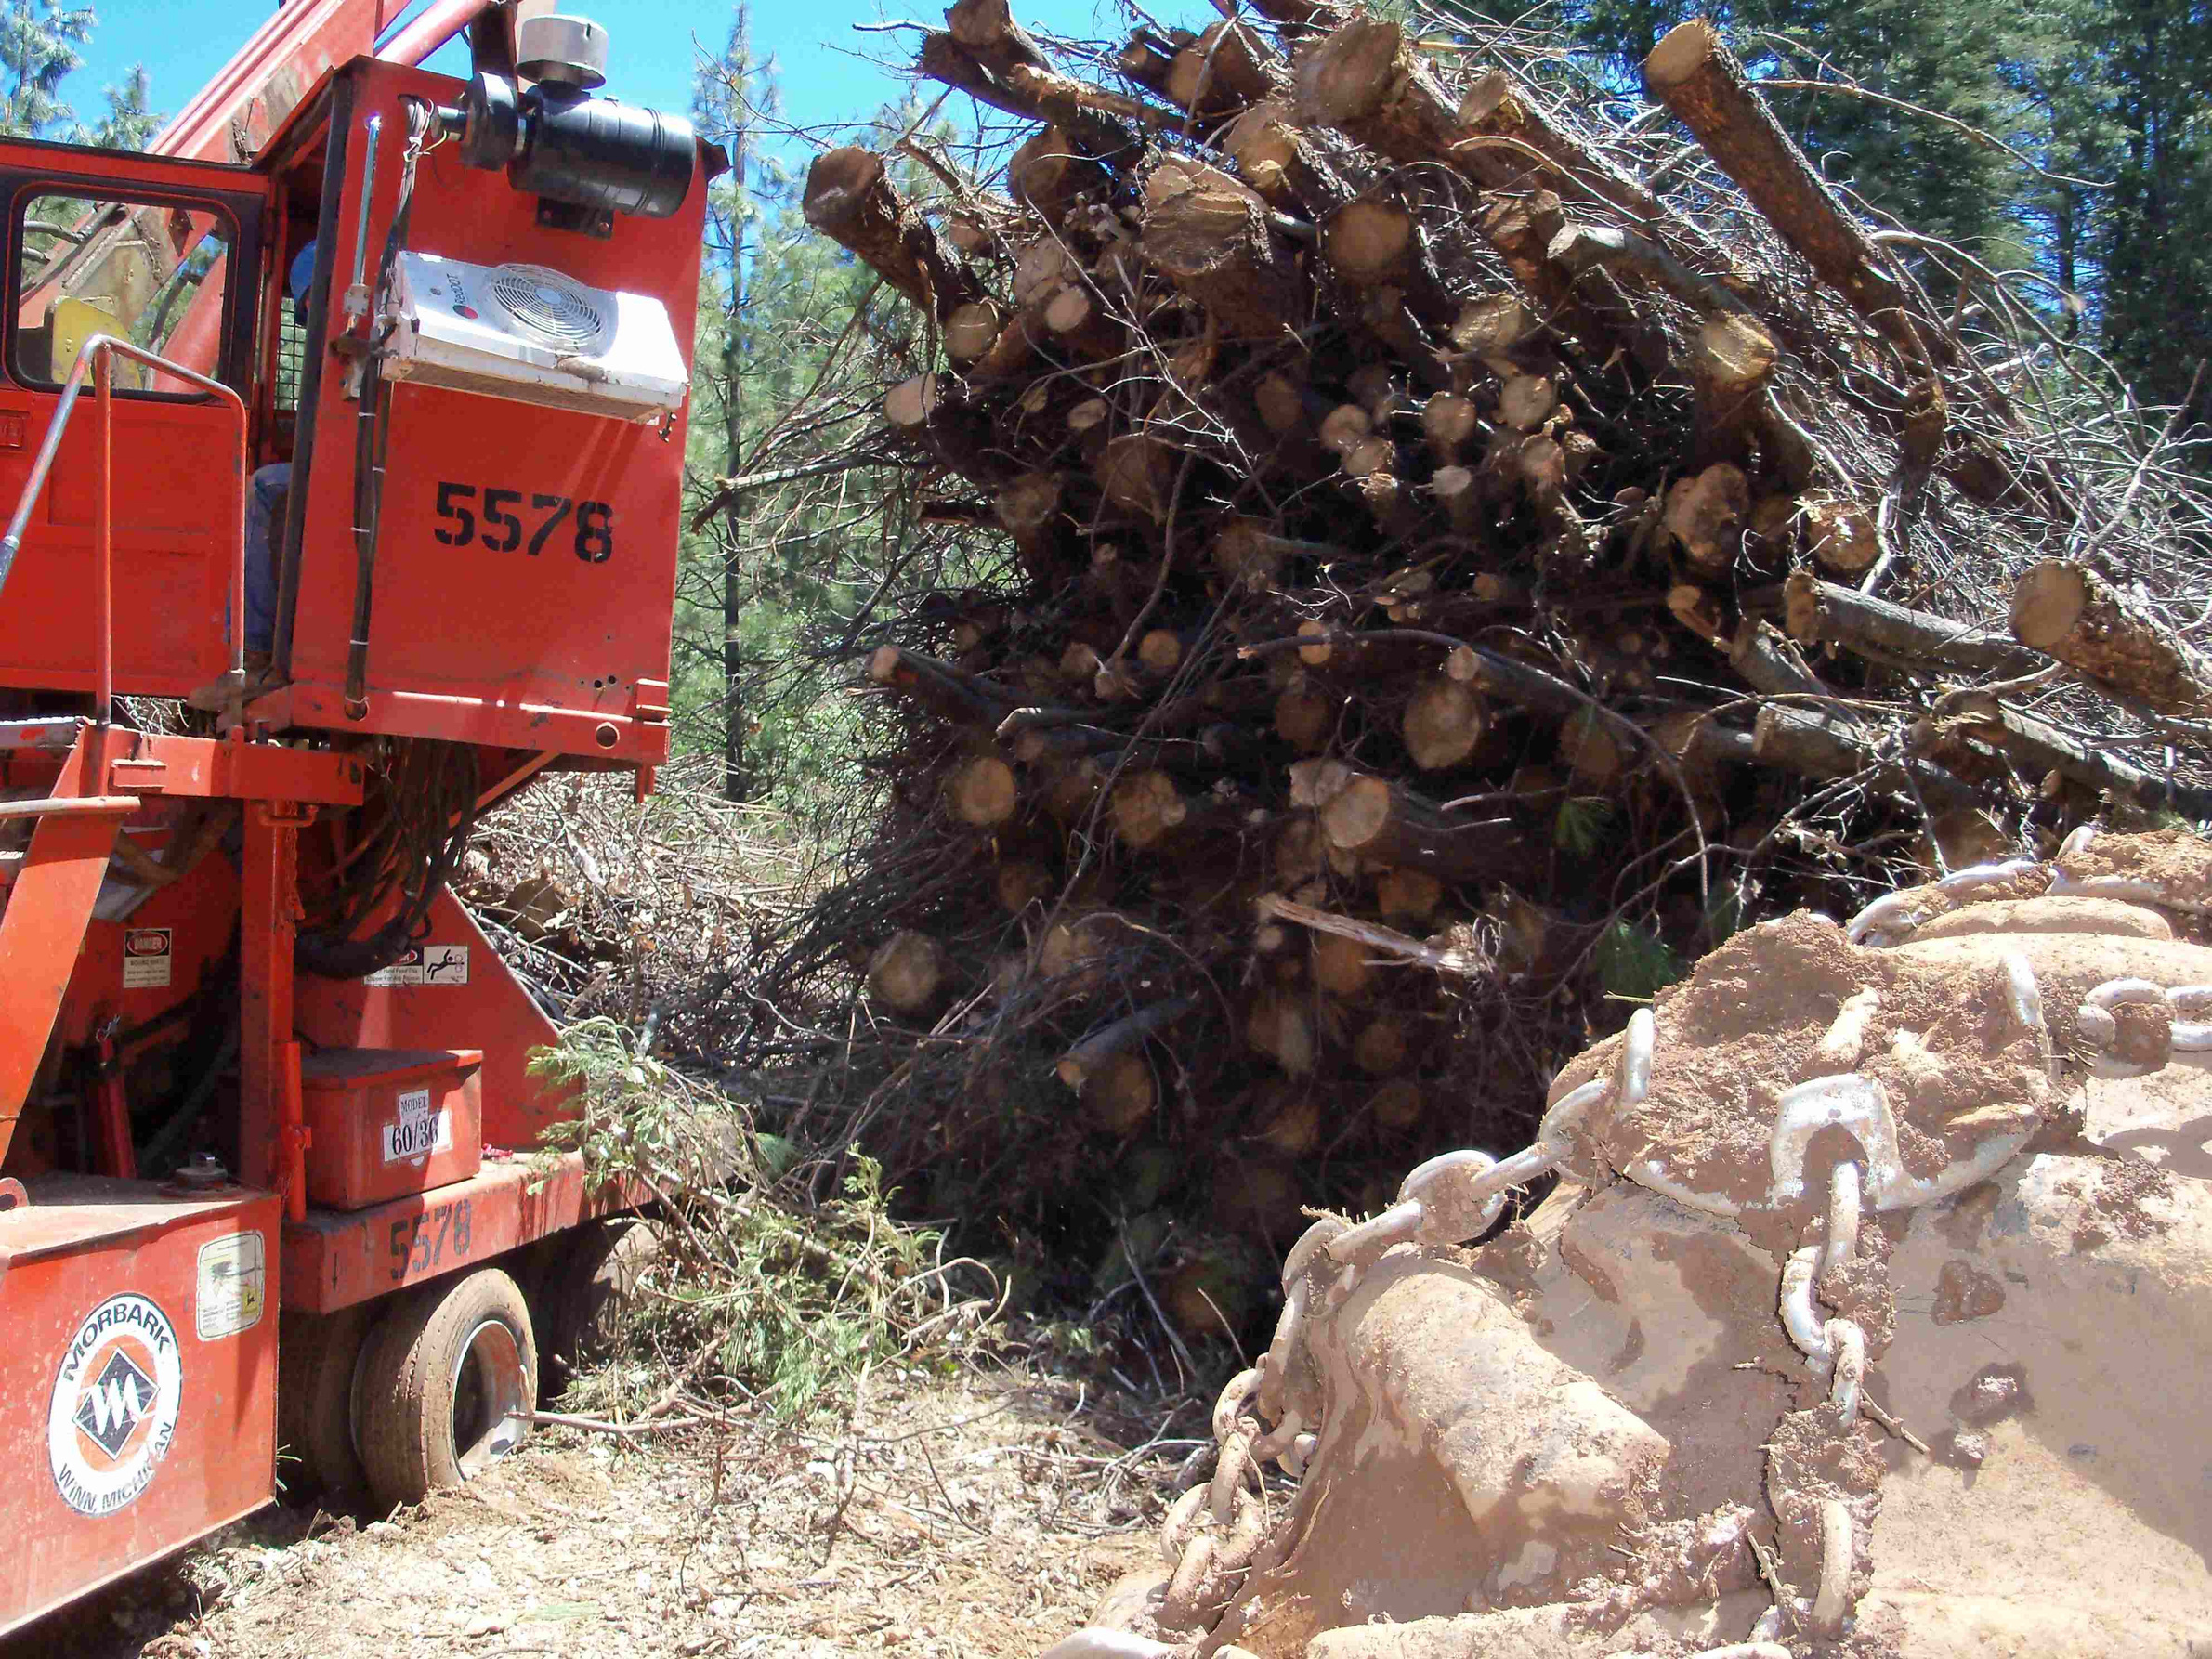

Slide 15
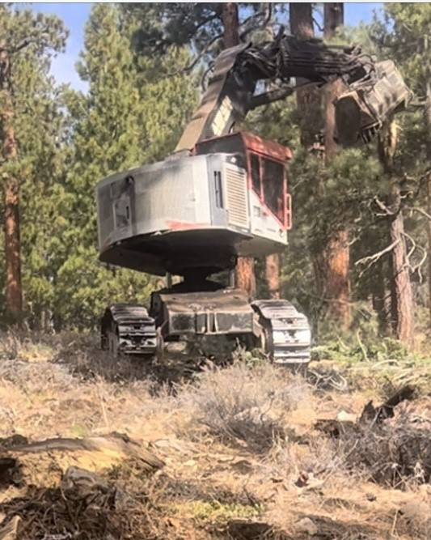

Slide 16
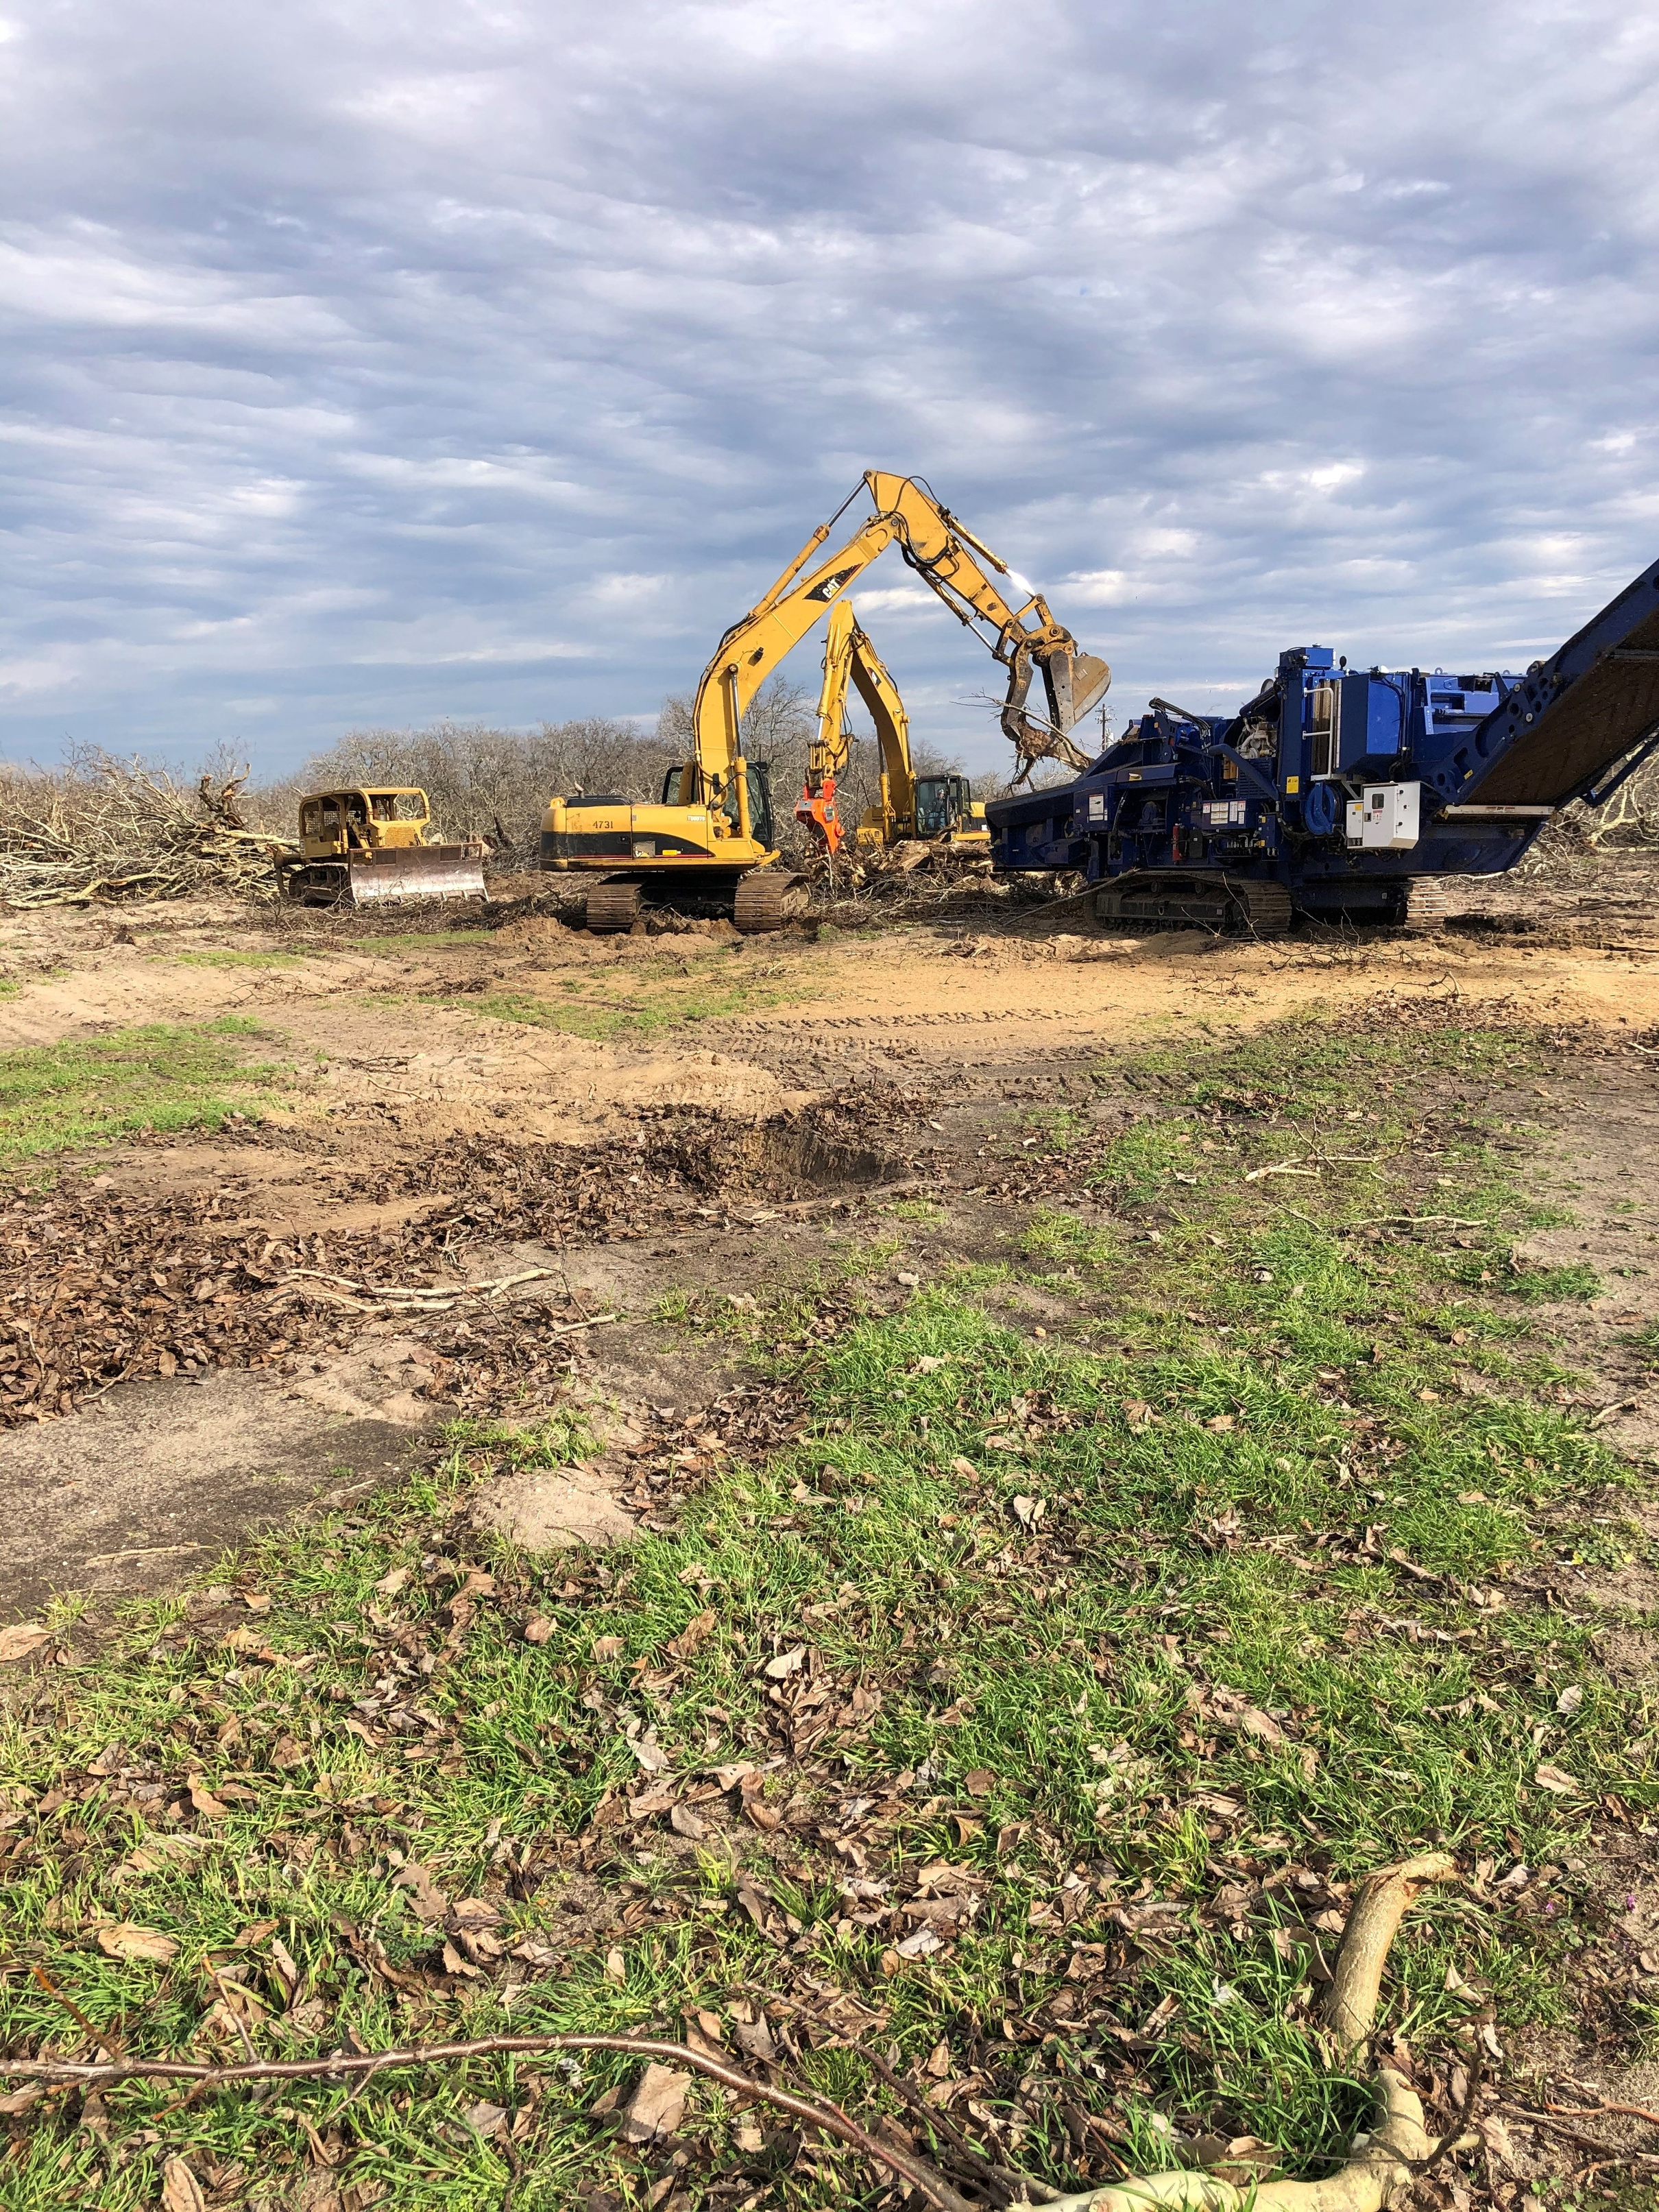

Slide 17
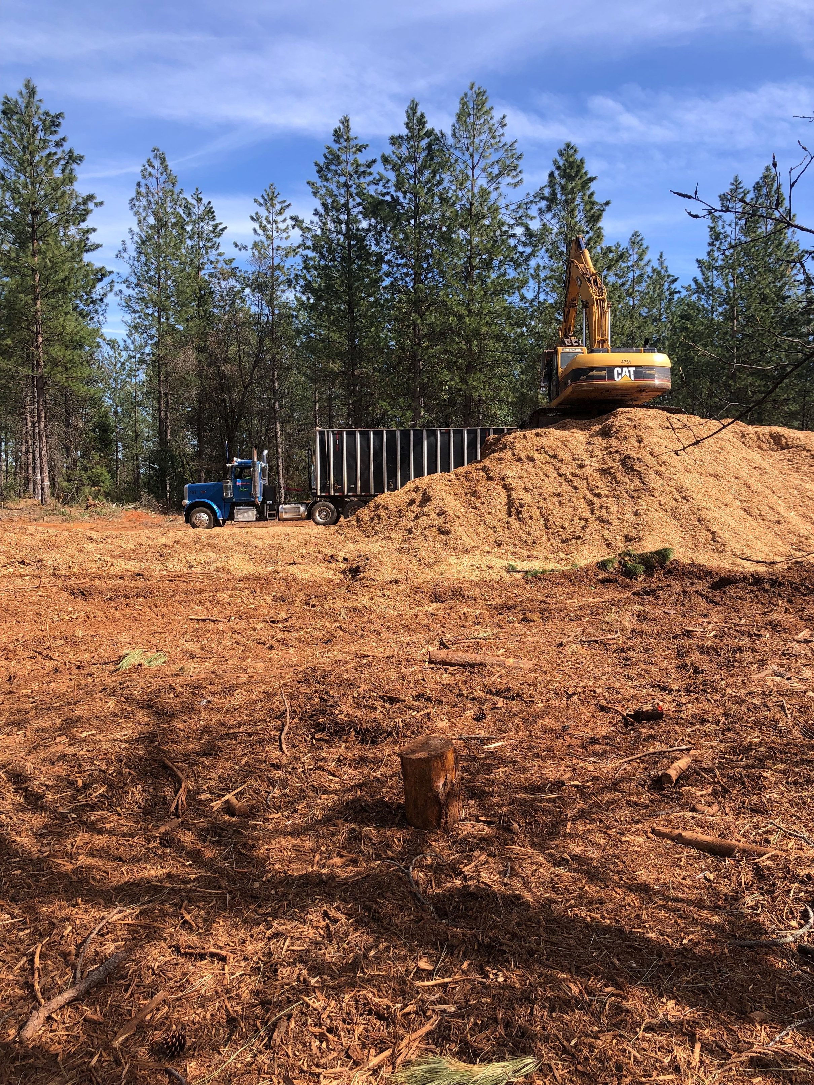

Slide 18
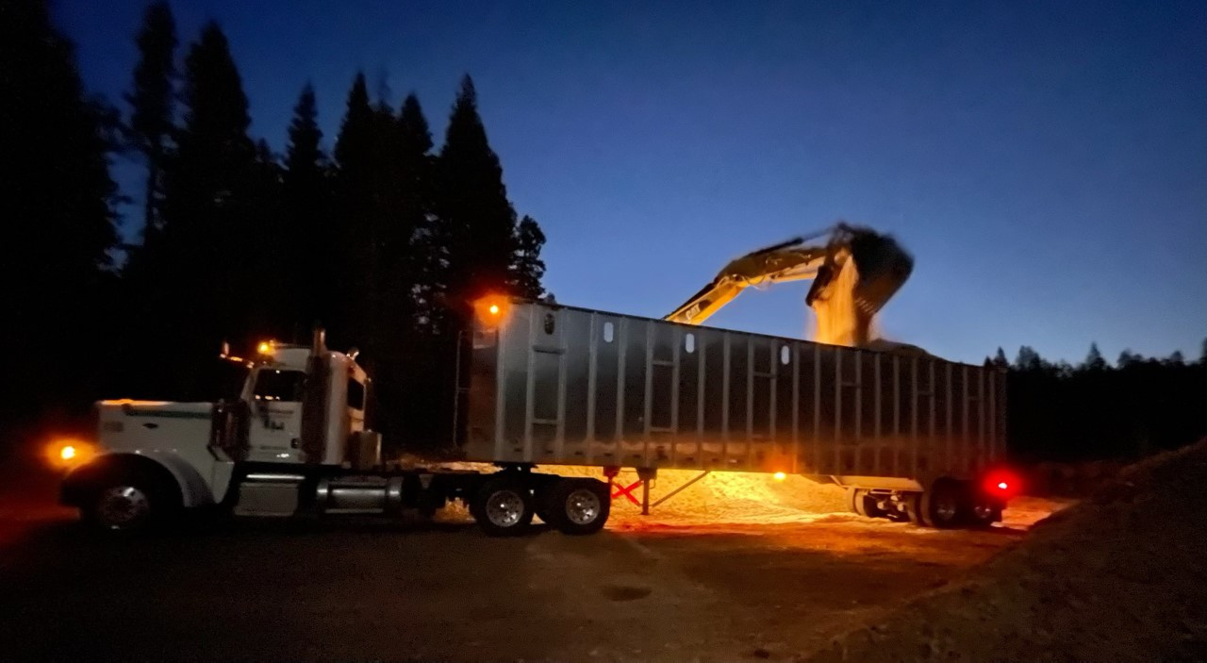

Slide 19
