Slide 1
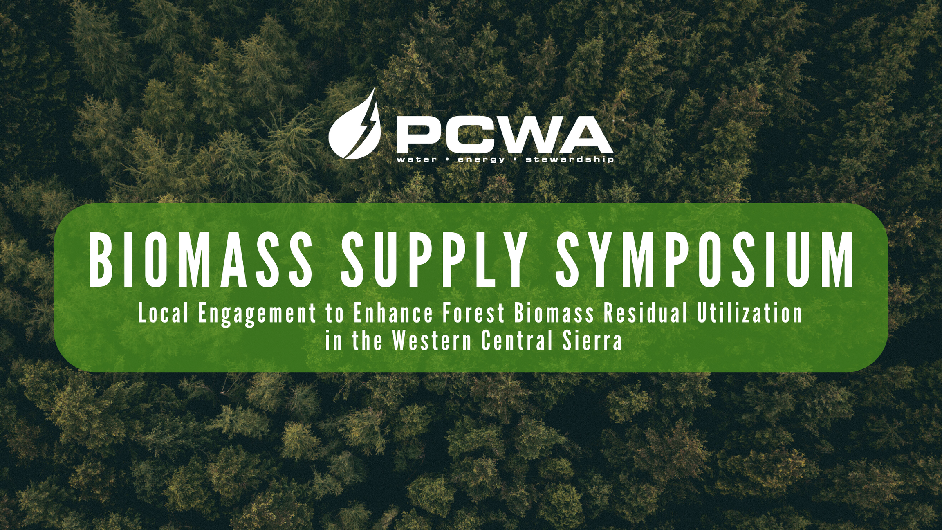
“Technology that Finds where the Biomass is Growing or Piled”

Slide 2
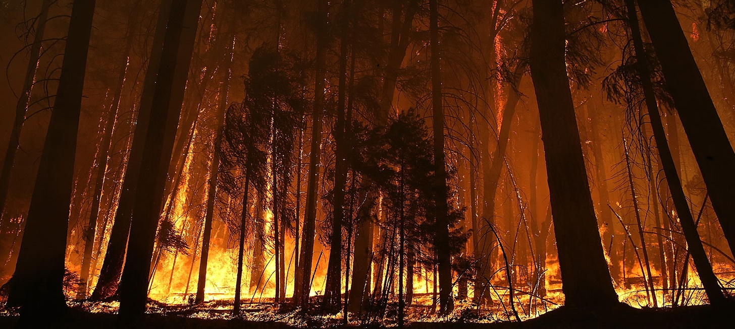






California Burn Pile Mapping and Quantification
Carl Rudeen
Jason Moghaddas (RPF #2774)
Travis Freed
Gary Roller (RFP #2899)
Matt Meyerl
Dr. David Saah
ª Spatial Informatics Group, LLC
^{b} University of San Francisco, Geospatial Analysis Lab
^{c} University of California Berkeley, Dept. of Envir. Sci., Policy, & Mgmnt.
^{d} TSS Consultants, Rancho Cordova, CA 95670

Slide 3

Key Questions
How many acres of piles are there?
What is the total estimated tonnage?
Distribution of acres and tonnage across Air Districts?
How much of that material is within
100 feet of a road?

Slide 4
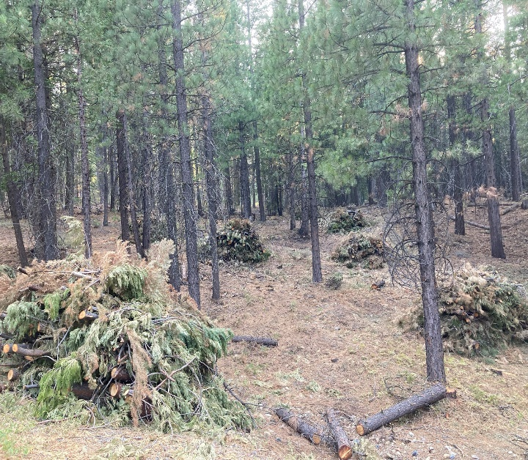
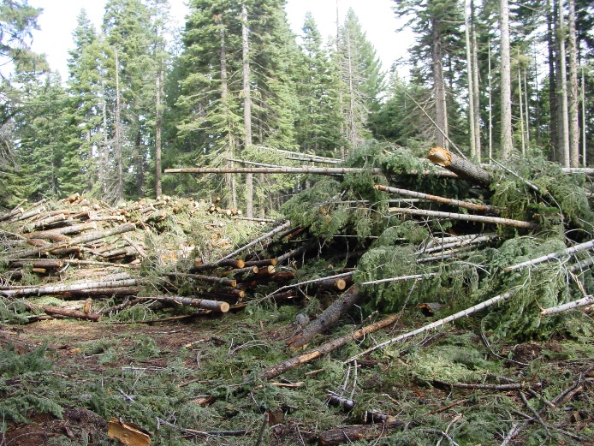
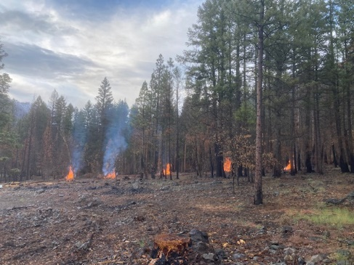
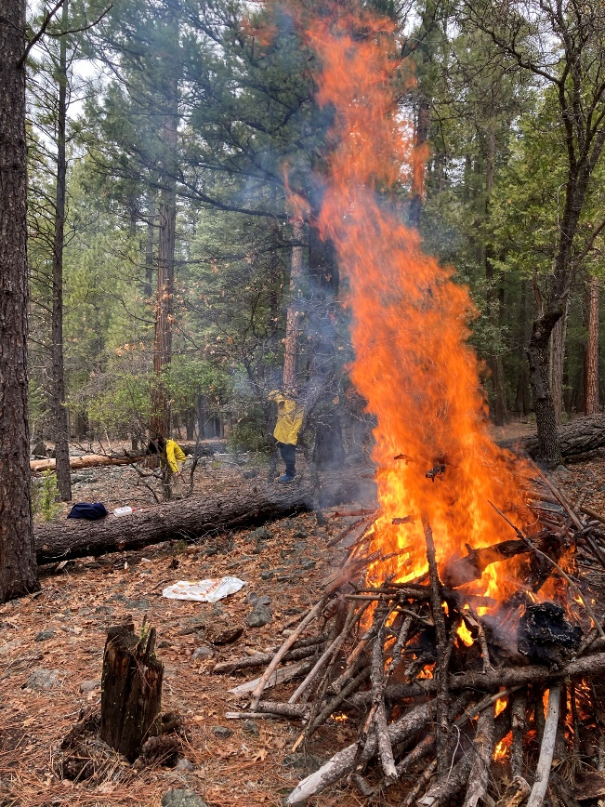
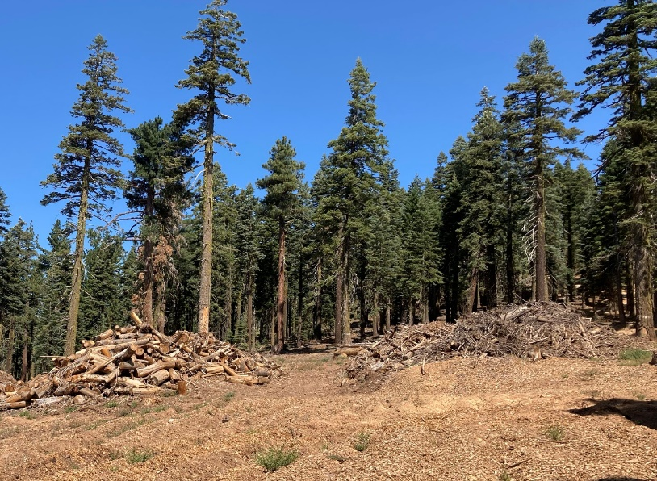
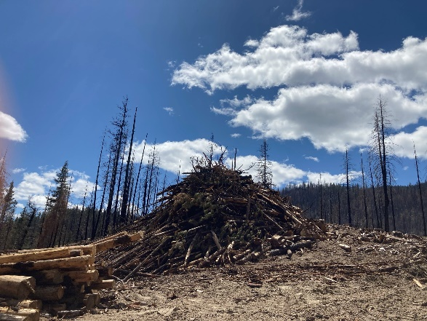
Piles
Some Fuels Treatments & Timber Harvests Result in Piles
Piles not removed can be fuel for wildfire or potentially utilized
Pile Types (PFIRS):
  Landing Pile
  Machine Pile
  Hand Pile
  Broadcast

Slide 5
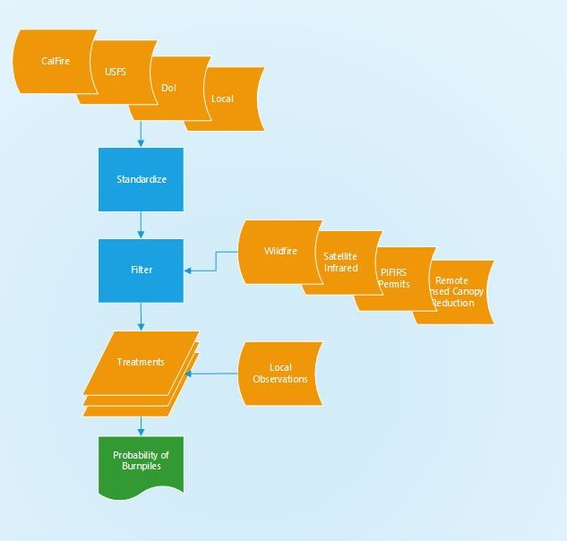
Step 1- Import Treatment Location Data
Publicly Available Fuels Treatment and Harvest Data (FACTS, CALFIRE…)
Standardize Treatment Types
Assign Pile Types
(hand pile, machine pile)
Assign Fuel Types
(natural, slash….)

Slide 6
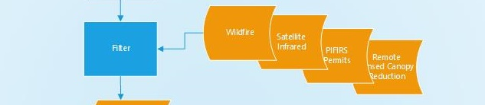
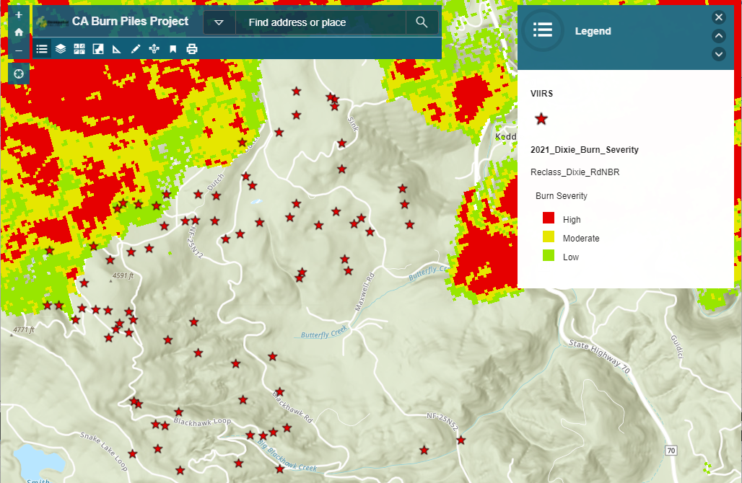
Step 2 - Filter
Assign Probability of Finding Piles
Burned in Wildfire?
Age of Treatment
PFIRS Permit
Satellite Infrared Heat Detection (VIIRS)
Remotely Sensed Canopy Cover Reduction

Slide 7
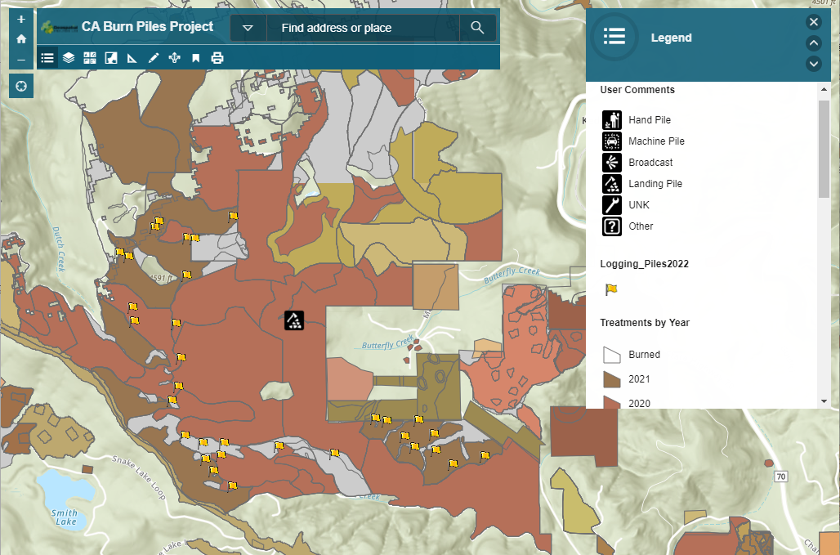
Step 3 – Local Validation
Verify Known Locations
(In Progress)
Local Data
(where available)
User Comments on Web Map

Slide 8
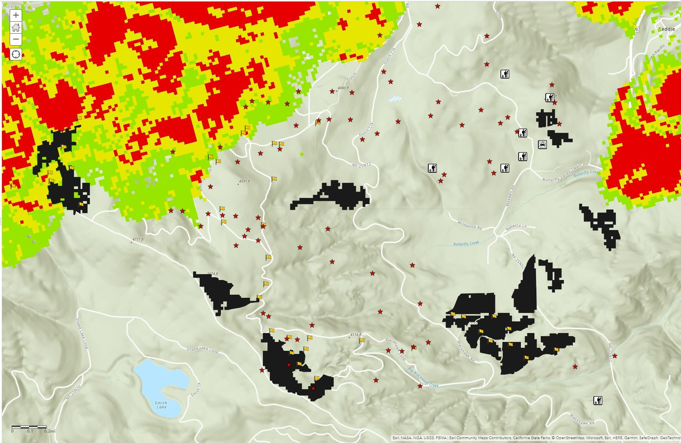
Step 4: Filtered Potential Pile Locations
Filtering:
Treatment Type: Thinning Manual
(Hand Pile)
Treatment Age
Wildfire is Present/Absent after Treatment
PFRS Data within 300 Yards of Treatment
Satellite Infrared Detected within Polygon
Satellite Canopy Cover Reduction Detected

Slide 9
Top 10
Air District Name | Total Acres of Piles | Rank of Acres of Piles | Total Tons of Piles | Rank of Tons of Piles | Tons per Acre
Siskiyou | 25,081 | 1 | 109,818 | 3 | 4
San Joaquin Valley | 16,130 | 2 | 47,734 | 9 | 3
Northern Sierra | 15,028 | 3 | 129,865 | 2 | 9
Tuolumne | 11,732 | 4 | 41,338 | 10 | 4
Lassen | 10,918 | 5 | 36,726 | 11 | 3
Placer | 10,472 | 6 | 136,282 | 1 | 13
Shasta | 9,467 | 7 | 48,685 | 8 | 5
Modoc | 9,083 | 8 | 57,939 | 5 | 6
North Coast | 5,845 | 9 | 71,859 | 4 | 12
South Coast | 5,259 | 10 | 54,771 | 7 | 10

Slide 10
Ownership for Pile Locations
Ownership | Sum of Acres | Sum of Tons
Federal | 115,991 | 695,353
Local | 1,621 | 14,429
NGO | 495 | 3,006
Private-Industry | 4,523 | 37,329
Private Non-Industry | 22,992 | 246,448
State | 1,749 | 14,388
Tribal | 209 | 2,611
Total | 147,579 | 1,013,565

Slide 11
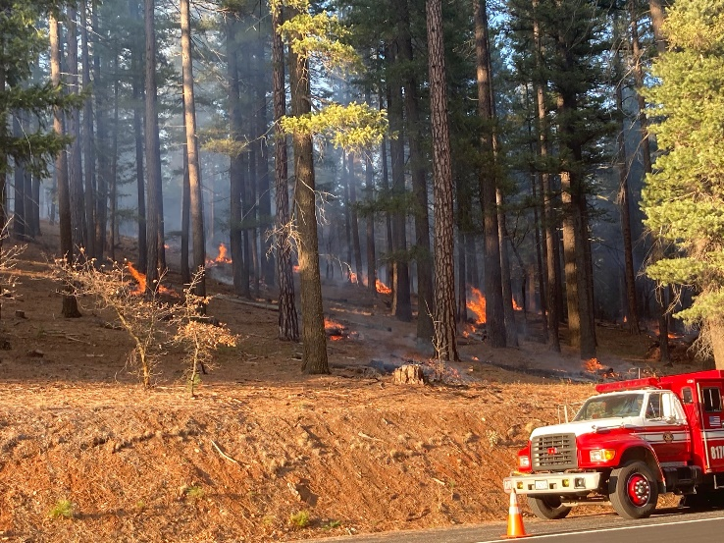
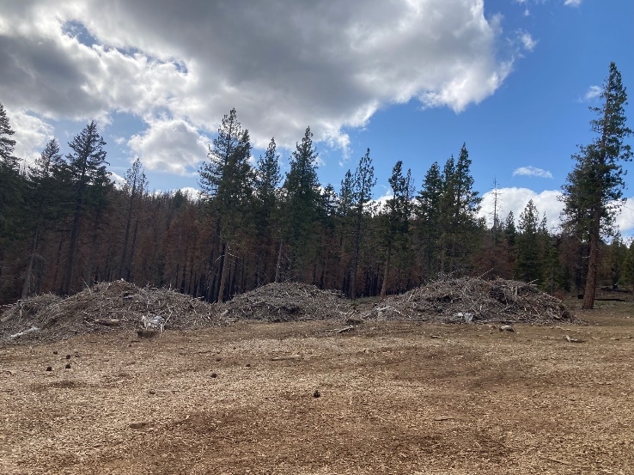




Thank You…Questions
Carl Rudeen, crudeen@sig-gis.com
Jason Moghaddas, jmoghaddas@sig-gis.com
Christiana Darlingon, christiana@clereinc.net
Camille Swezy, camilleswezy@gmail.com
Greg Fanslow, greg@bluetree.io

Slide 12


The decision support tool for wildfire resilience
Biomass Supply Symposium
June 2024

Slide 13
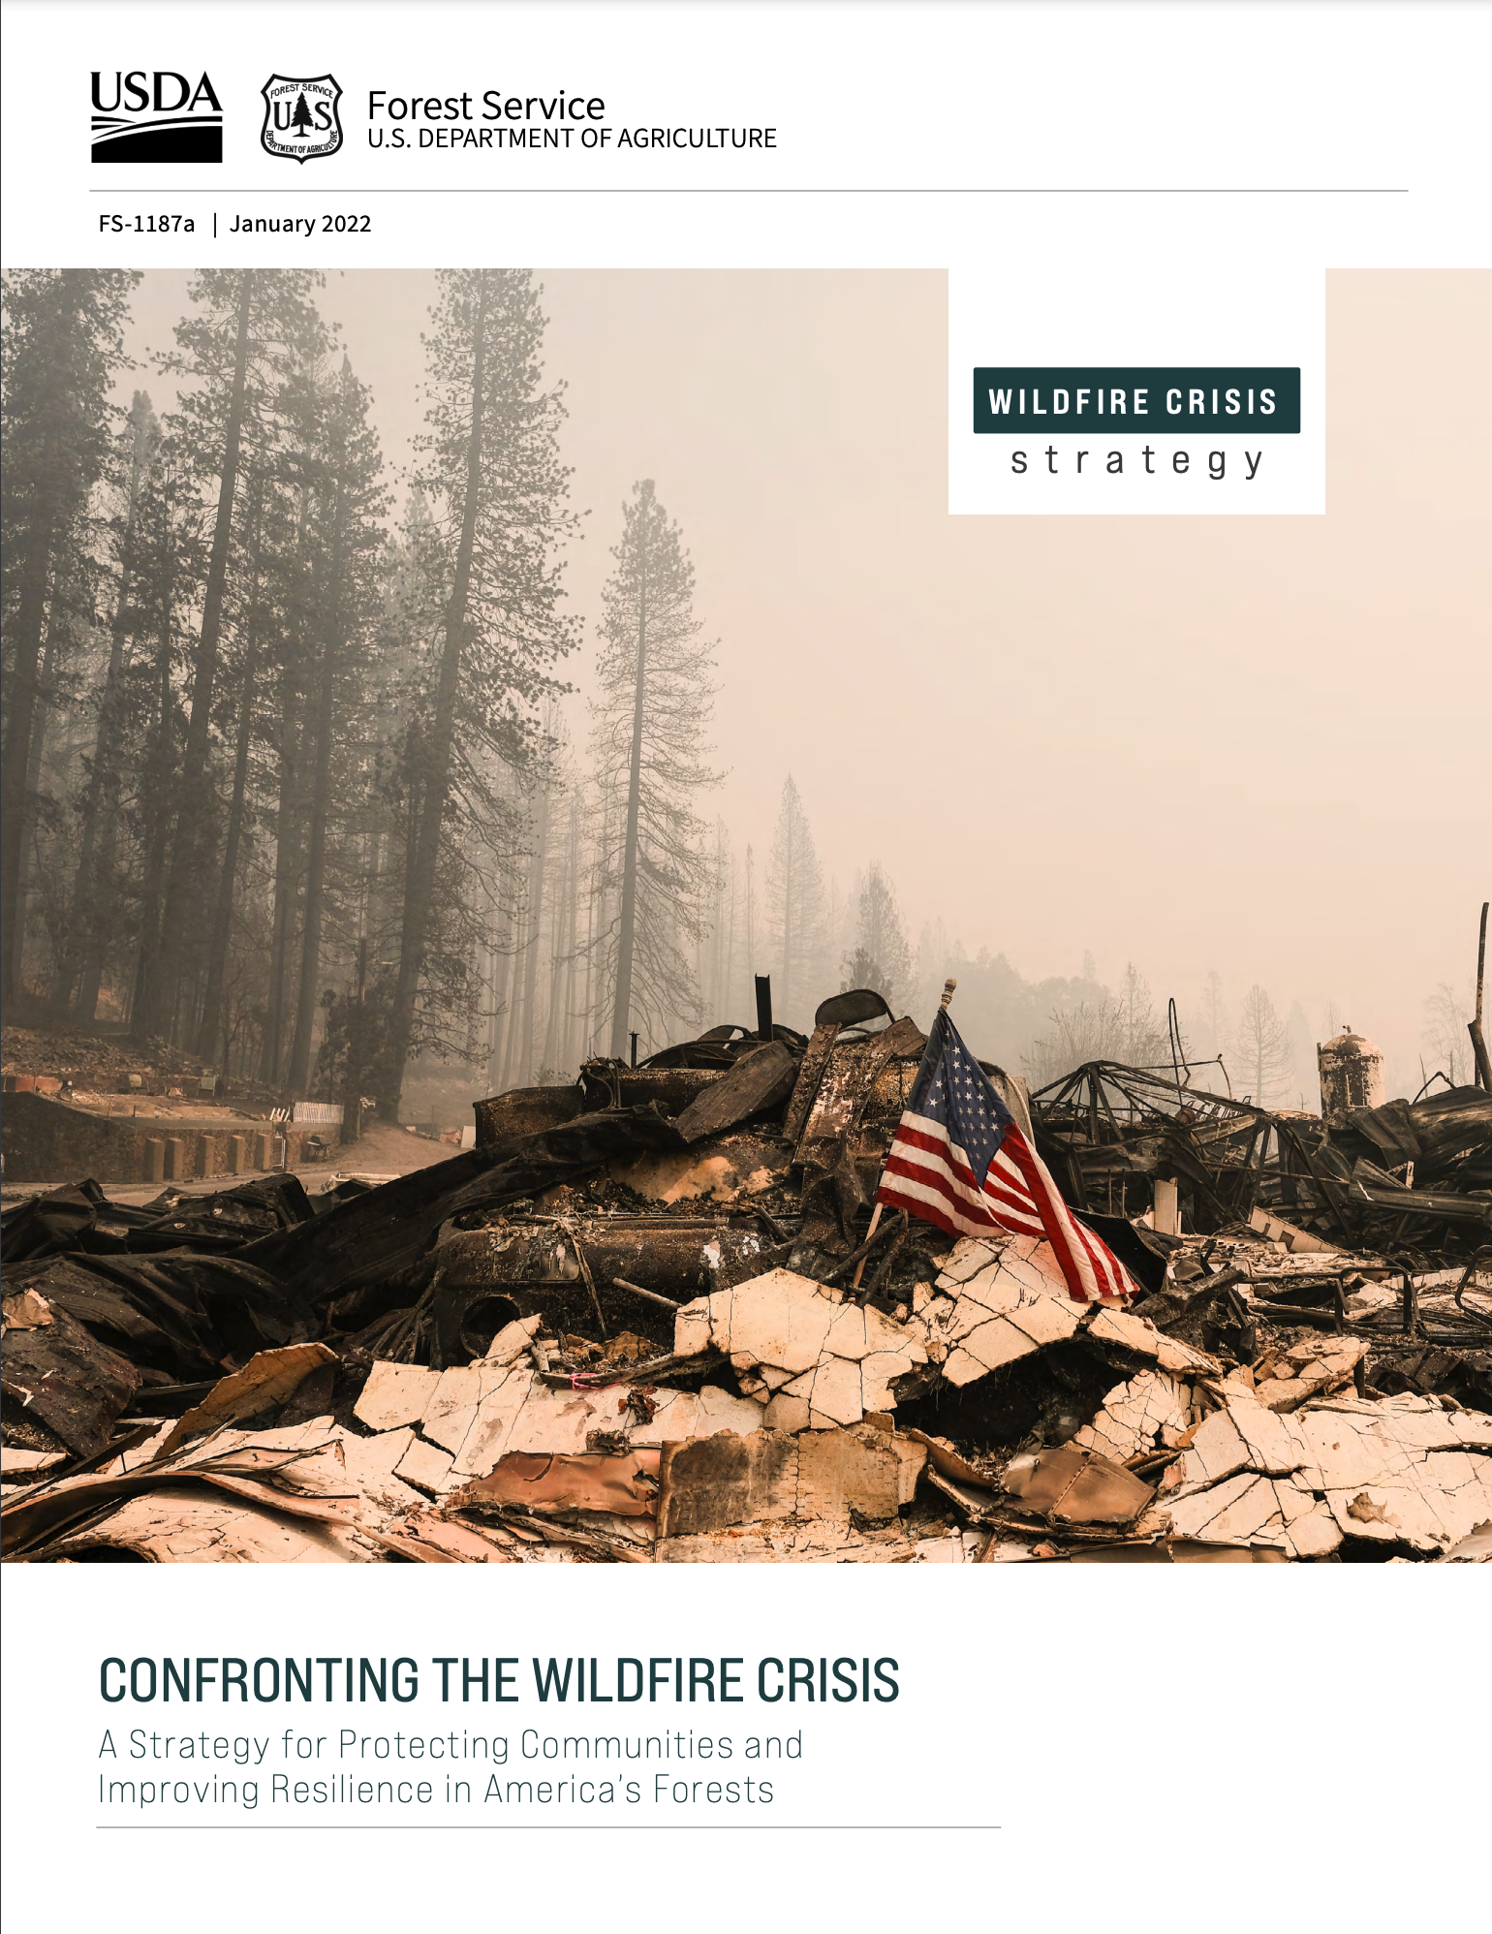
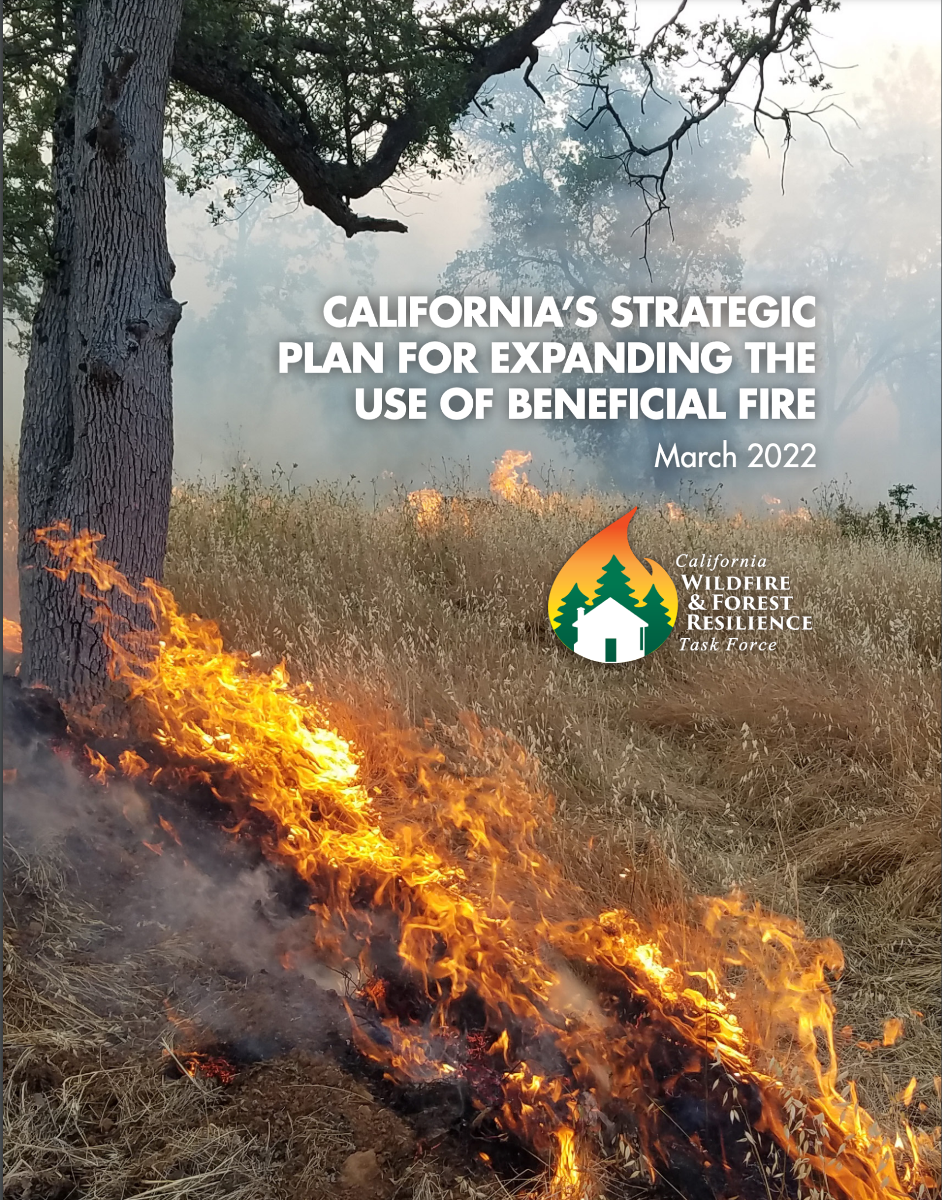
The Challenge
Increase the Pace & Scale of Restoration:
10 yr wildfire crisis strategy
1M acres annually by 2025
Enable collaboration
Notes:
Framing: “This project used science and data the State of CA already has and made it accessible to users”
With support from Google.org Fellows, CNRA is working to help the State of California to reach their goal of treating four times the acreage of forest and wildlands annually – 1 million acres by 2025.
Google.org Fellows have been embedded with CNRA since June 2022 and are currently in the design and build phase of development for the tool (Planscape). This tool will combine the best available science, including climate models, and it will be free and fully open source.
Key attributes of the tool include:
Free and open source, providing transparency on scientific models and data sources to all users
Built to take advantage of the best available science, data and models
Designed to utilize the Regional Resource Kits as the primary data sets intended to support landscape scale evaluation and planning

Slide 14









The Co-operative

Slide 15
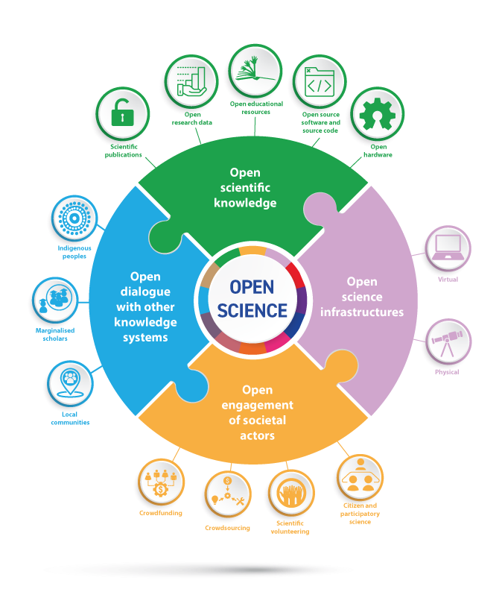
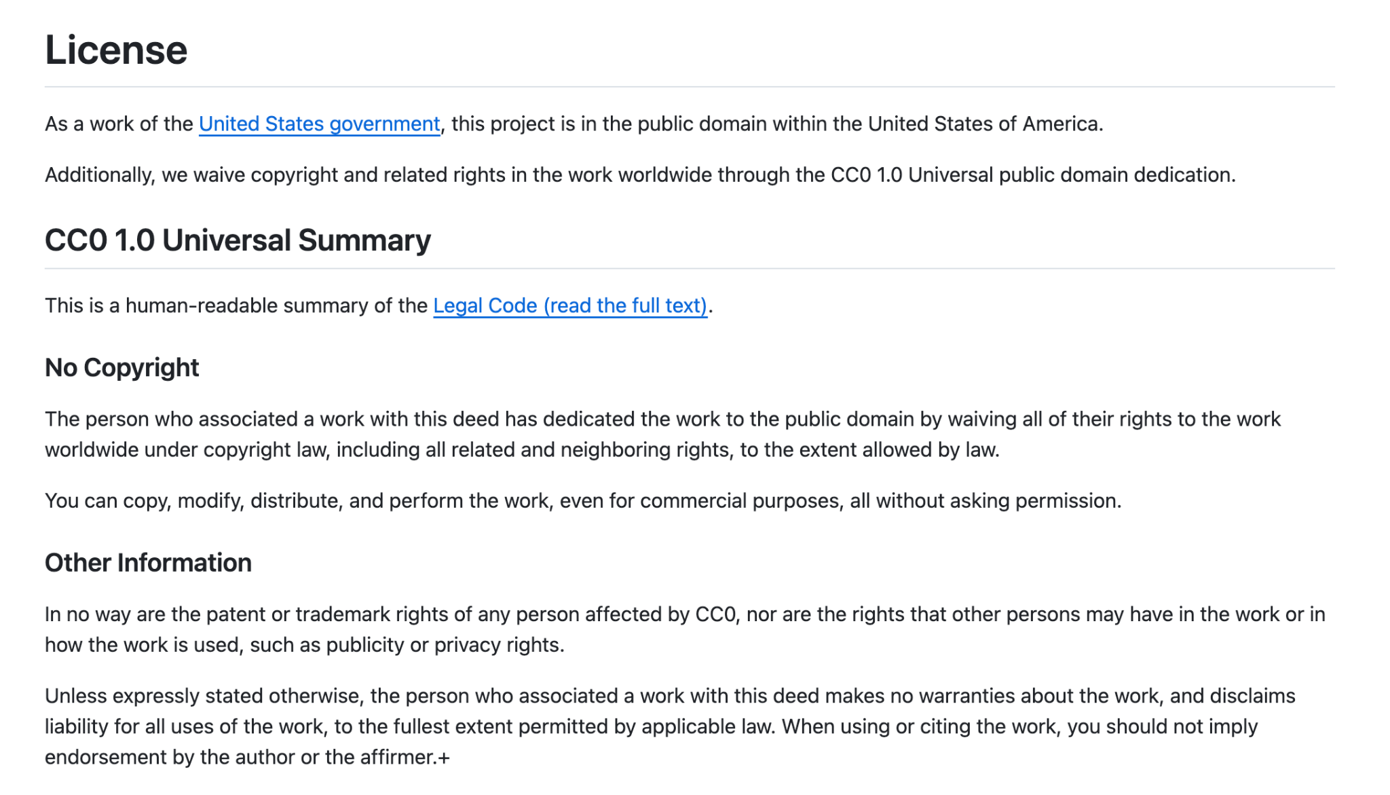
Open Science. Open Source.
https://www.unesco.org/en/open-science
https://github.com/OurPlanscape/Planscape/blob/main/LICENSE.md
Notes:
Open science - 4 quadrants
Open Source - nobody owns
Big tent - we encourage new participation

Slide 16
Five User Journeys & Timelines
Live
Live
Live
Summer 2024
Explore
View data on maps and focus on planning areas
Plan
Generate project areas based on user provided constraints
Collaborate
Share plans and projects with others for commenting, editing
Impact Analysis
Model direct and indirect effects of treatments on the landscape
Integrate
Combine outputs with other sources to enable end-to-end program execution
Notes:
User and product timeline.
Explore - surfacing hundreds of map based data layers in easy to use viewer.
Plan - Plan projects according to the factors that are most important to you
Impact analysis - how will things change?
Collaboration - multiple landowners, stakeholders, interest groups. Transparency.
Exporting - compliance. CEQA/NEPA faster

Slide 17
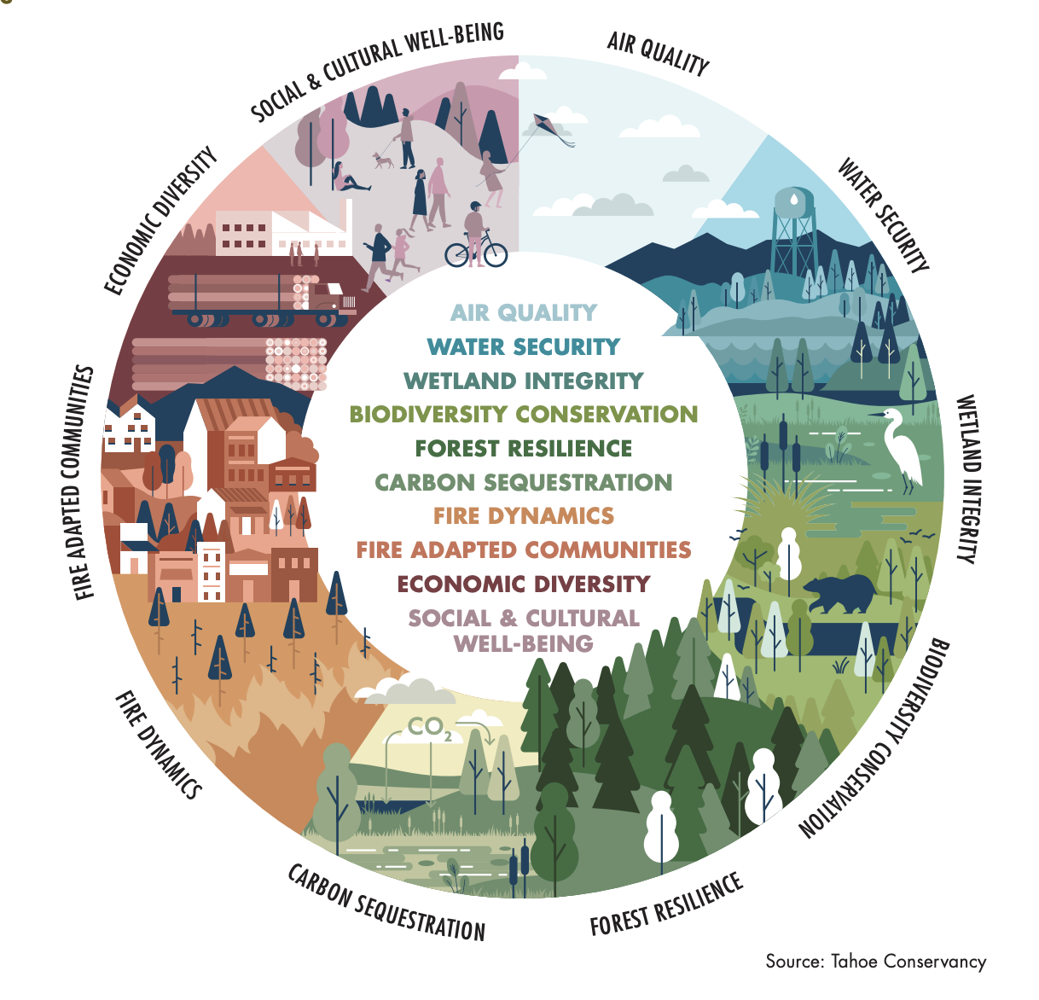
10 Pillars of Resilience

Slide 18

Demo

Slide 19
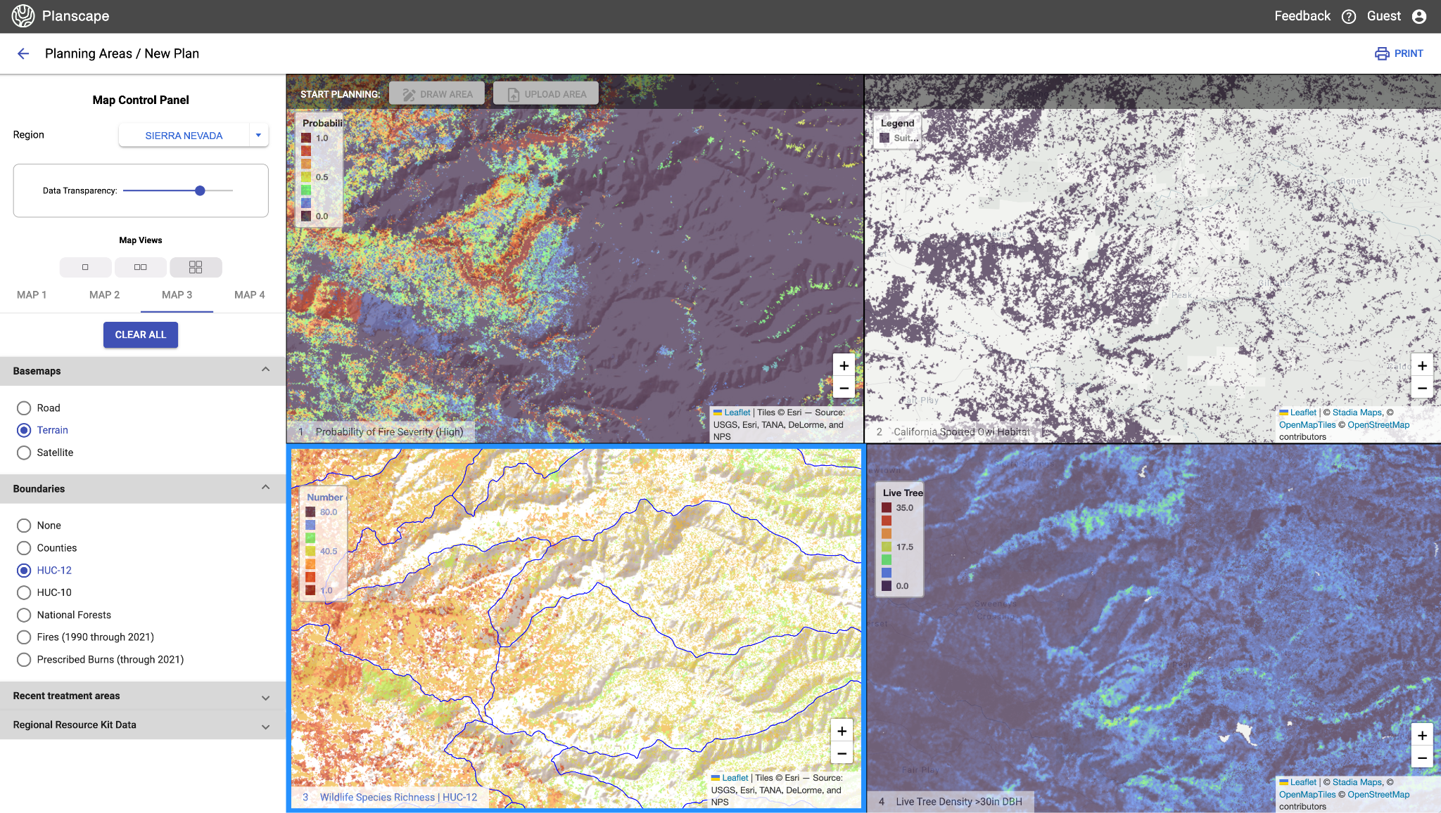
View the best available data & science in one tool
1
Notes:
In order to provide trustworthy guidance, our tool starts with combining the best available data and science in one. We offer a unique multi-map view that allows users to visualize data layers side-by-side to help access the conditions of their landscapes. The map panel includes various boundaries, existing project data and condition scores for each region.

Slide 20
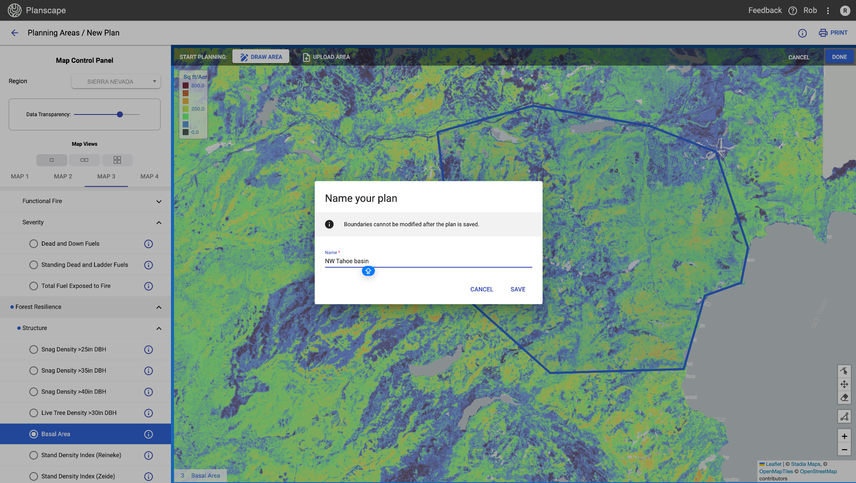

2
Define the area you want to plan within
Notes:
After assessing the landscape, users can define a general area to plan within. This planning area only evaluates conditions within drawn or uploaded boundary polygons.

Slide 21
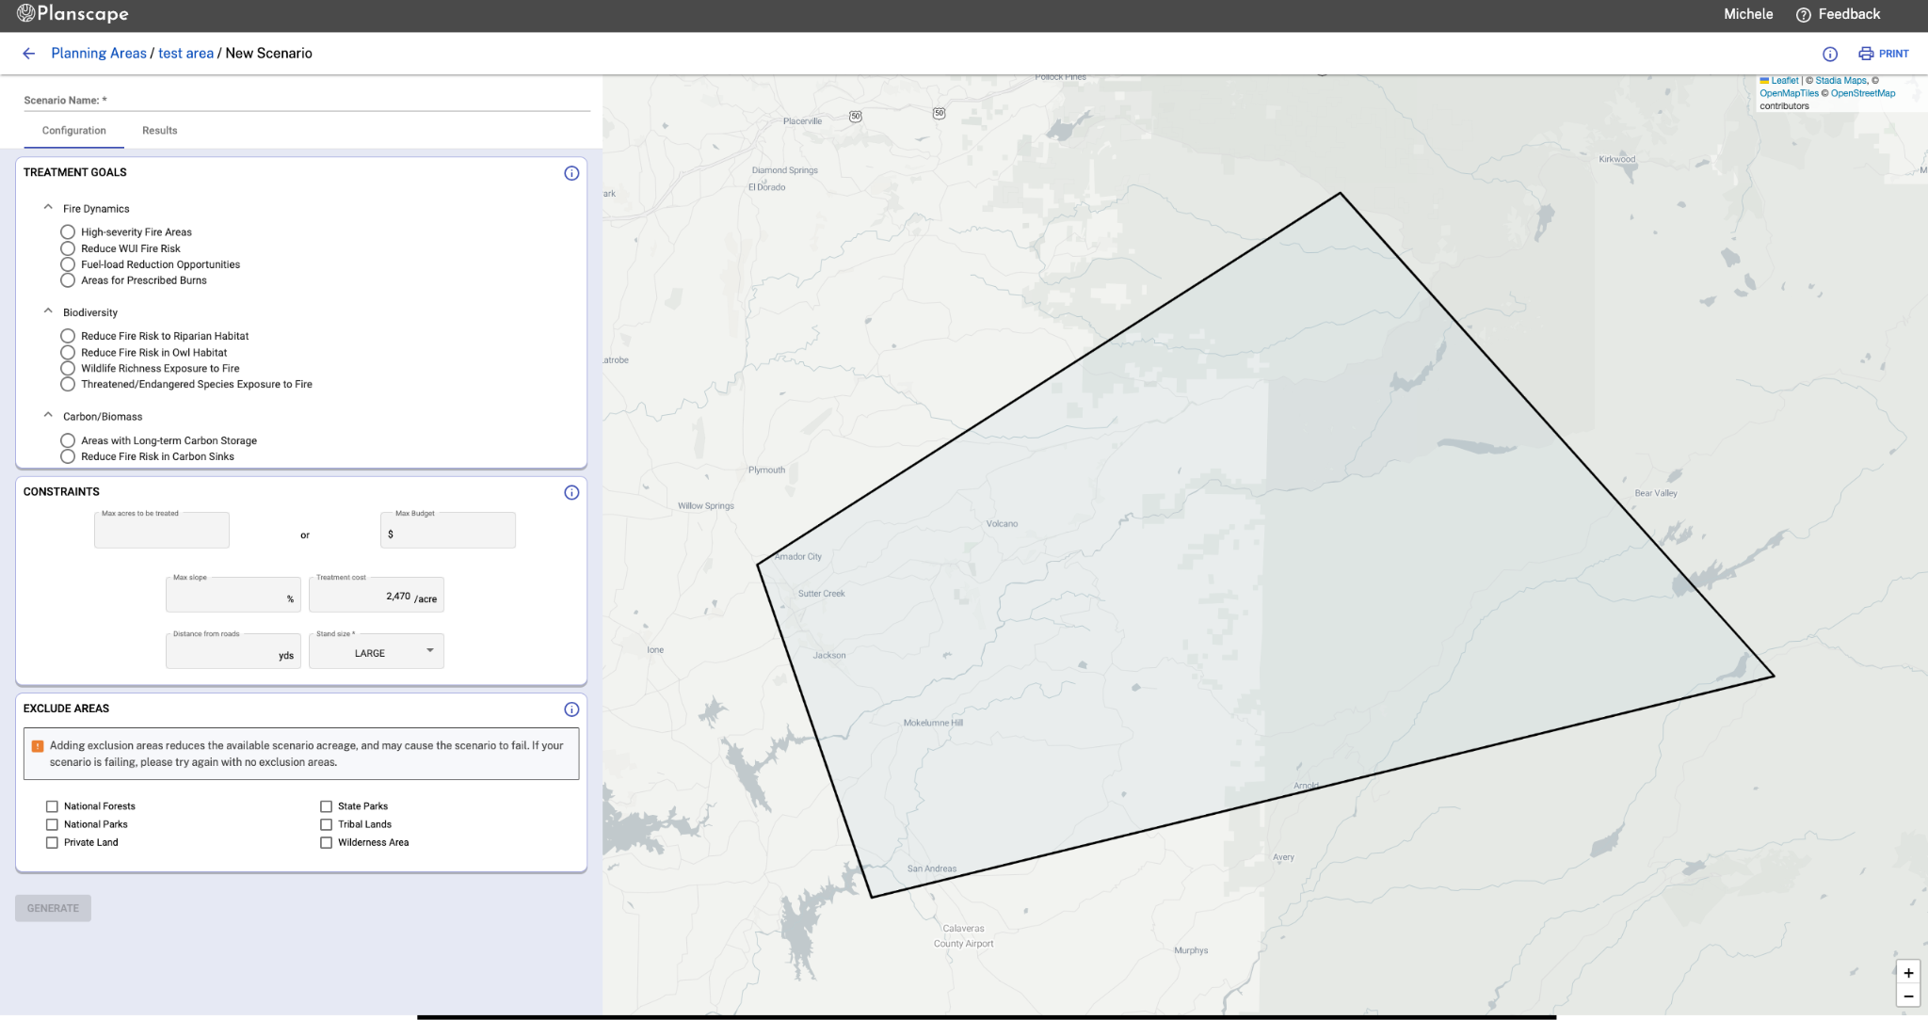
3
Configure scenarios
Notes:
In order to identify project areas, the user will first begin configuring scenarios based on their treatment objectives. For our MVP, we’ve simplified scenario planning. The user can choose from a number of predefined questions to ensure that valid priority variables are being used. These questions center around Forest Resilience, Biodiversity and Carbon/Biomass. The Biodiversity questions are focused on how to best protect sensitive species, or stands with high species richness. Carbon/Biomass center around maximizing carbon in selected stands. These questions will vary depending on the region of the state that is selected. The user can then identify constraints and exclusions, and generate the project areas.

Slide 22
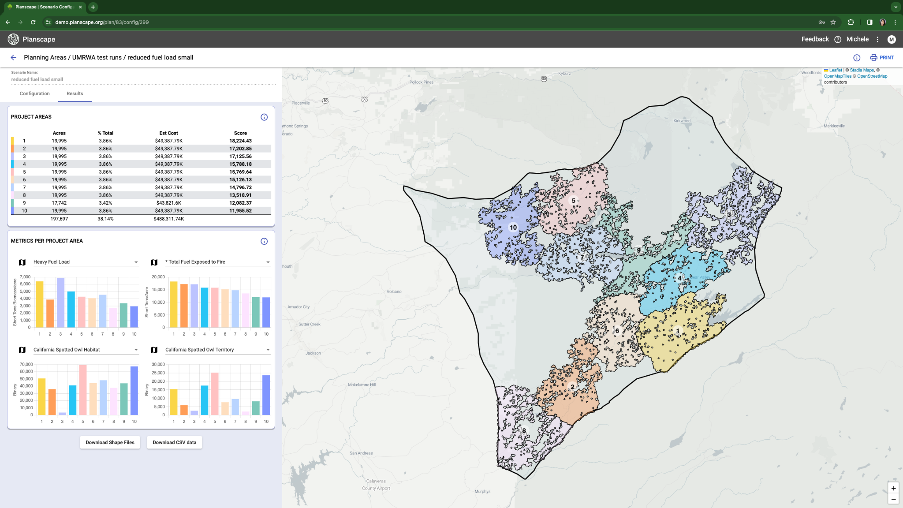
4
View
Outcomes
Notes:
Here you can select the base layer tied to the metric, in this case “Dead and Down Fuels” and see the project areas overlaid on that layer.

Slide 23
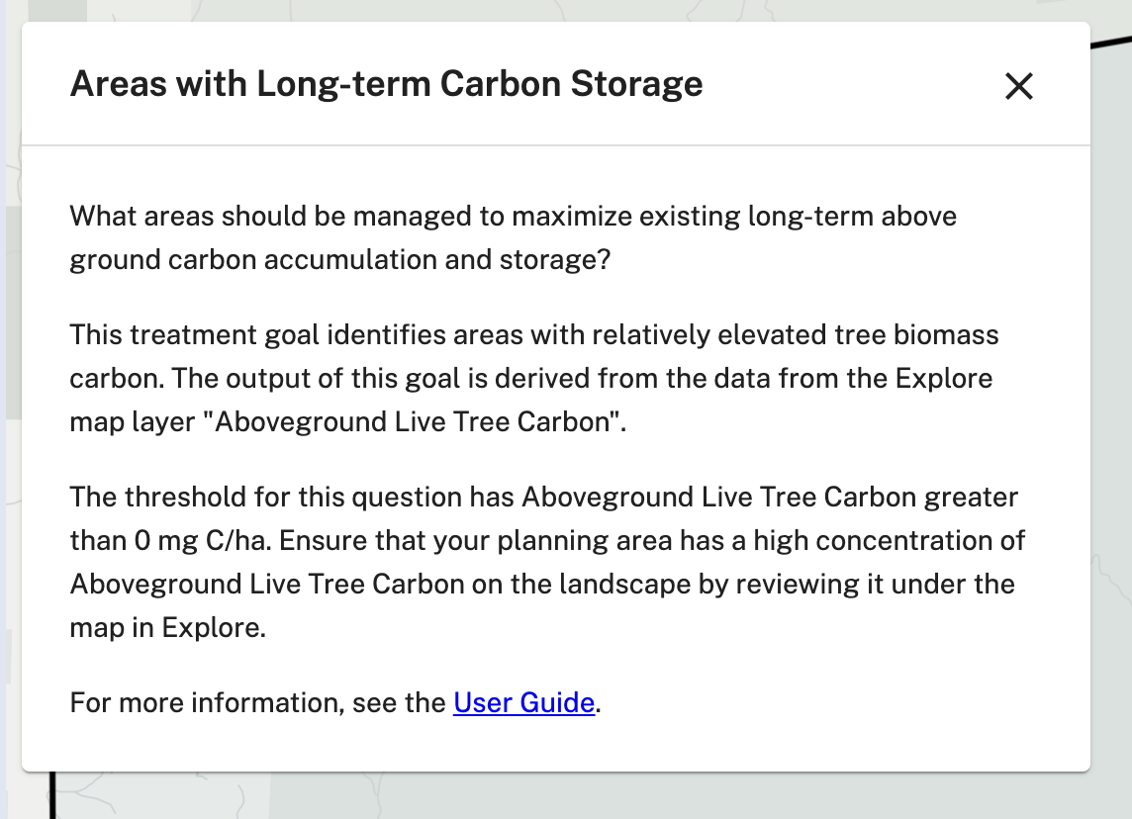
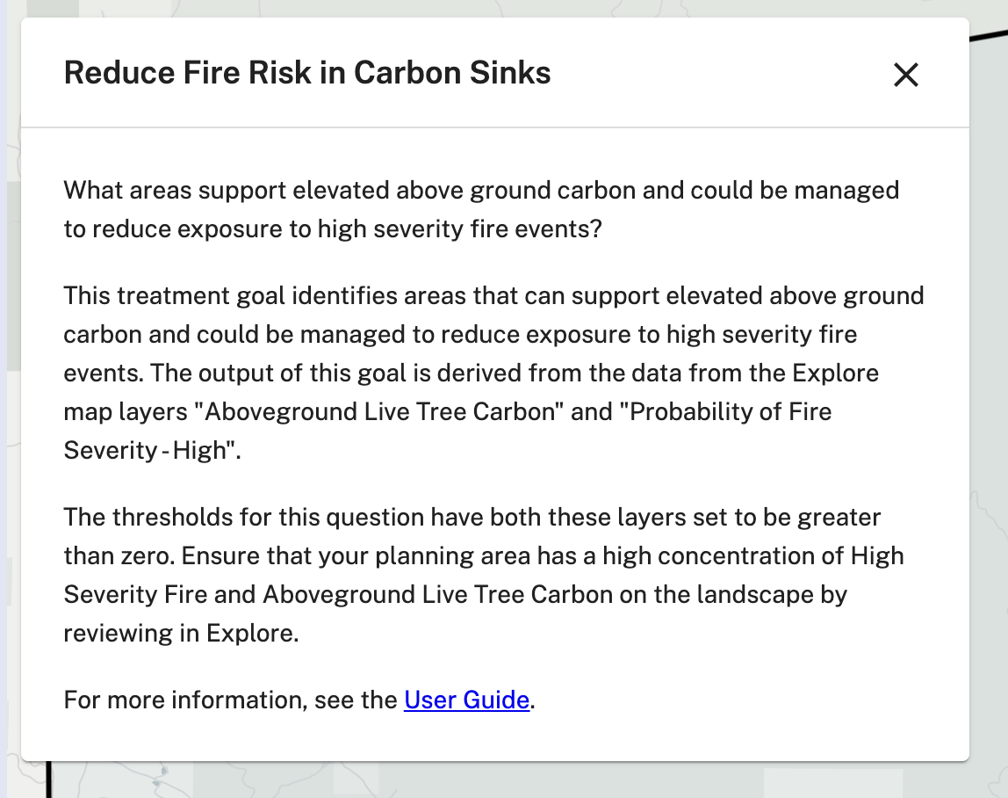
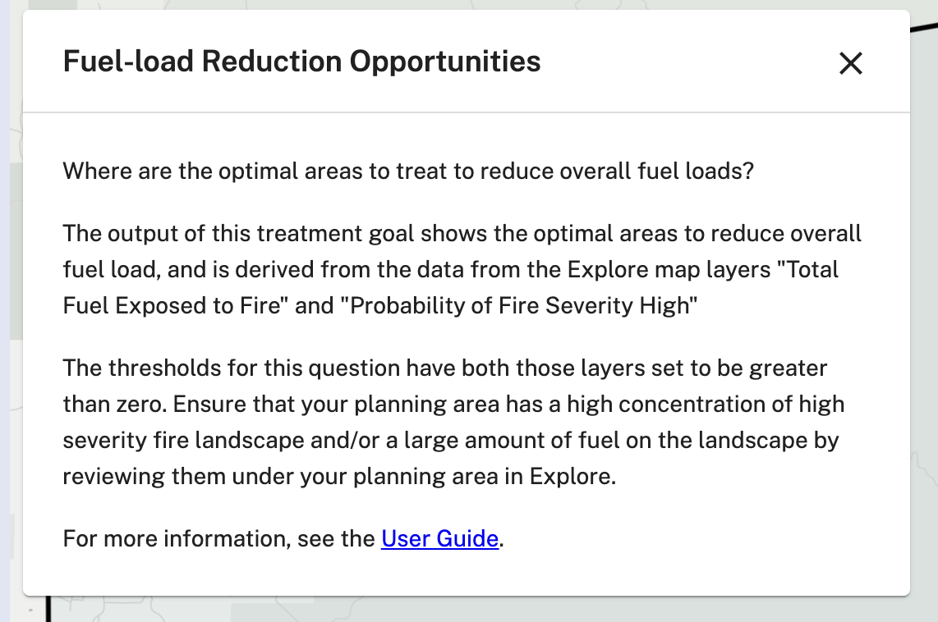

Slide 24
What makes it unique
Open source and free to users
Builds on existing science and tools
Governed by Federal & State partnership
Focus on landscape scale solutions for regional planners
Flexible to extend to other areas and add new data layers over time
Incorporates climate change constraints
Collaboration and sharing capabilities

Slide 25


app.planscape.org
rlawson@sig-gis.com

Slide 26
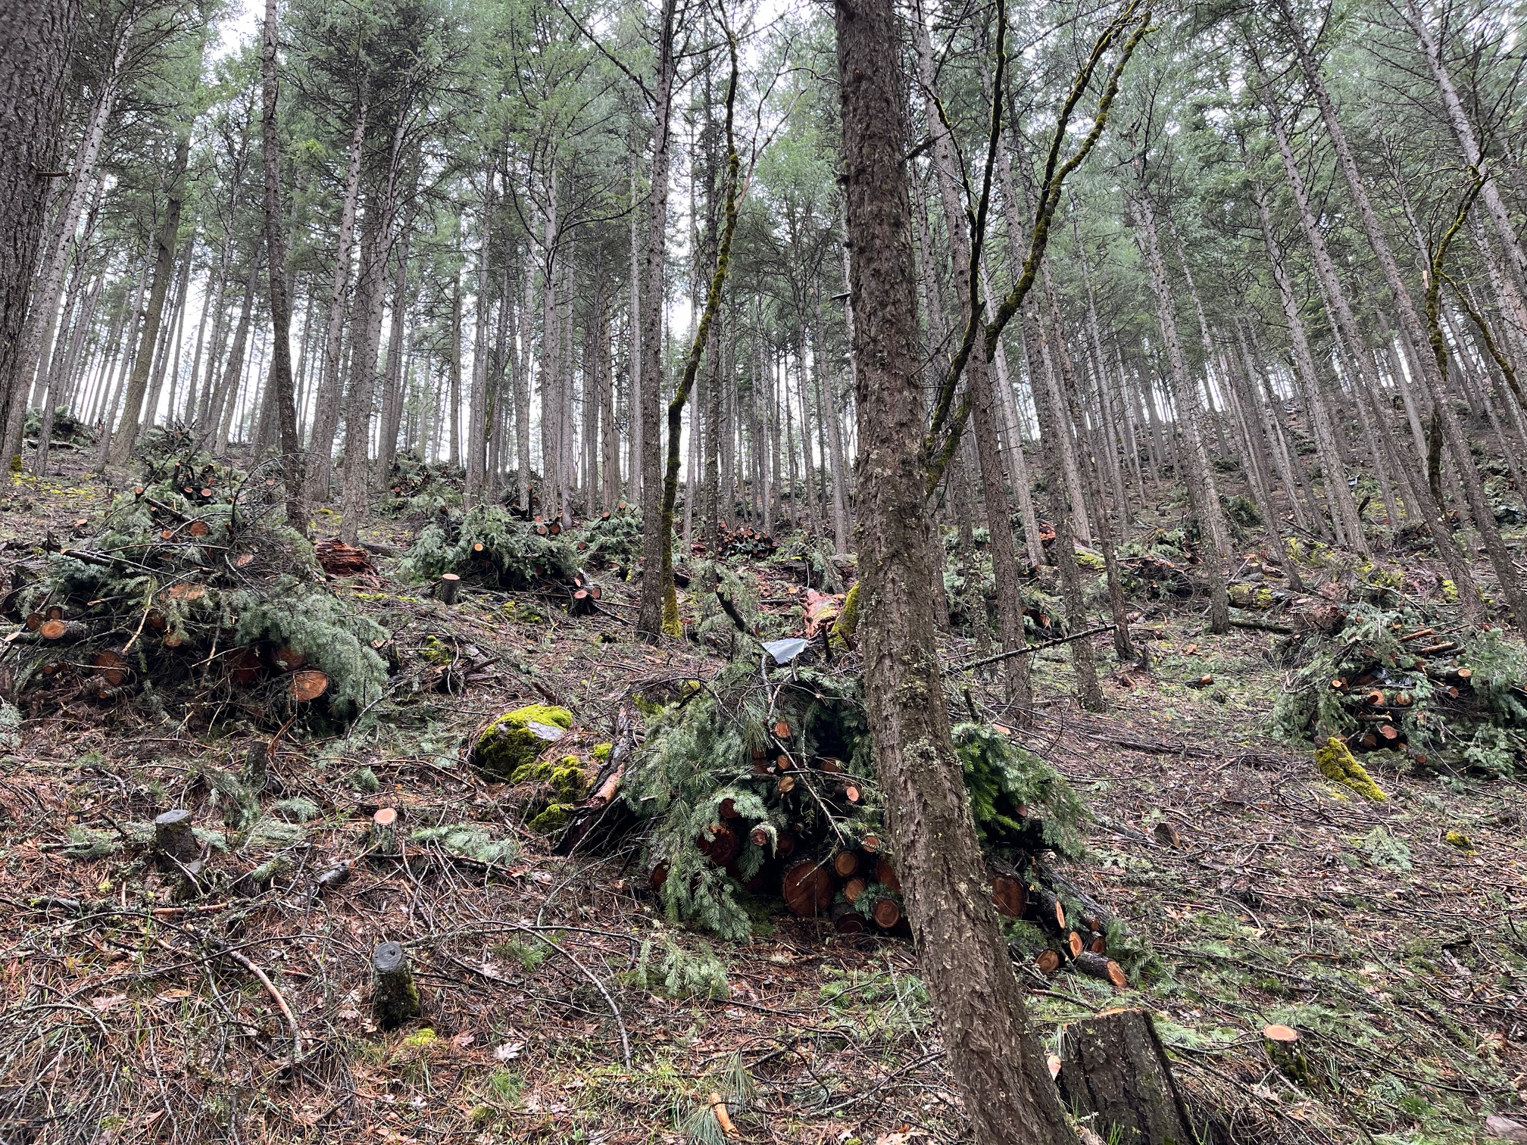
Moving Beyond Biomass Supply Studies
Camille Swezy
Mule Ears Consulting
June 26, 2024

Slide 27
Recap:
There are many publicly available tools and studies to quantify biomass and identify priority projects.

Slide 28
Why do we do biomass feedstock studies?
To de-risk project for investors, banks, community members
Can give a broad overview of how active timber industry is in the area
Can be grouped together with feasibility of available sites

Slide 29
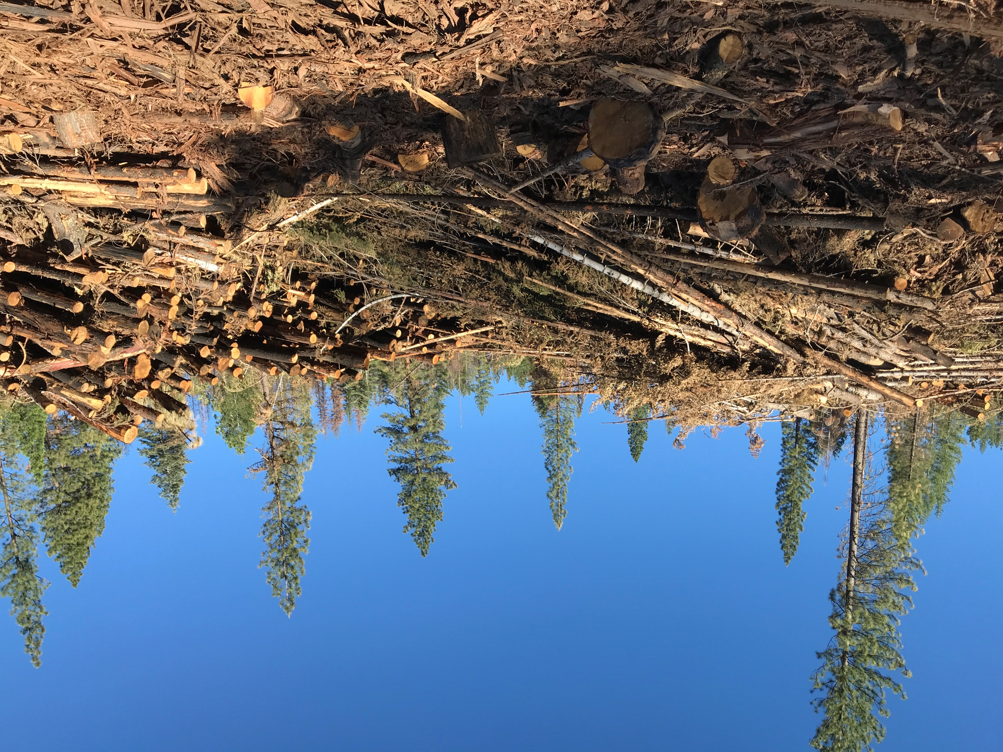
What are other regionally-specific considerations to focus on instead?
(for biomass facility development in Sierra-Cascade region)

Slide 30
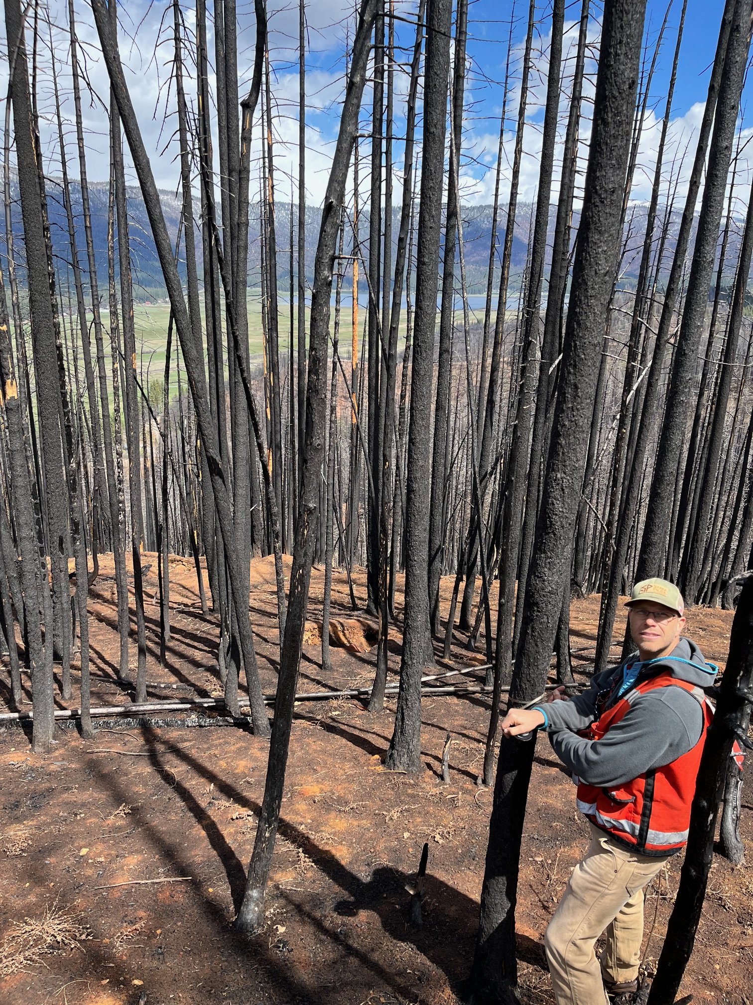
Forest Management Activity – Will Biomass Be Made Available?
USFS capacity, planned projects, partnerships
Other forest landowners
  Private timber
  Nonindustrial private, RCD projects
Activity levels without grant funding

Slide 31
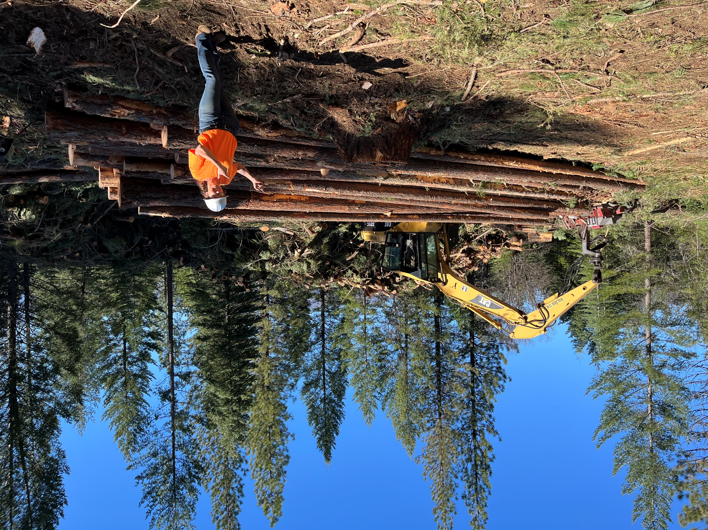
Local Logger Capacity
# of active LTOs in area
Types of typical logging jobs (e.g., timber harvesting vs mastication)
Are LTOs limited by biomass disposal options?
Estimated delivered biomass prices
LTO willingness to commit to supply contracts

Slide 32
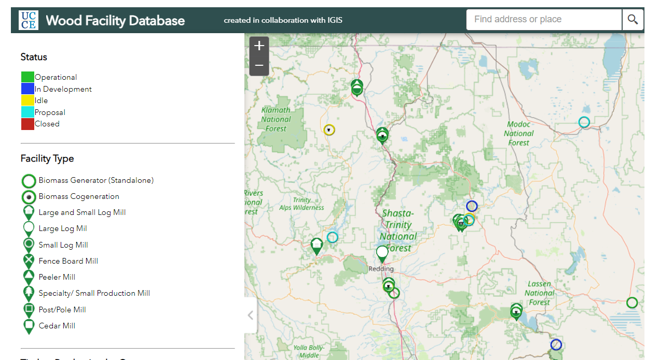
Existing Markets and Prices

Slide 33
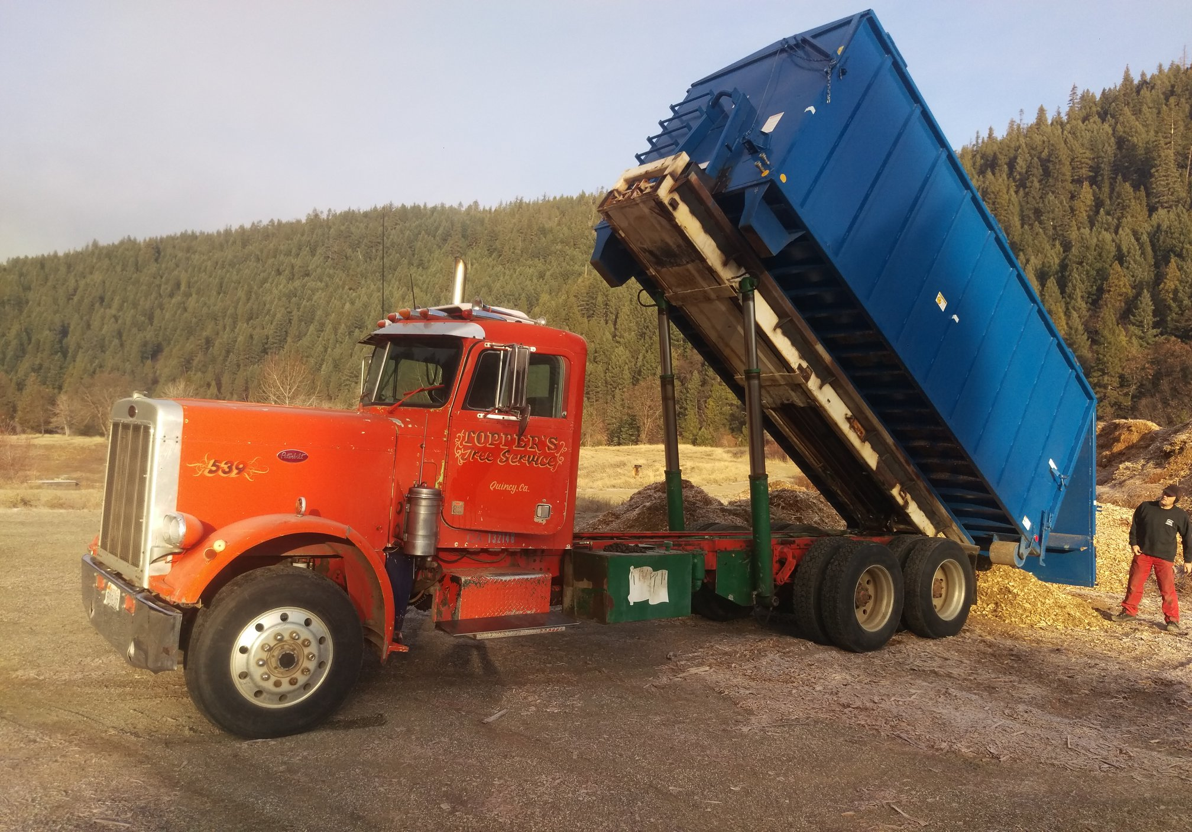
Biomass Handling, Storage, Hauling
Is the facility designed and scaled correctly to work with infrastructure available locally?
Winter storage considerations
Photo credit: Wisewood Energy

Slide 34
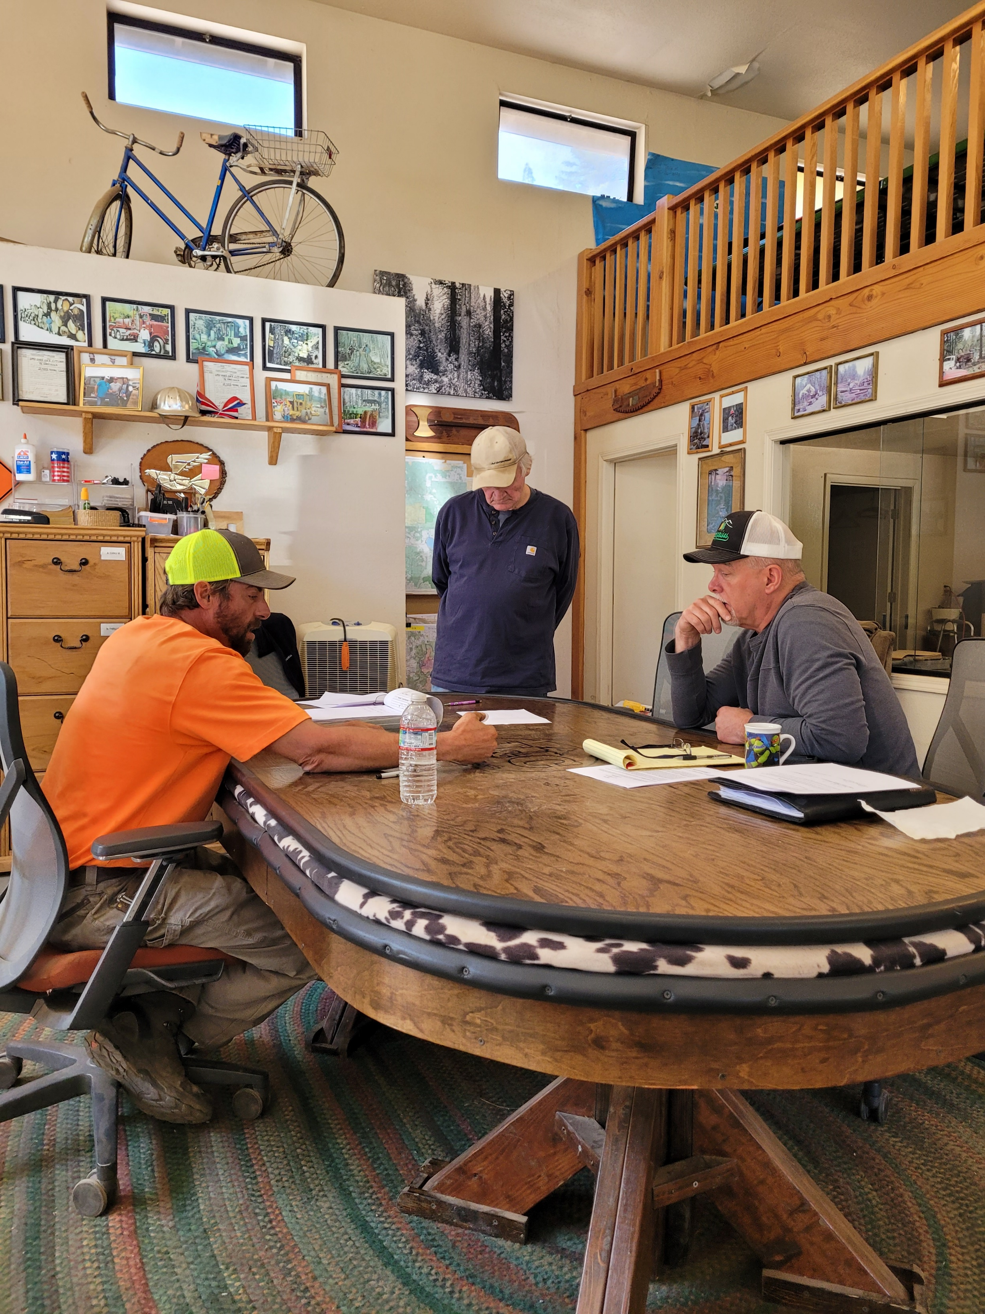
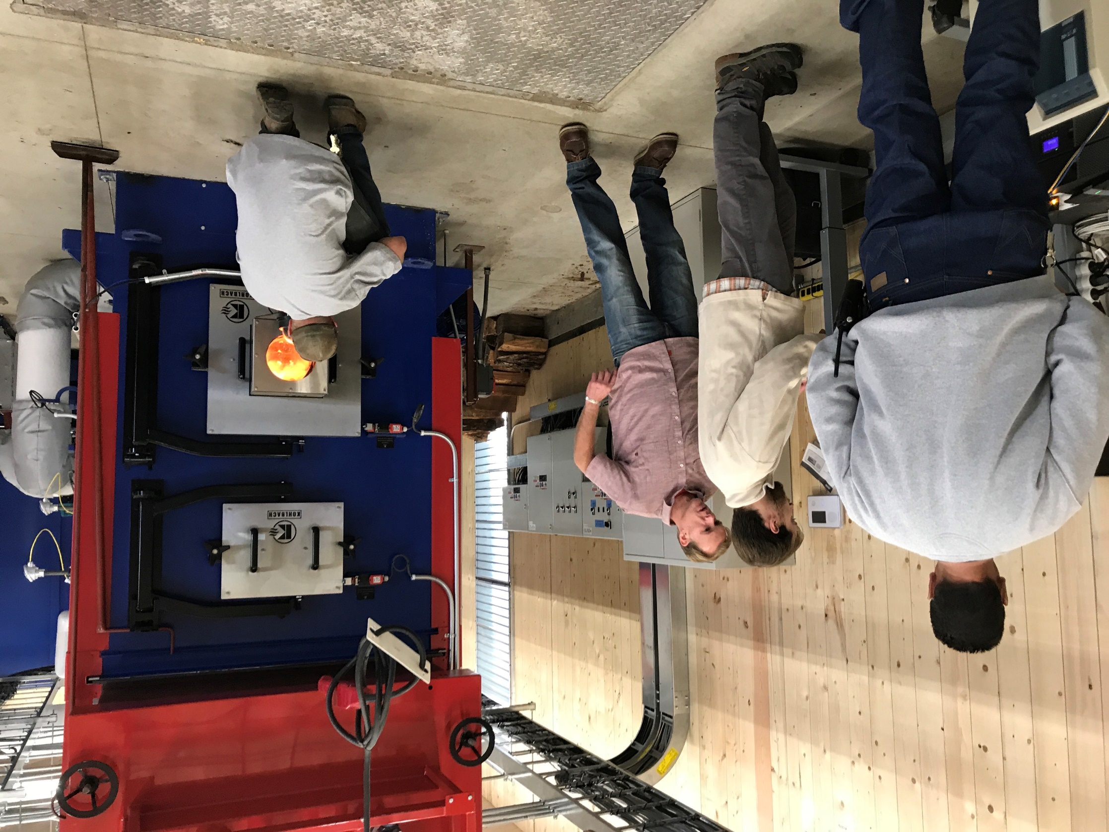
Is there someone who will manage/run the operation long term?

Slide 35
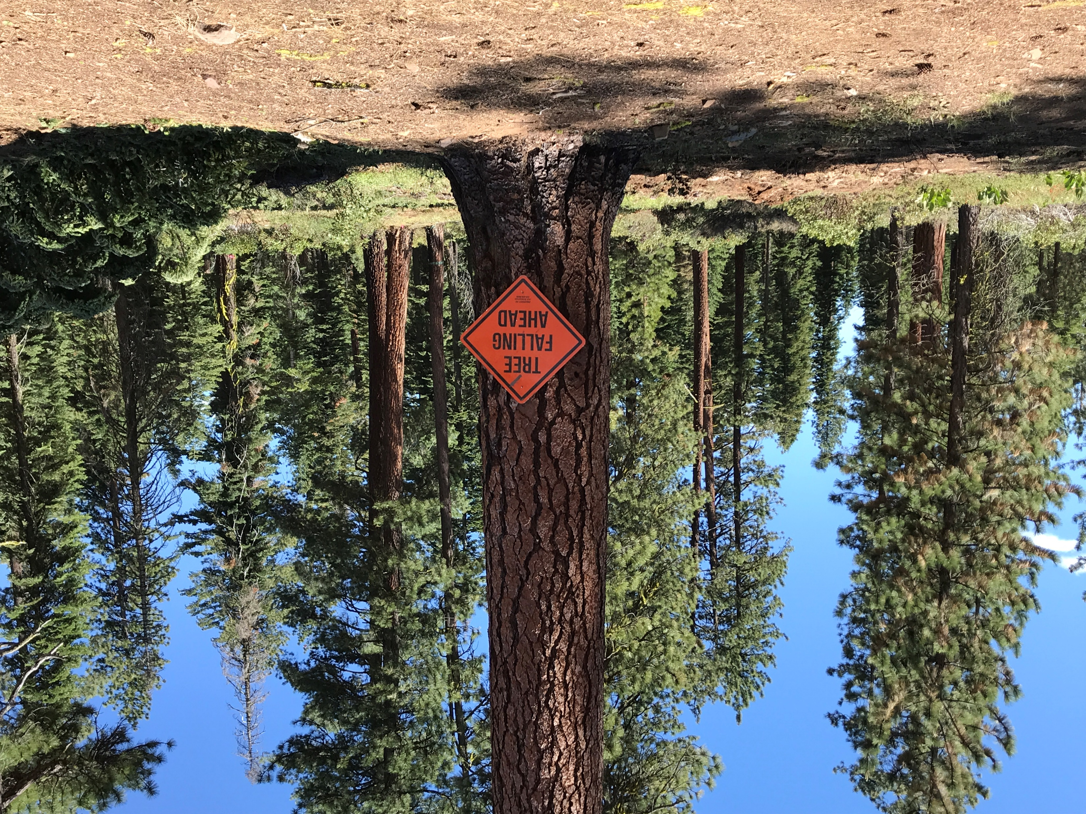
Concluding Thoughts
There is more risk in these other details than amount of biomass supply on the stump.
The tools exist –but investment in landscape and commitment by forest managers to offer projects is critical.
Ensure the facility is right fit for the adjacent landscape!

Slide 36
Thank you!
Camille Swezy
Mule Ears Consulting LLC
camilleswezy@gmail.com
(415) 302-4547

