Slide 1
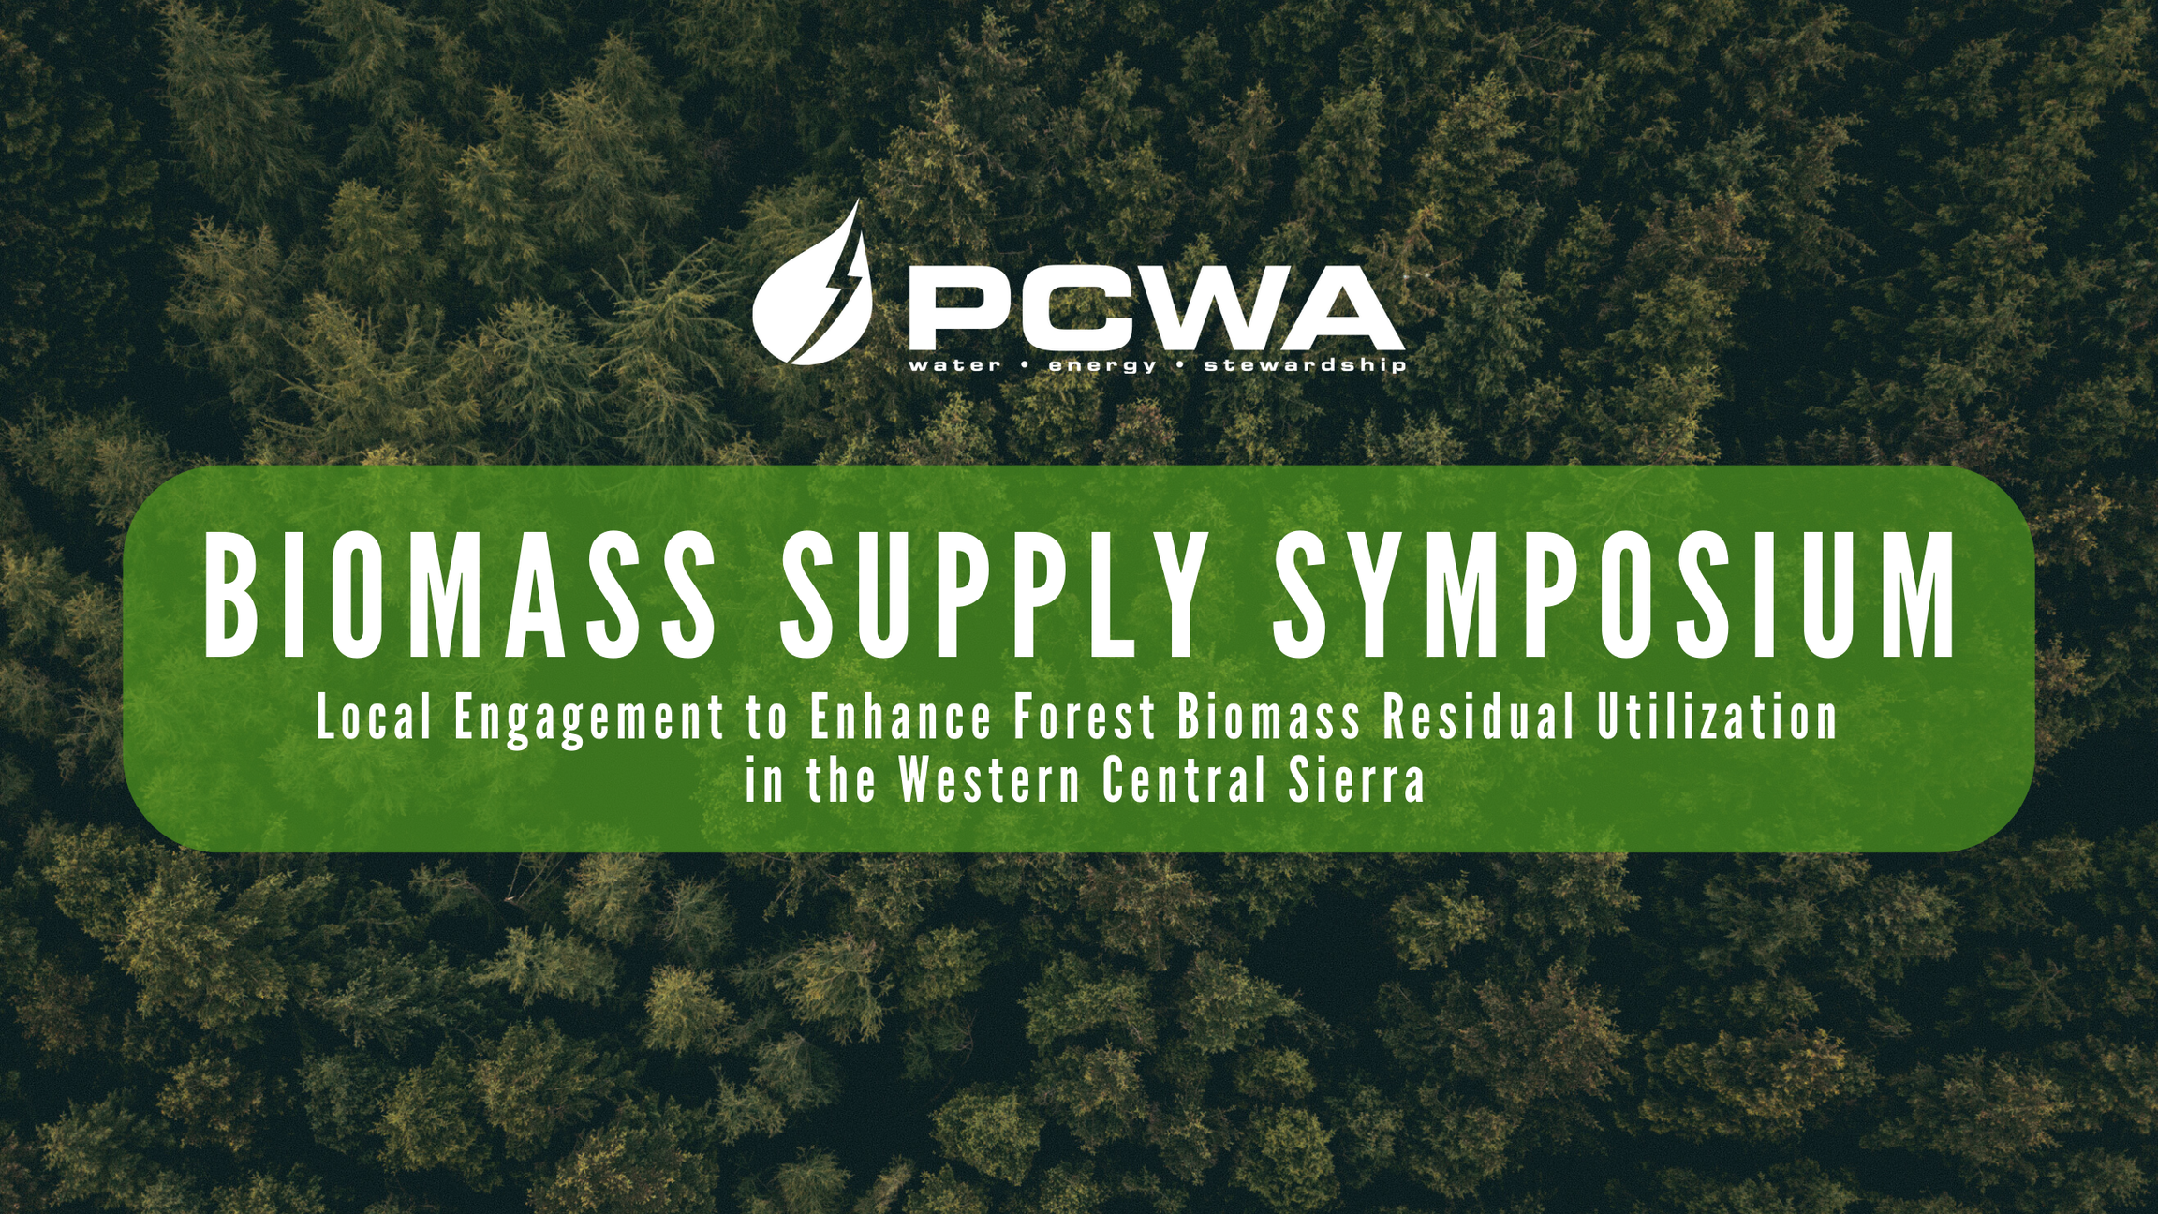
“Cal FRAME and other State Agency Involvement”

Slide 2



CAL FRAME
California Forest Residual Aggregation and Market Enhancement
The Office of Planning and Research
TAHOE CENTRAL SIERRA Region PILOT project

Slide 3
Project Team
Name
Affiliation
Role
Tony Firenzi
Kerri Timmer
Regine Miller
Christiana Darlington
Camille Swezy
Karen Quidachay
Catherine Silvester
Tom Johnson
Amy Lapin
PCWA
Placer County
Headwaters Environmental
CLERE Inc.
Mule Ears
Landmark Environmental Inc.
Landmark Environmental Inc.
Thomas R Johnson LLC
Economic & Planning Systems Inc.
Principal Investigator
Project Manager
Contracted Project Manger
Legal Counsel
Project Assistant
Technical Writer/Permitting Specialist
Environmental Planner
Power Consultant
Economic Consultant
Notes:
Kerri

Slide 4
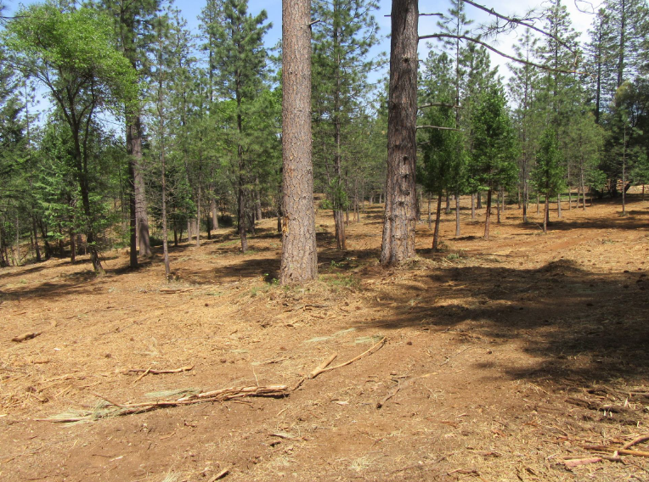
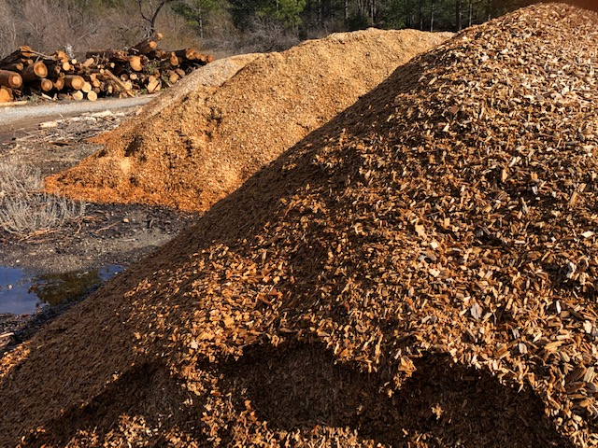
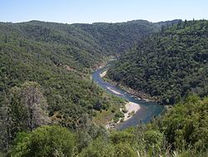
Project Vision
To find pathways, that may include the creation of a public entity, to ensure feedstock supply chain logistics for locally gathered biomass from public and private lands, utility and transportation corridors, and forest thinning projects, and to advance utilization in an environmentally sustainable way that supports a circular forest economy.

Slide 5
Project Scope
Engage stakeholders to understand current challenges and future opportunities to increase biomass removal and utilization
Evaluate the feasibility of a community-scale bioenergy facility at Ophir, including the likely sources of biomass
Assess existing and potential future roles of water agencies in forest health, feedstock supply and biomass utilization
Evaluate potential legal entities, and their possible funding mechanisms, that could hold long-term feedstock contracts with forest landowners and facilities
Notes:
Set of collaborative recommendations for a possible public regional entity and its core services, and understand possible interest in participating in biomass market development

Slide 6
Presentation
Outline
Panel 1
  Community Collaboration
  Biomass Availability
  Biomass to Energy Facility Case Study
Panel 2
  Water Agency Role in Forest Health
  Legal Entity Review
  JPA Funding Mechanisms
Notes:
Kerri

Slide 7
Community Collaboration Report
Presented by kerri timmer, placer county regional forest health coordinator

Slide 8
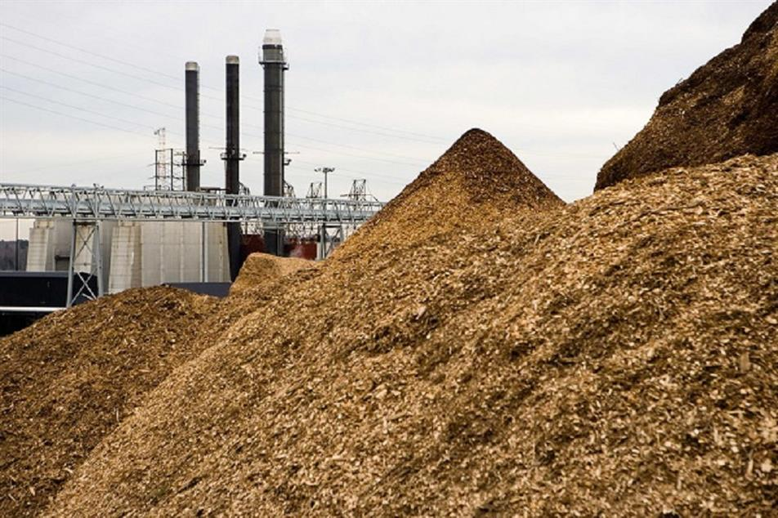
Community Collaboration Report
Purpose of the Study
  Implement Action Plan measure
  Address feedstock barriers
  Assess potential benefits of biomass aggregation
Key Objectives
  Understand the volatility & risks
  Manage biomass feedstock more efficiently
  Inform Stakeholders
Project Area
  Placer, Nevada, & El Dorado Counties

Slide 9

Study Methods
Study Activities
  Document review
  Stakeholder engagement
  Interviews
  Expert review
Approach
  Review of key documents
  Stakeholder engagement
  Practitioner interviews
Outcome
  Foundational data & insights to inform recommendations

Slide 10
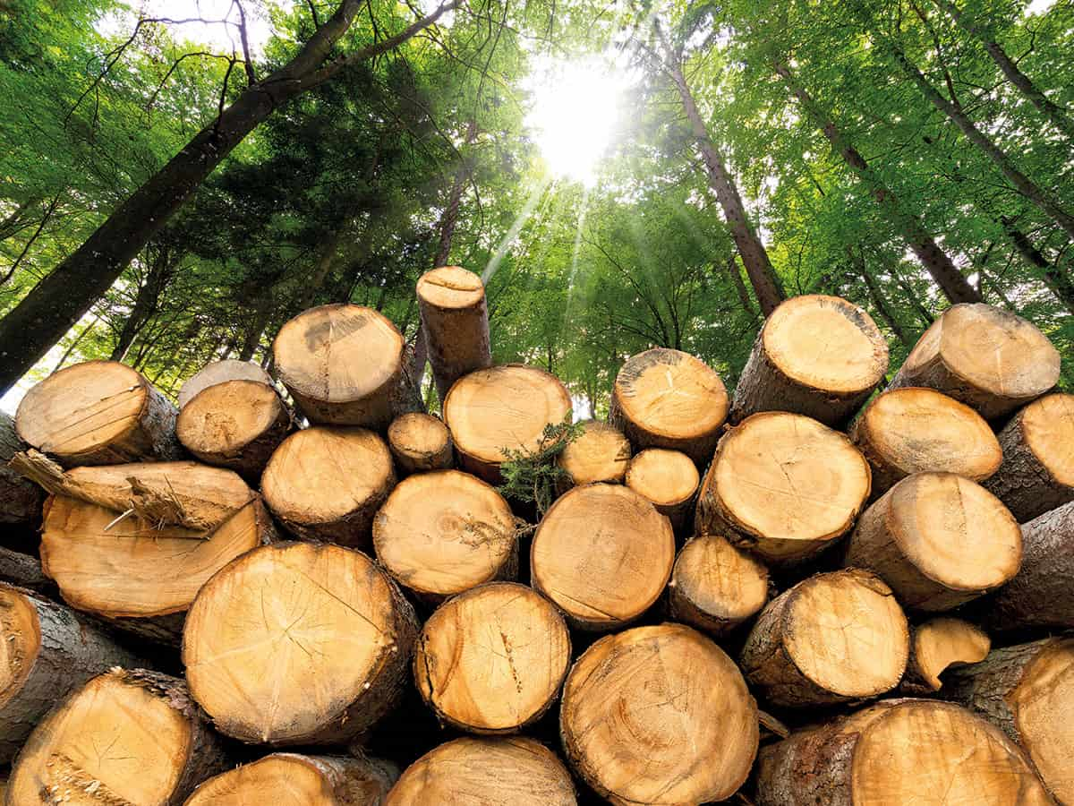
Results/Key Findings
Issues, Challenges, and Opportunities
Issues/Challenges
  Too few biomass facilities
  Material removal/sale price gap
  Vendor capacity limitations
  Lack of coordination
  Negative perception of biomass
Opportunities
  Aggregation hub/services
  Facility & technology development
  Workforce development
  Coordination & efficiency
“We’re good at making biomass but not so good at disposing of it.”

Slide 11

Functions and Benefits of a Biomass Aggregation Hub
Core Functions
  Biomass broker – manage long-term contracts between suppliers & buyers
  Biomass owner – own & control biomass materials
  Risk management – offer indemnification/liability/business interruption insurance

Slide 12

Geographic Focus and Support Services
Geographic Focus
    Initial focus
    Potential expansion
  Support Services
    Environmental review/permitting
    Grant pursuit & administration
    Green waste management
Future Considerations
    Workforce training & development
    Subsidy programs
    Public outreach & education

Slide 13
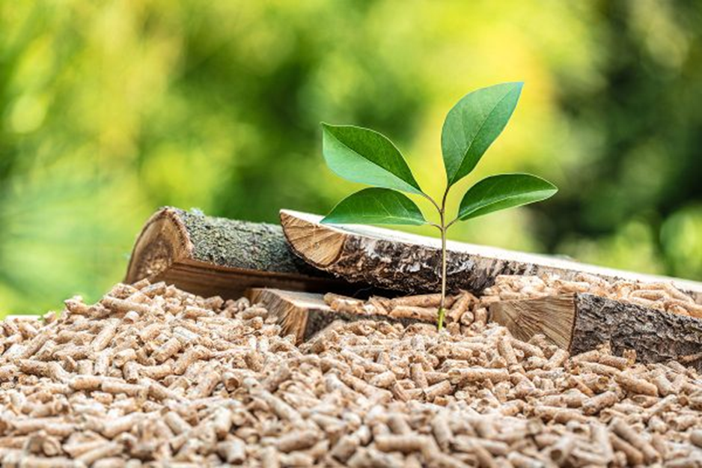
Future Work and Recommendations
Establishment of biomass aggregation hub
Geographic focus & membership
Pilot programs
Advocacy & policy implementation
Financial strategies
Public outreach & education

Slide 14
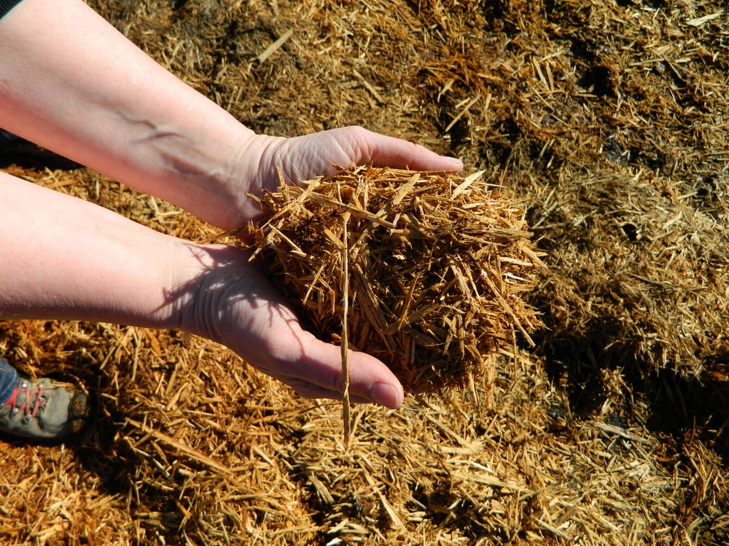
Conclusion/Next Steps
Stakeholder engagement
Detailed model/financing analyses
Pilot program implementation
Policy advocacy
Financial considerations
Public outreach

Slide 15
Biomass Supply Report
(Ophir Case Study)
Summary of Findings and Recommendations
Presented by Camille Swezy, clere inc.

Slide 16

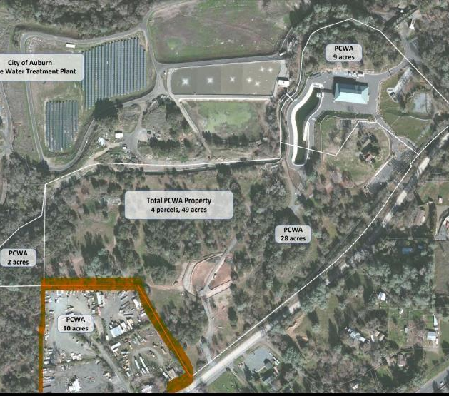




Arbor Energy Facility – Ophir, CA
3 MW to be exported to grid
5 MW for on-site uses
35,000 BDT of biomass per year

Slide 17
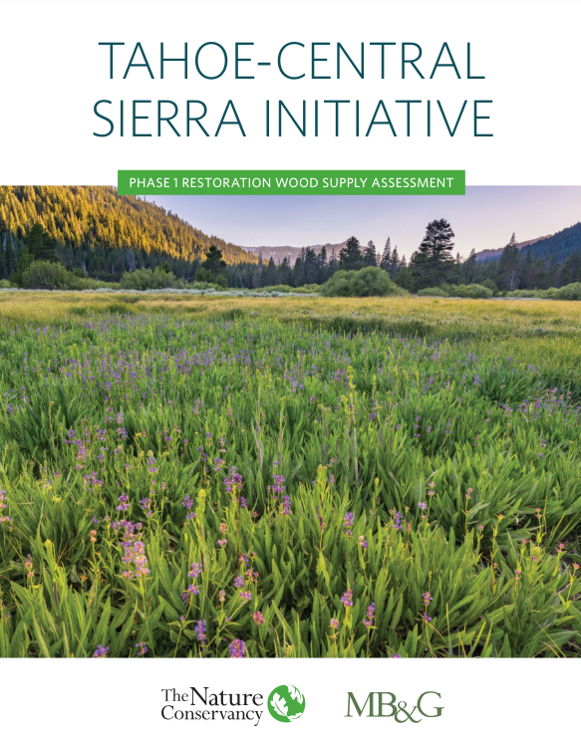
TCSI Landscape:
610,000 acres over 20 years = 320,000 BDT per year
Notes:
This will overwhelm existing regional wood processing infrastructure.

Slide 18
Timber Harvesting is Relatively Active in TCS Region
Average Annual Volumes of Timber/Biomass in TCS Region (2016 – 2022)
Annual Volume of Timber Harvested | 115,915 MBF
Annual Biomass Generated (from timber harvests – likely consumed by Rio Bravo etc) | ~104,323.5 BDT
Source: CA Department of Tax and Fee Administration
Notes:
TSS consultants value of 0.9 BDT per MBF
Biomass value may not include biomass thinning
This is likely already consumed by existing facilities (rio bravo uses ~100k bdt per year from forest)
Shows that workforce exists and is capable

Slide 19
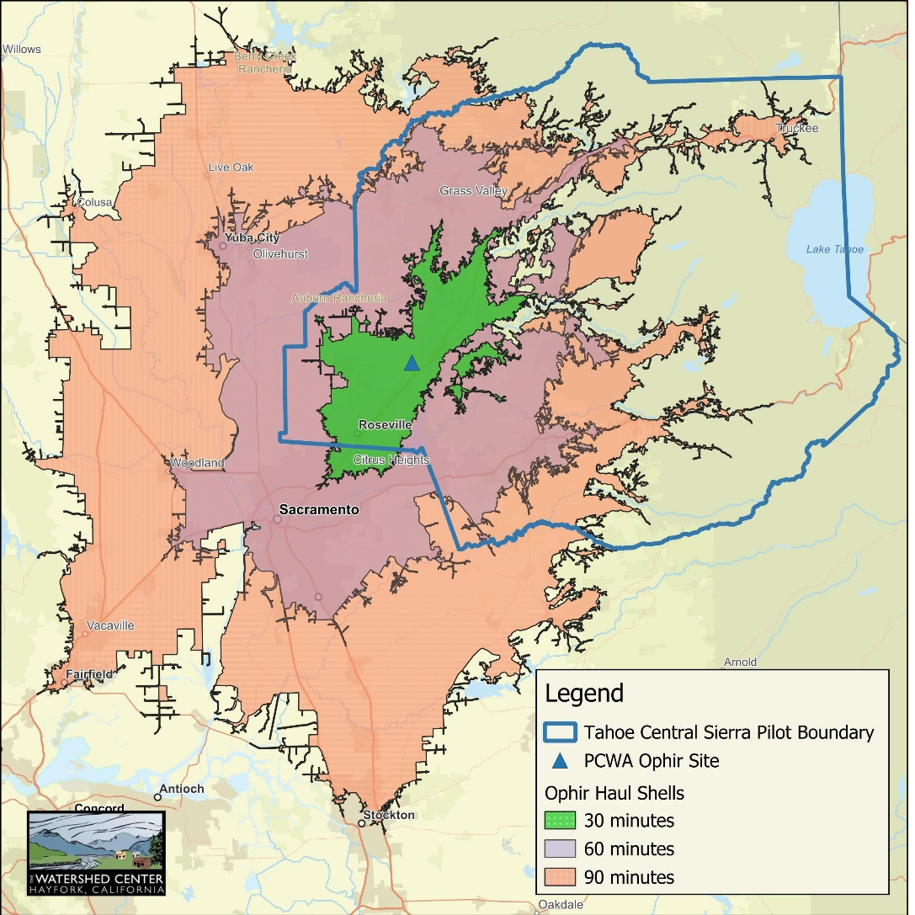
Case Study Area
30, 60, and 90 minute haul distances
Notes:
Extensive work occurring in the TCS Region to plan and implement forest health projects, especially by USFS partners (NFF, PC)
TCS Region contains high value watersheds, extensive WUI landscape, a high degree of tourism due to the Lake Tahoe Basin, and the existence of TCSI supporting efforts to advance the pace and scale of forest restoration.
NOTE: many WUI projects focus on broadcast chipping and mastication due to fragmented project areas and limited biomass disposal options
Sources: USFS, industrial timber, nonindustrial timber (RCDs, FSCs, RPFs), utility ROW, landfills, existing biomass facilities

Slide 20
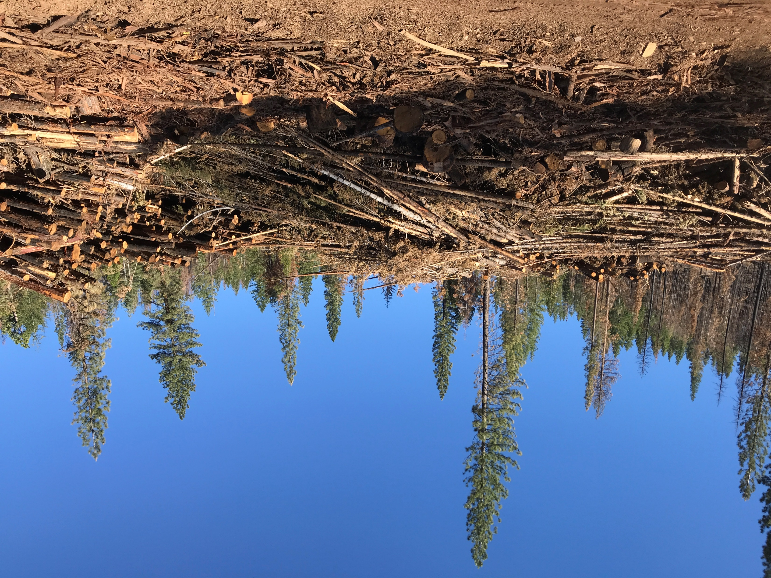
LTO Perspectives: Biomass Disposal is Cost Prohibitive, Options are Limited
No surprises there…
Strong interest in setting up multi-year supply contract with Arbor

Slide 21
Delivered Biomass Prices (from LTOs)
Could be up to $200/BDT from more distant locations
Harvesting costs (cut, skid, process, load): | $56 - $64/BDT
Haul costs: | $28 - $50/BDT
Grand total range: | $84-$114/BDT
Notes:
Recommendations
For supply now, work directly with operators.
Work directly with Fire Safe Councils, RCDs, and county/city governments to source from wildfire prevention or green waste disposal efforts.
Explore partnerships with USFS partners
Biomass from Western Regional Landfill and existing biomass facilities?
Monitor CalFRAME and JPA development

Slide 22


Biomass to Energy and Carbon Capture and Storage
Placer County Water Agency and Arbor Energy

Slide 23
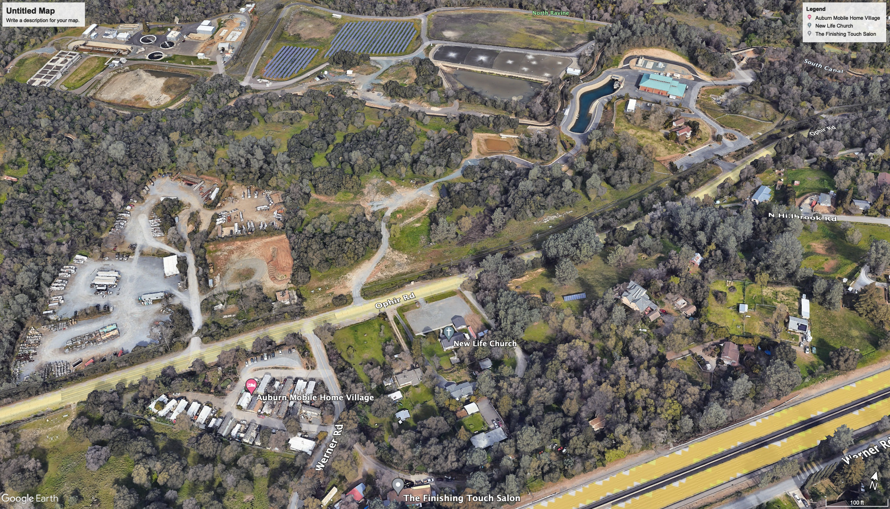
Business Case
Primary - Behind the meter energy independence for reliability and rate insulation.
Value Added – Biomass utilization for forest and community fuels reduction.

Slide 24








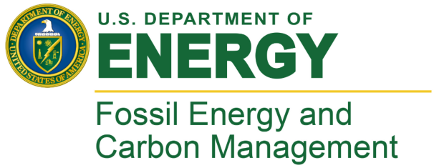






Traction with Project Partners
Purchasers $1m sales
Grants
Deployment

Slide 25
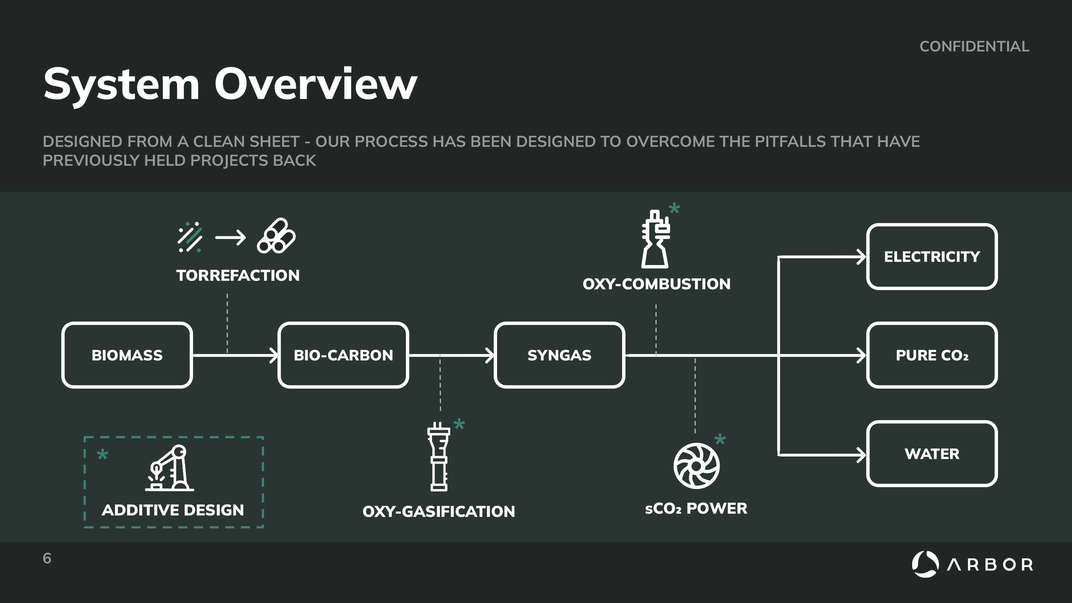

Slide 26
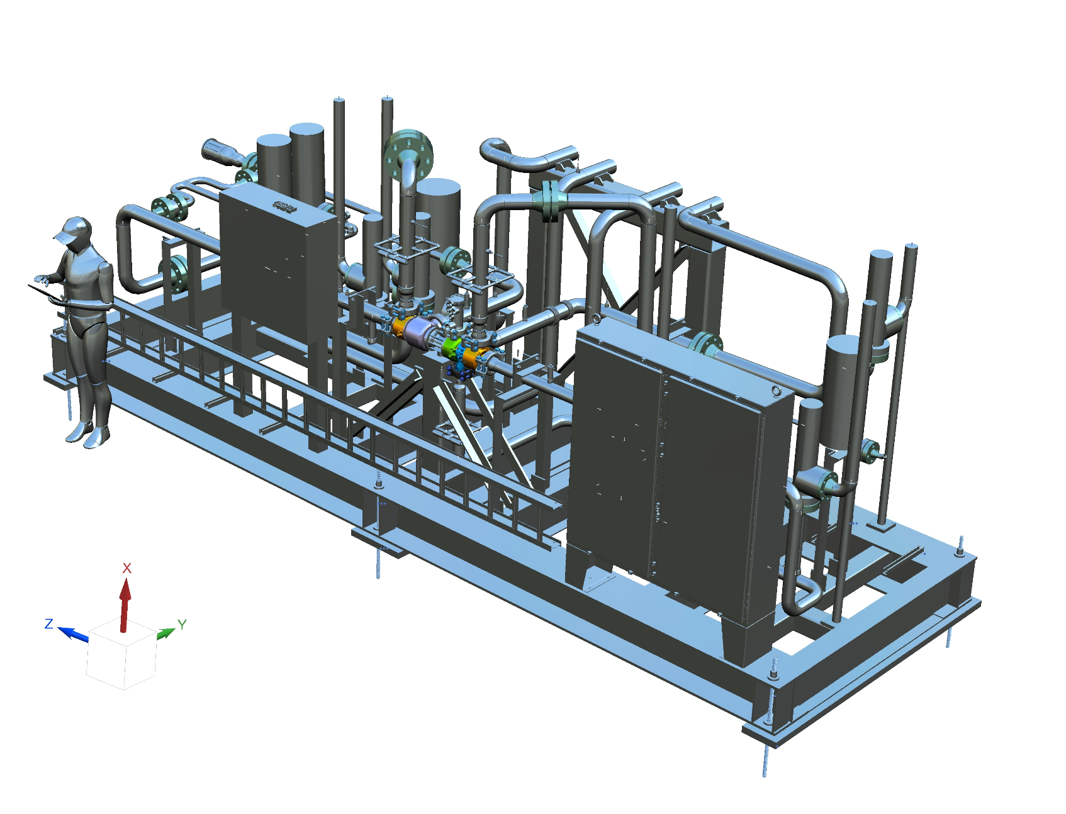
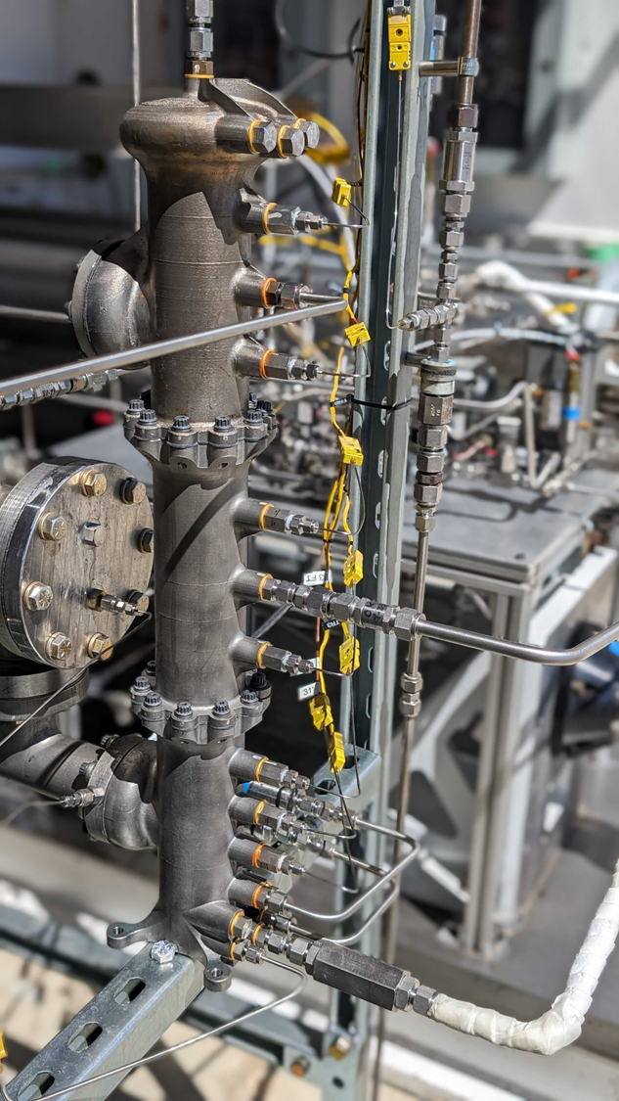
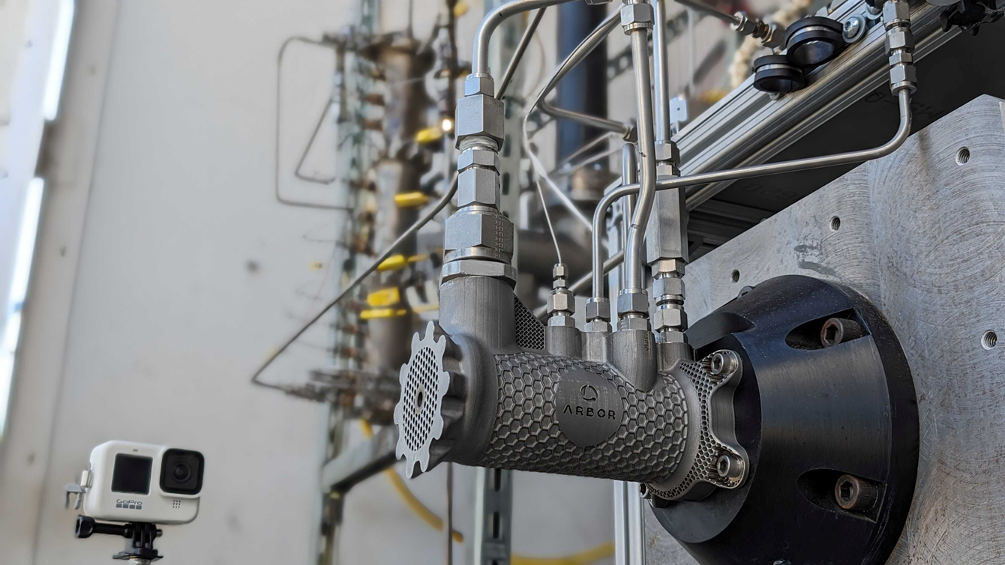



Technology Pilot: Underway in San Bernardino
Objective: Test individual Arbor technologies in isolation, then in an integrated system to prove technology capability
Location: San Bernardino, CA
Partners:
Site Host: Kelly Space and Technologies
Biomass Provider: Rio Bravo Rocklin - Biomass industry leader
Community Support: Technical Employment Training
Timeline:
April 2024: First Fire of System
July 2025: Full system long duration testing, TRL 6 demo of powerpack
Sept. 2025: Construction at Kelly complete
Nov. 2025: Full system long duration testing, TRL 6 demo of powerpack + sublevel gasifier
Feb. 2026: Full system long duration testing, TRL 6 of integral gasifier system @ powerpack
December 2026: Kelly CO2 removal delivered
Final render for Test Skid at Kelly Space
Gasifier prototype, ready for testing
Oxycombustor unit at Arbor’s Test Facility in Mojave, CA

Slide 27
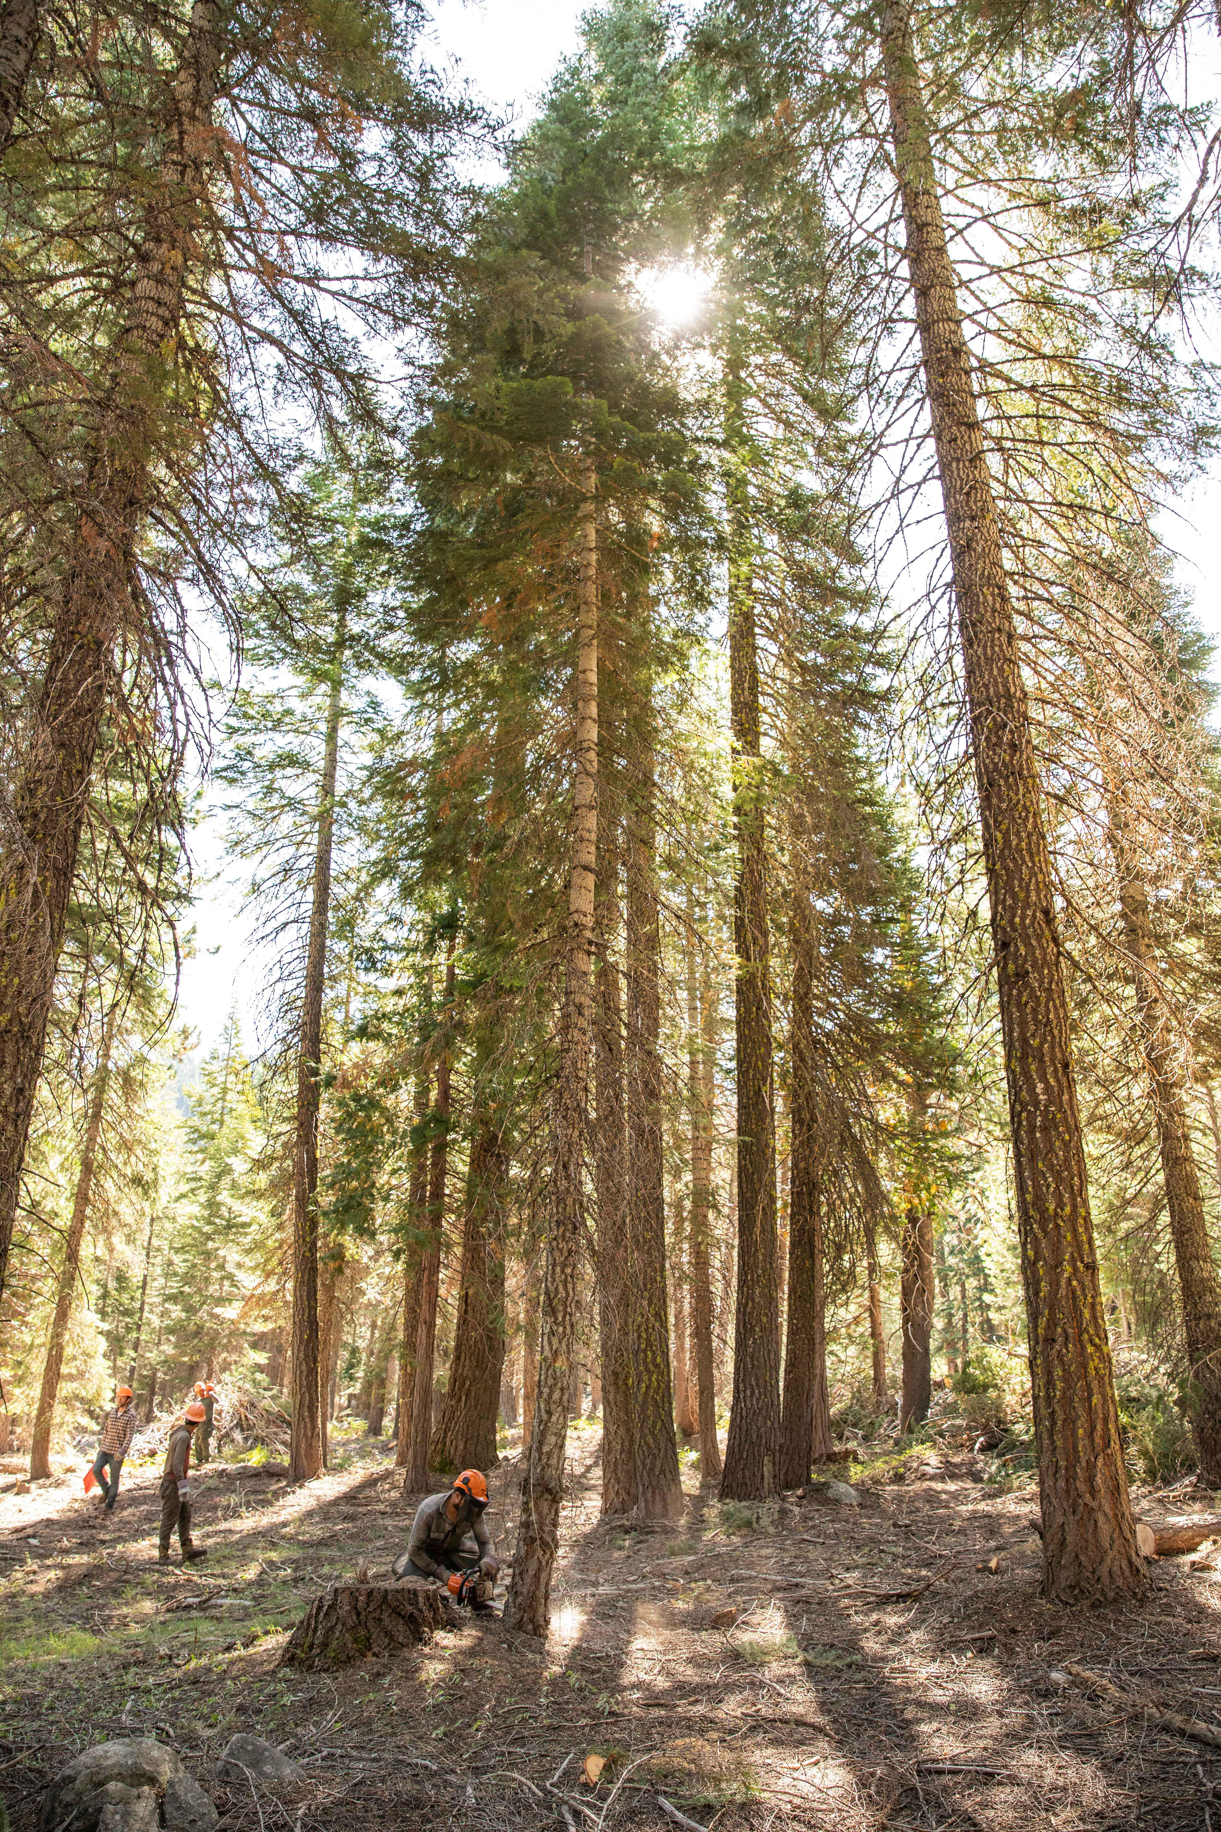
Challenges
Feasibility of biomass to energy
End product markets
Guarantee of biomass supply
Notes:
Feasibility – conventional biomass to energy plants do not pencil out, so some other element or byproduct must be monetized to make these projects successful.
Markets – these are speculative and waiting on end use technologies, funding, and regulatory hurdles. For the carbon market a major hurdle is the permitting and construction of Class VI wells.
Biomass – there is an insurmountable supply of biomass, but getting commitments to supply this material to a facility that are adequate to justify spending tens of millions is proving difficult.

Slide 28
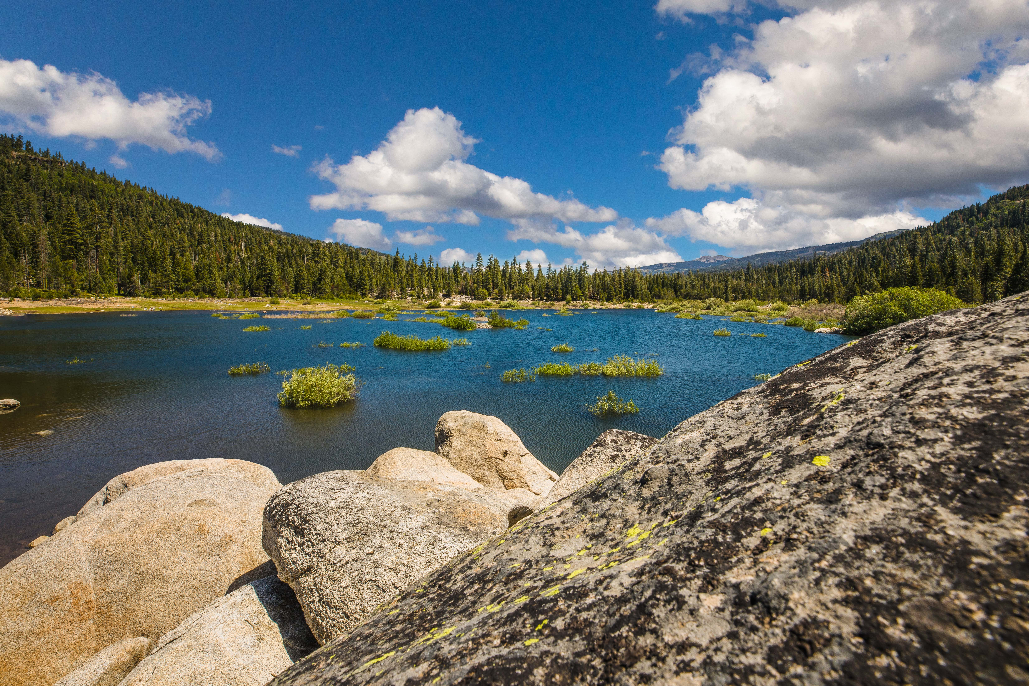
Thank you!

