Slide 1
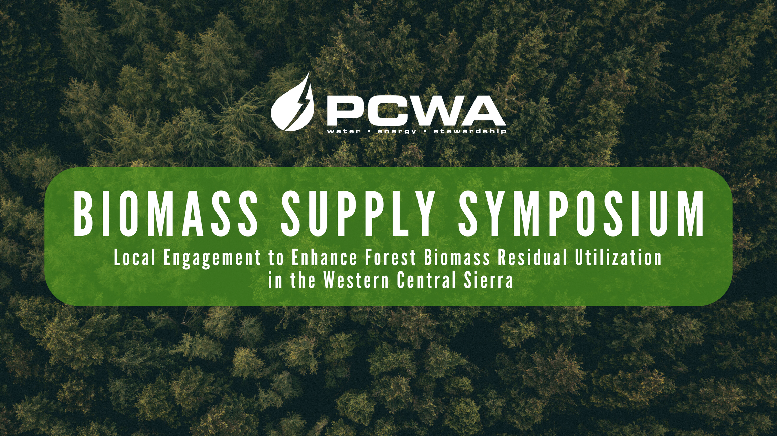
“Cal Frame and other State Agency Involvement”

Slide 2
WATER AGENCY ROLE IN
FOREST HEALTH
Presented by CATHERINE SILVESTER, LANDMARK ENVIRONMENTAL, Inc TEAM

Slide 3

Water Agency Role in Forest Health
Purpose of Study
To understand the existing and potential roles of water agencies in forest health and biomass feedstock aggregation and utilization.

Slide 4

Study Approach
Background Research and Interviews
  Existing and planned programs
  Biomass use/disposal methods
  Partners and funding
  Challenges and lessons learned
  Role in future biomass utilization programs
Legal Research
  Ability to fund fuel reduction activities
  Ability to direct how the biomass waste is used
  Ability to support biomass electricity conversion projects

Slide 5
Results/Key Findings
Existing and Planned Efforts
  36,000 to 40,000 acres, increasing
  Various partnerships, jurisdictions, and funding
  Reflected in planning framework
  Able to justify work outside of WUI
  Annual funds available
Participation in Biomass Utilization
  Importance of/role in varies
  Removal to an outlet is preferred
  Initiating and implementing biomass conversion projects
Objectives and Justification for Efforts
  Protect infrastructure, catchment area, water quality
  Wildfire prevention or recovery
  Cost and water supply
Legal Research
  Able to fund projects on private and public lands
  Able to direct how biomass is used
  Able to support biomass utilization projects

Slide 6

Results/Key Findings
Challenges
  Too few biomass facilities
  Material removal/sale price gap
  Vendor capacity limitations
  Lack of coordination
  Lack of expertise, capacity
Lessons Learned/Considerations
  Prioritize partnerships
  One solution may not work for all
  Roles of existing inter-agency groups

Slide 7
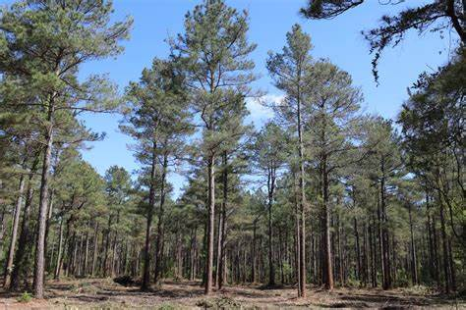
Conclusions
Water Agencies Present Opportunities
  Reliable and sustaining source of biomass for outlets
  Could be positioned for an increase in pace and scale
  Statutory powers allow work in forest health, contracting, and biomass utilization
  Insight from challenges and lessons learned

Slide 8
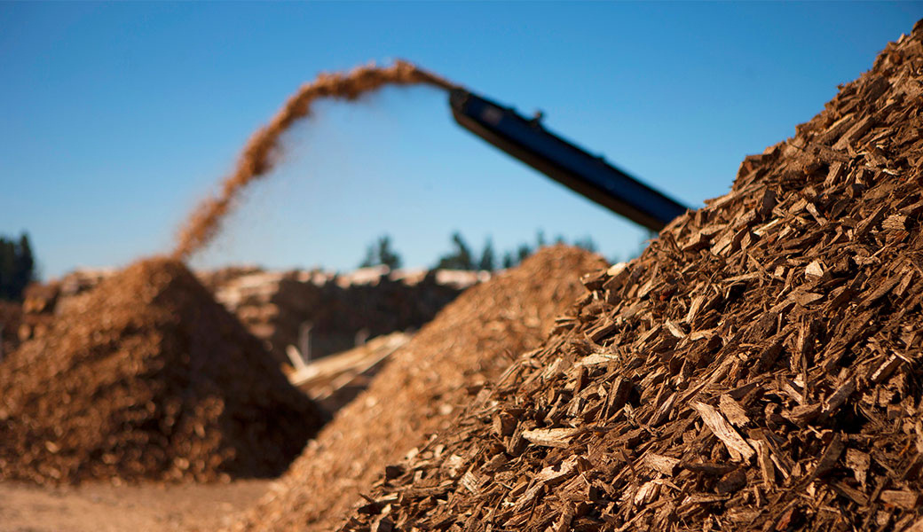




CLERE Inc.
JPA Study Overview
Christiana@clereinc.net
www.clereinc.net

Slide 9
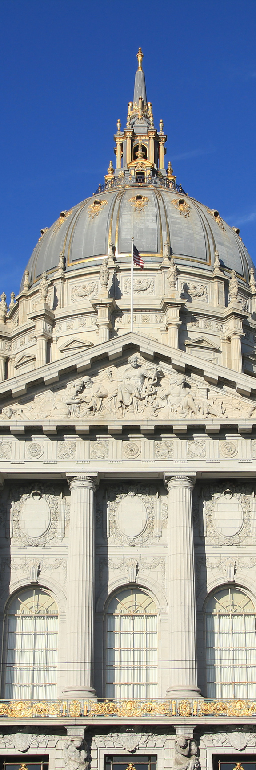
What is a Joint Power Authority?
  Joint Powers Authorities (JPAs) are legally created entities allowing two or more public agencies to jointly exercise common powers.​
  The Joint Exercise of Powers Act, codified in California Government Code section 6500, governs JPAs and restricts their use to public agencies, which are defined very broadly, including federal, state, and recognized Indian tribes, but does not allow non government entities to act as members without specific legislative action.
​​
  The Act authorizes two kinds of JPA arrangements: one for jointly exercising common powers and another for forming a separate legal entity with independent rights and liabilities.​
  Forming a separate JPA entity allows it to enter into contracts, hold property, maintain debts and obligations, and assets that belong solely to the entity, separate and apart from its member entities.​
  Joint powers Agreements and Agencies are created through a contract between the member entities, and can also be dissolved by the members.
​ ​
  The authority of an agency is only as broad as its weakest member.​​
  Internal procedures of a JPA can mirror a member’s processes.

Slide 10
Benefits of a JPA
JPAs are formed to solve mutual problems, to fund a project, or to act as a single representative entity for specific activities. Forming such entities may not only provide a creative approach to the provision of public services but also permit public agencies with the means to provide services more efficiently and in a cost-effective manner.
In general, the benefits of a joint power authority include:
  Enhanced coordination and communication among local groups and citizens in different cities and counties​
  Shared risk mitigation​
  Improved service delivery, including providing contract development and management for third parties​
  Cost-sharing, pursuing grants and seeking shared staffing could be part of new relationship through JPA law​
  Could put together and approve bonds and other debt tools, Insurance tools, or Financing public infrastructure

Slide 11
Challenges with the Biomass Market Today...
  California's forests have an excess of dead trees, brush, and small wood materials that need removal to reduce fire risk and improve forest health, but securing long-term access to these materials is difficult, hindering efforts to utilize them for wood products and bioenergy.​
​
  The uncertainty of a continuous supply of woody materials makes it challenging to attract necessary funding for projects, as lenders and investors typically require at least a ten-year feedstock supply assurance.​
  In 2021, the OPR allocated $2.5 million from wildfire resilience funds to Cal FRAME for five long-term wood feedstock pilot projects aimed at enhancing feedstock logistics and market opportunities through resource-backed contracts.​
​
  The California Forest Residual Aggregation for Market Enhancement (CAL FRAME) concept aims to establish biomass supply management entities to streamline the biomass supply chain, ensuring a steady and reliable flow of materials between landowners, suppliers, and buyers.​
​
  The Tahoe Central Sierra CAL FRAME Pilot Project, led by the Placer County Water Agency, explores the viability of such an entity in Placer, Nevada, and El Dorado Counties, aiming to facilitate long-term contracts and advance forest resilience projects for economic and environmental sustainability.

Slide 12
Using JPA’s for Biomass Market Enhancement
  Using Joint Powers Authorities (JPAs) to enhance forest biomass feedstock supply chains aims to create a more efficient and financially viable system for managing forest residues.​
​
  The effectiveness of JPAs relies on aligning incentives, hedging long-term risks, and securing robust participation from key stakeholders​
  A new contract management system that includes insurance or bonding for contract failure would make new biomass businesses bankable by providing long-term feedstock contracts.​
  JPAs could mitigate risks for suppliers and buyers, encourage sustainable forest management practices, and enhance business confidence and financial viability through indemnification and innovative insurance solutions.​
  JPAs could offer services to support forest health programs, such as environmental review, business support, and equipment leasing, addressing challenges faced by landowners, forestry professionals, and wood product businesses.​
​
  voluntary participation in the JPA activities, no regulations are currently being proposed to be established, and the aim is not to displace existing businesses​
  Federal tax credit law changes could support the development of public infrastructure by a JPA for biomass projects

Slide 13


JPA Models for Biomass Utilization
Water Agency JPA
  Model involves counties, cities, and water agencies​
  Inspired by Upper Mokelumne River Watershed Authority (UMRWA)​
  Leverages water agencies' expertise and relationships in forest health projects​
  Would need to Addresses hesitancy and capacity issues in water agencies​
  Focus on feedstock aggregation from forest health treatments by the water agencies and other entities​
  Leverage local water agencies' JPA experience​
  past successes with UMRWA in forest restoration could serve as model

Slide 14
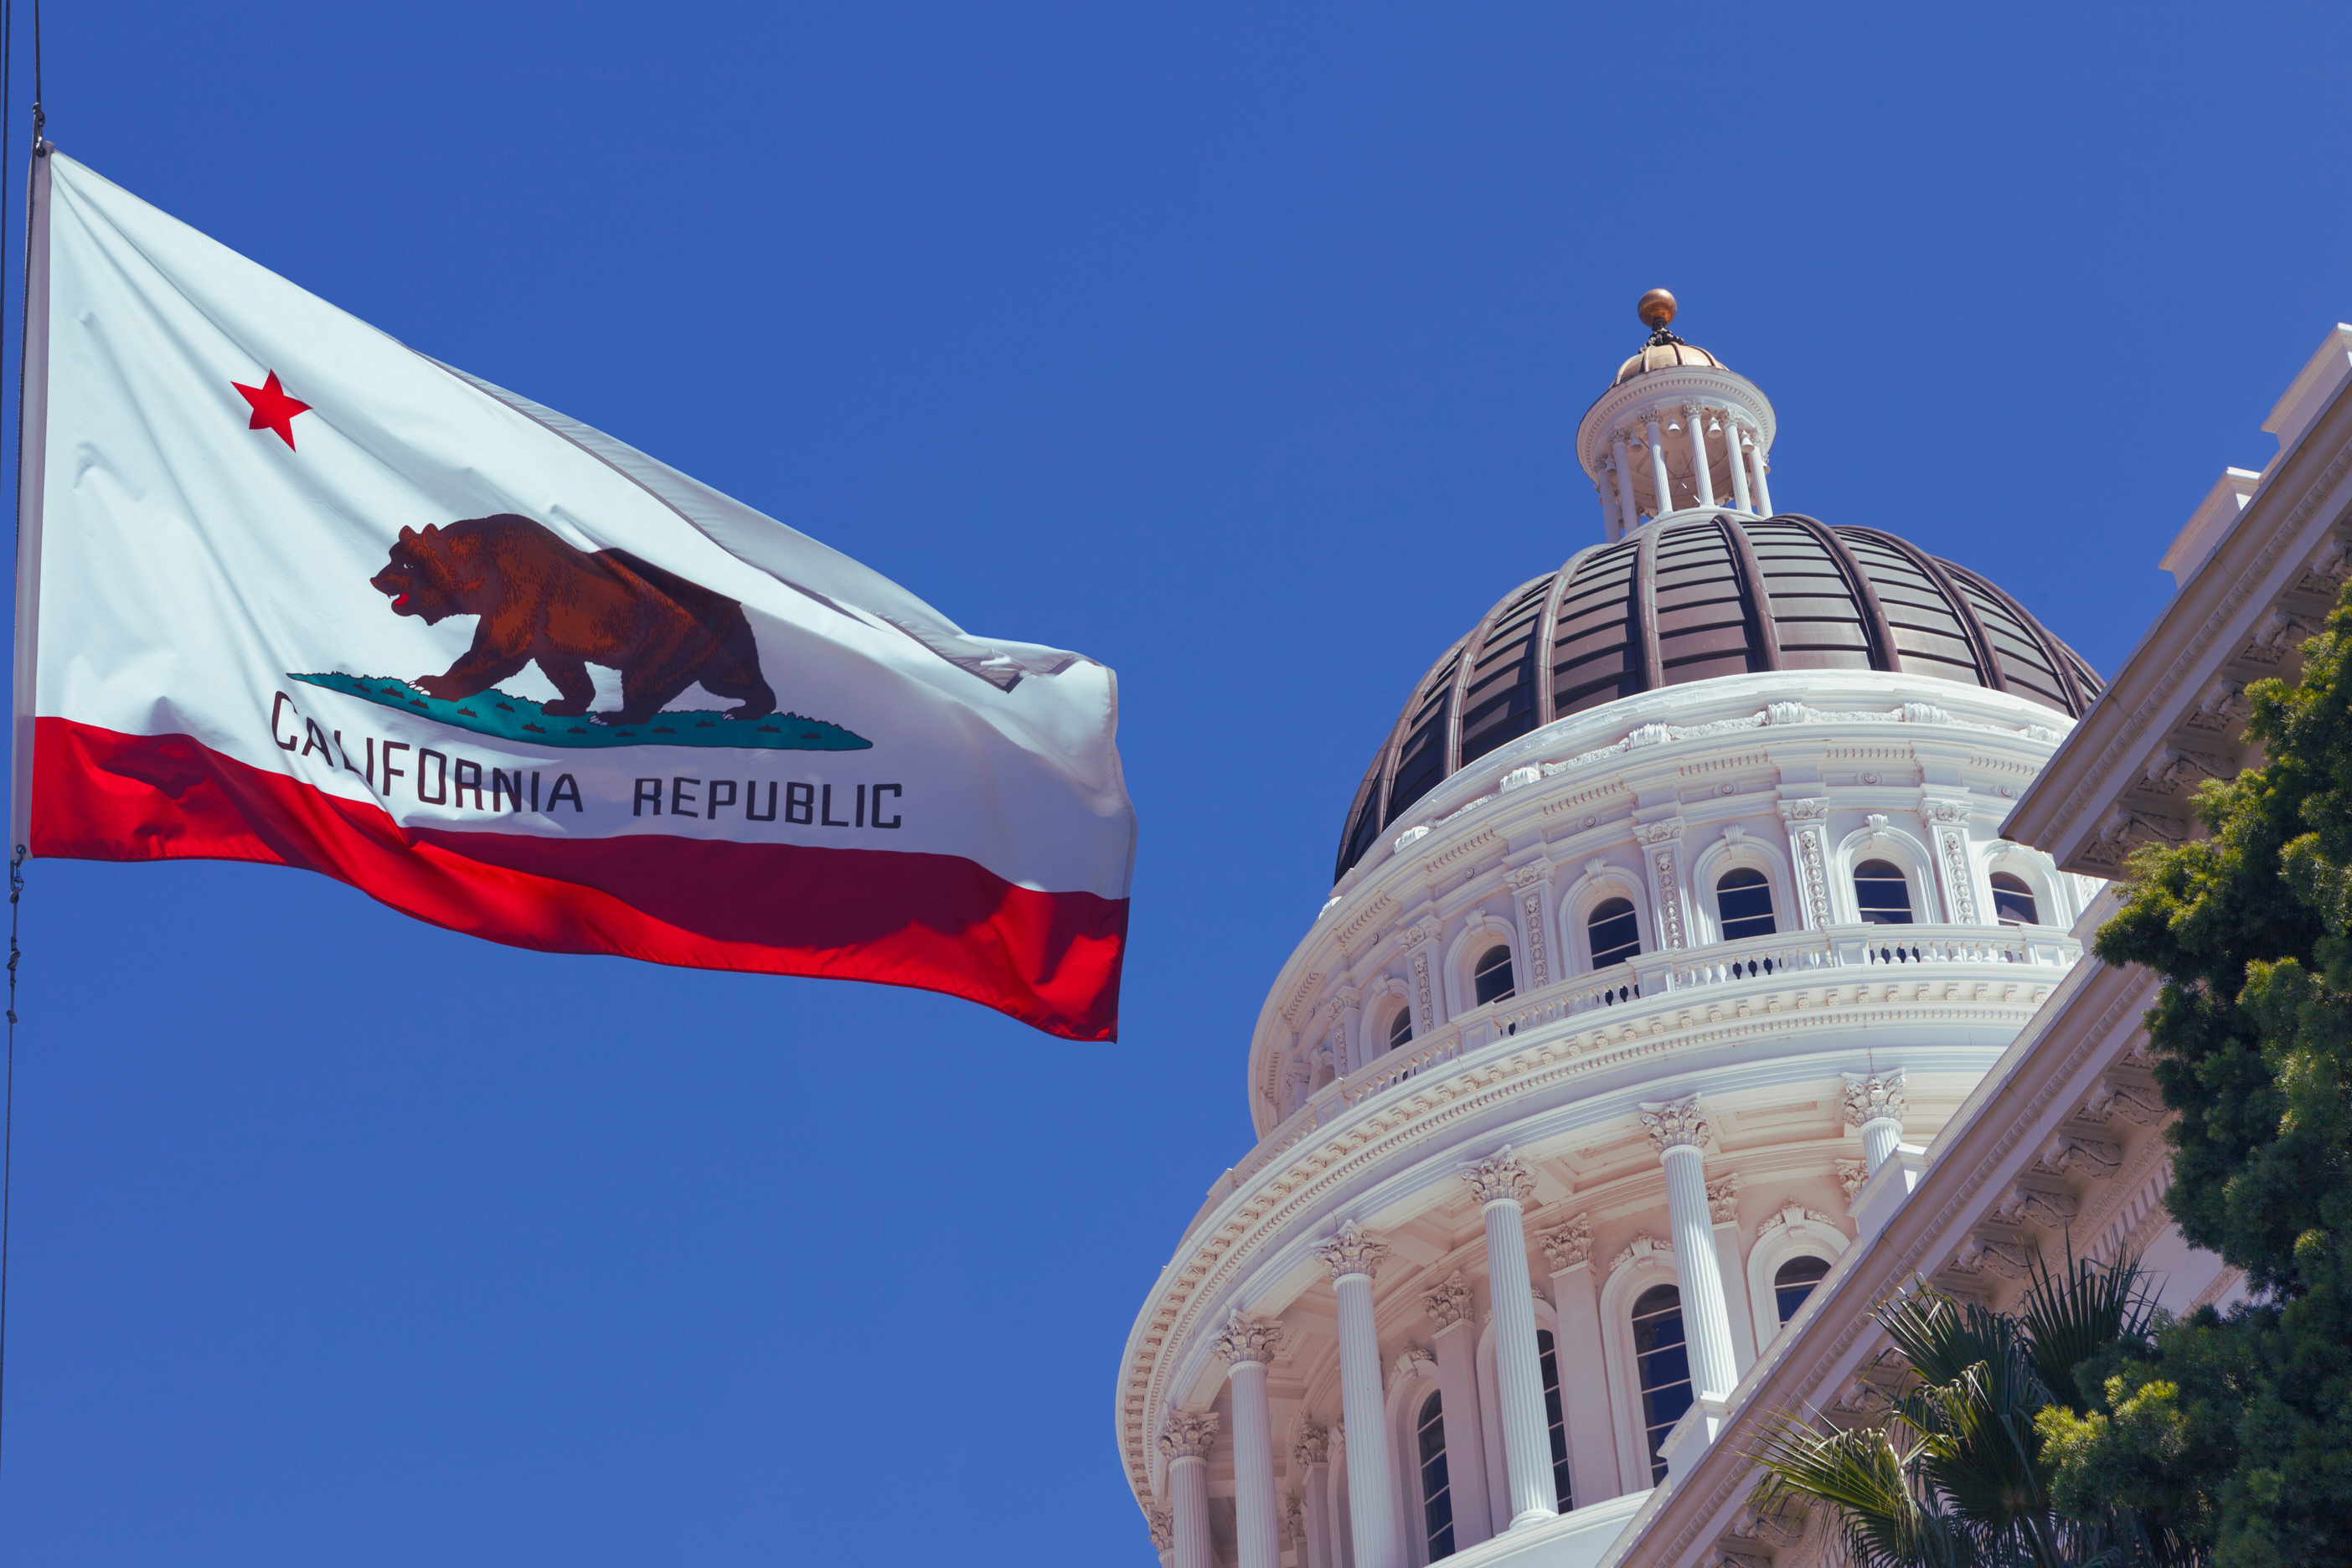
JPA Models for Biomass Utilization
State Agency JPA
  Collaborate among state conservancies and local agencies
  Possible creation of a new entity for biomass utilization
  Fee-for-service model and subgrant programs
  Aligns with state resilience hubs, structured with dedicated staff
  Concerns: potential bureaucracy and community buy-in
State Agency Joint Powers Agreement (without creating a seperate entity)
  Amend existing agreements between SNC and TTC to add members and services for biomass aggregation​
  Utilizes existing frameworks and shared financial resources
  Faster process, but no dedicated staff
  Maintains risks and liabilities for agencies involved

Slide 15
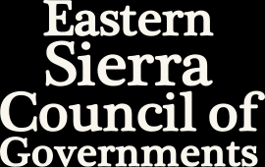
JPA Models for Biomass Utilization
Local Government JPA
  Three County JPA with city or special district partners​
  Focus on regional service provision​
  Inspired by successful models in other sectors​
  Streamlines local control​
  Could lead to innovative solutions like municipal green waste disposal​
  Promotes public-private partnerships​
  Emphasizes transparency and functionality​
  Includes support for insurance tools for members, businesses and potentially even the public​
  Avoiding duplicative bureaucracy is key

Slide 16
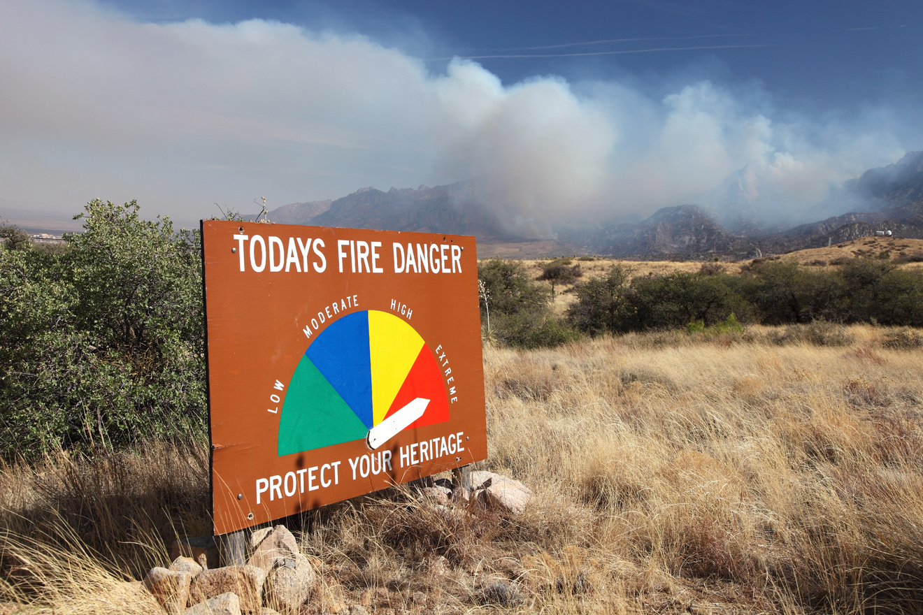

JPA Models for Biomass Utilization
Wildfire Prevention Authority
  JPA focused on fuel treatment and biomass utilization​
  Set up to provide for fuel reduction projects and home hardening​
  Comprised of fire districts and potentially CAL FIRE​
  Requires careful tax strategy, voter communication, and strong local fire agency involvement

Slide 17
Funding Options for New Joint Powers Agreement or Authority
Presented by Amy Lapin, Economic & Planning Systems, Inc.
Notes:
Amy - In support of a new JPA, EPS evaluated the range of funding sources and mechanisms to support initial and ongoing operations.

Slide 18
New JPA Funding/Finance Powers
Funding sources and financing mechanisms available to carry out the purposes of a new Joint Powers Authority composed of cities, counties, and special districts:
  Member agency contributions
  Gifts and grants
  Charges for services
  Enterprise revenues
  Local funding measures (taxes and assessments)
  Passive income
  Tax increment financing (TIF)
  Bond issuances (debt financing)
Notes:
Of the JPAs researched, most JPAs are primarily funded through two to three main funding sources. The most common funding source of JPAs is through government funding and grants, as well as contributions from its member agencies. For six of the seven JPAs that received either government funding or a grant, almost half of their budget revenues were funded through this source. Additional sources of funding include passive income, program revenues (fees for services), and special tax revenue through established community facilities districts.

Slide 19
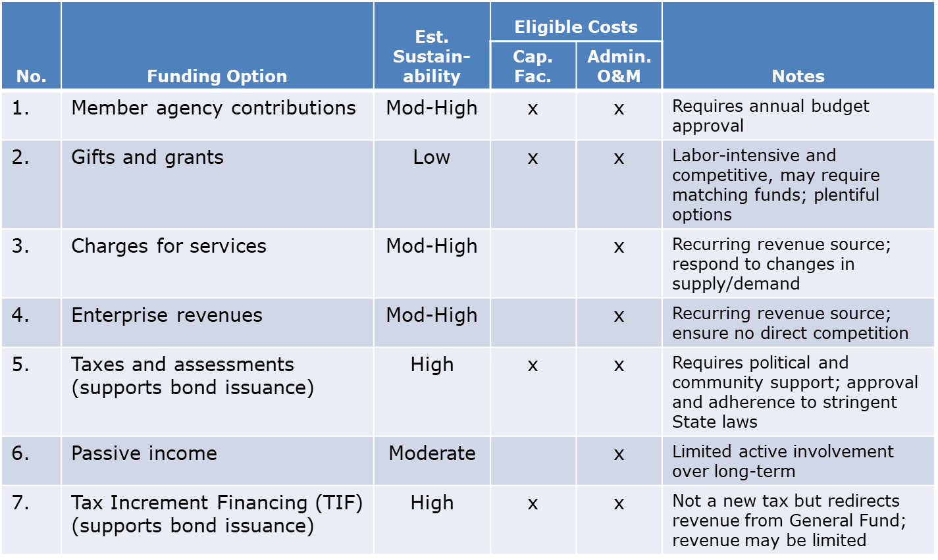
Funding/Finance Options Summary

Slide 20
Municipal Bond Issuances
Issuing municipal bonds provides an opportunity to raise upfront capital by selling debt securities to investors
  General obligation bond; revenue bond; CFD bond; EIFD/CRD bond
Debt repayment must be supported by a stable, annual revenue source:
  Property and sales tax revenue
  Special tax revenue
  Tax increment revenue
Voter approval is required for GO Bond; other types of bonds can be authorized by municipal ordinance
Evaluating financial feasibility and risk is imperative
  Municipalities: General Fund impact; cost of issuance can range from 3-20%
  Payors: Tax burden constraint (2% test)
  Investors and bond counsel: 110-135% debt service coverage ratio; value-to-lien ratio from 3:1 to 4:1
Notes:
Rule of thumb: net construction bond proceeds are estimated at about 10-12x annual revenues

Slide 21
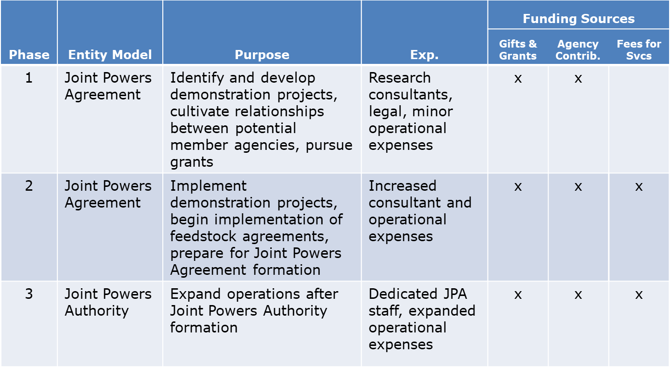
Phased Funding Strategy
Notes:
Incremental approach to governance and funding implementation

Slide 22
Considerations and Next Steps
Finalize the initial member agencies, the mission statement, and key functions.
Develop the timing and scope of phased annual costs associated with staffing and administering the entity's functions.
Identify existing staffing capacity and resources at participating agencies.
Determine the scope of participating agency contributions and additional funding potential from sustainable sources.
Identify the financial policies and desired agreements that should guide the new entity.
Work together to make the new JPA attractive for seed money available by the State and other funding sources.
Notes:
Incremental approach to governance and funding implementation

