Slide 1
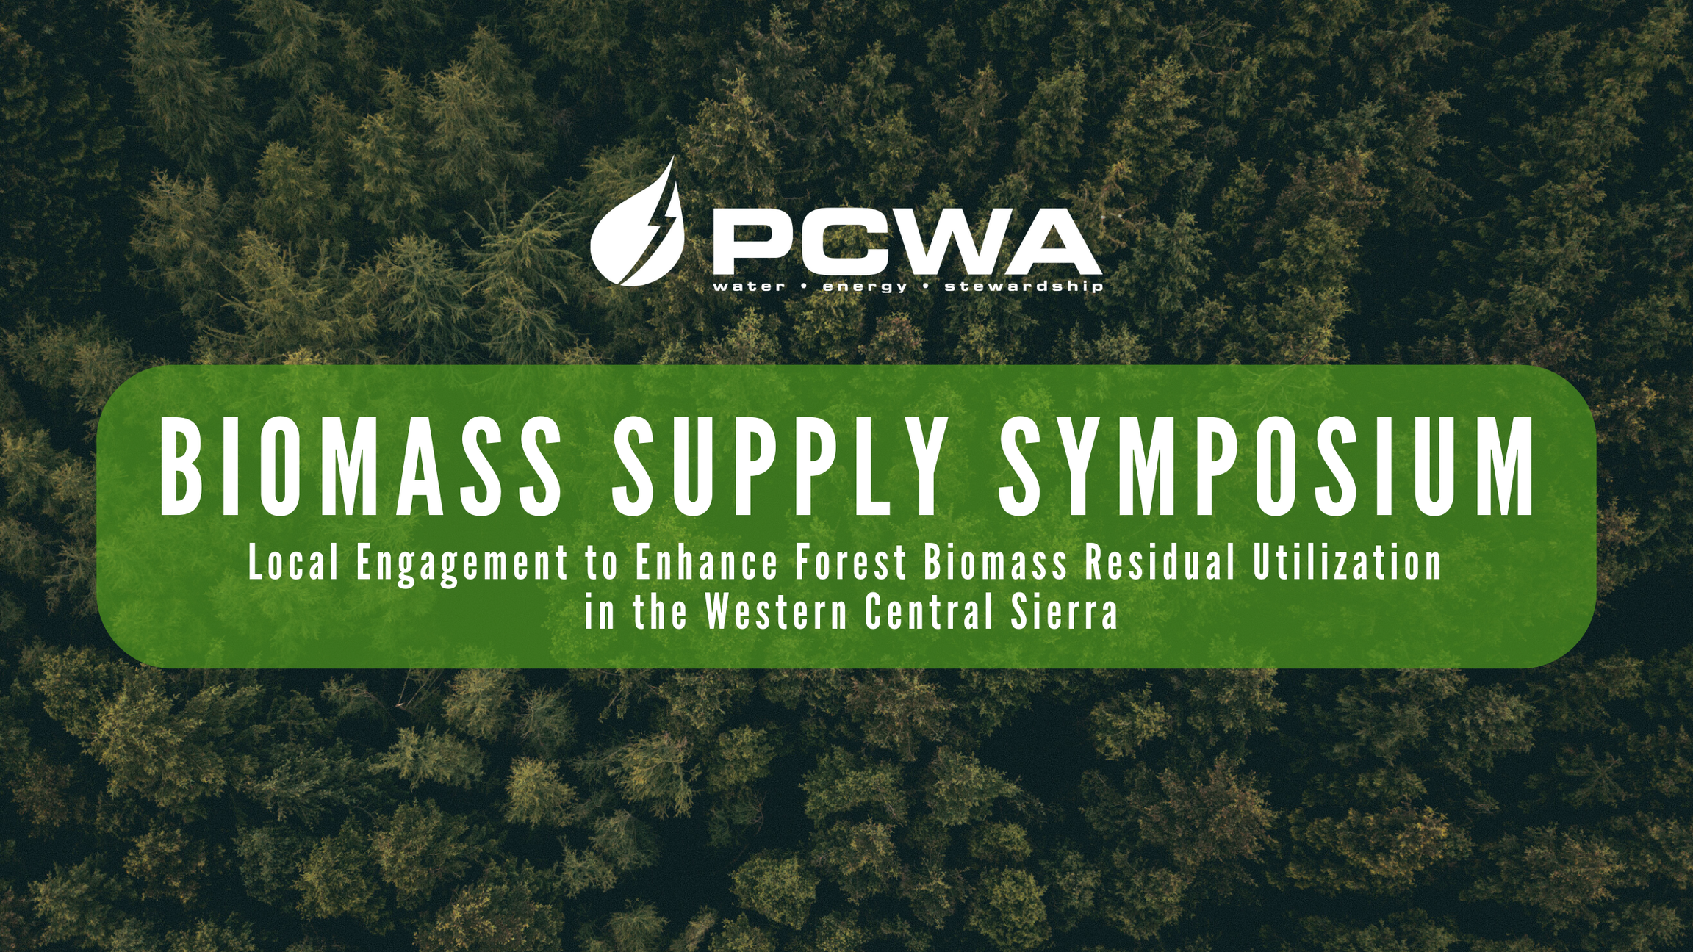
“Other State Programs that Work on Biomass Related Issues

Slide 2
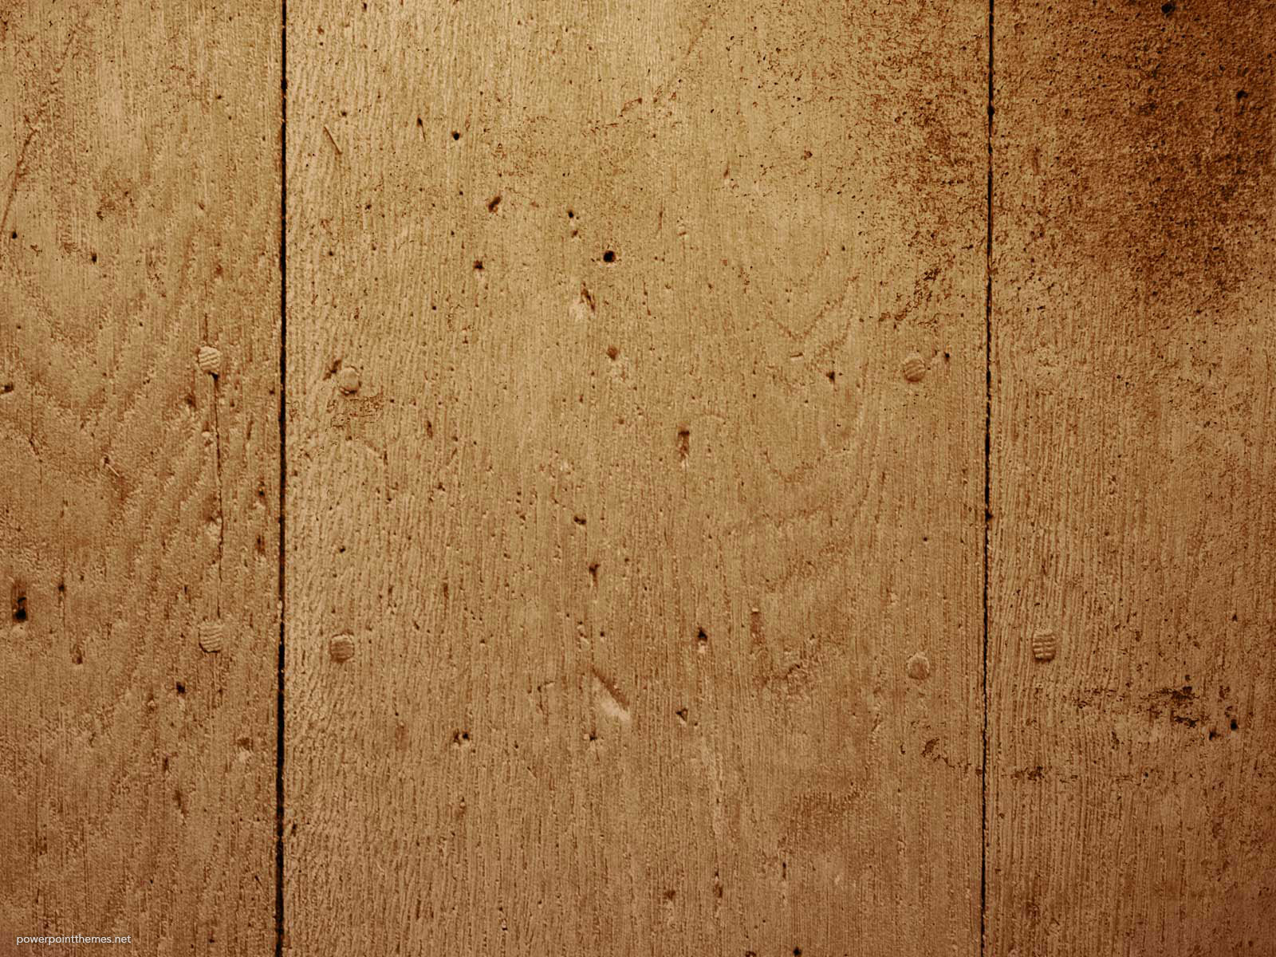

Joint Institute for Wood Products Innovation
California Board of Forestry and Fire Protection
Biomass Supply Symposium
June 26, 2024

Slide 3
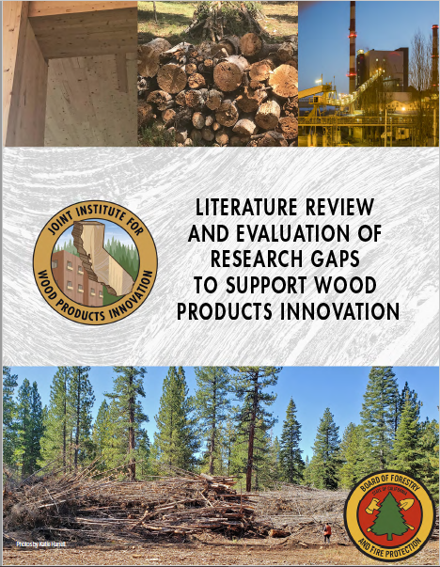
Near Term Wood Products
  Mass timber
  Liquid and gaseous transportation fuels
  Chemically and thermally treated wood
  Policy Recommendations
  Align state incentives to account for climate benefits of forest products
  Promote infrastructure development for wood product processing
  Fund research to further innovation in wood products

Slide 4
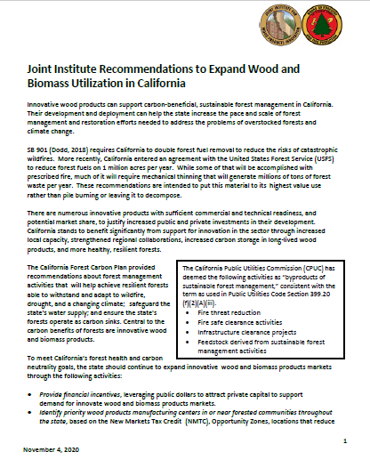
Recommended Actions
Wood and Forest Biomass Products
Forest Bioenergy
Innovative Wood Products
Oversight and Coordination
  Problem statement
  Action
  Cost
  Timeline
  Primary agency
  Supporting agencies

Slide 5
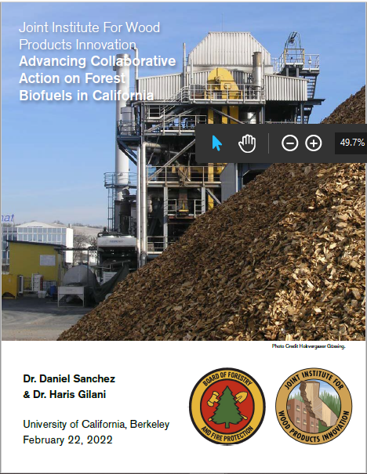
CA Fuel Consumption
  Over 11.3 bil gal gas in 2020
  Over 5 bil gal jet fuel in 2020
4 Types of Fuel Using Non-Merchantable Forest Biomass
  Hydrogen
  Ethanol
  Renewable natural gas
  Drop-in synthetic fuels that could displace gas, diesel, or aviation fuel
  Recommendations: Infrastructure, Policy Support, Feedstock Supply, Equity and Development, and Project Finance

Slide 6
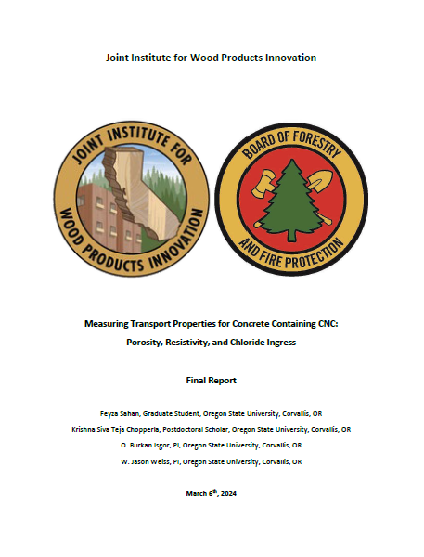
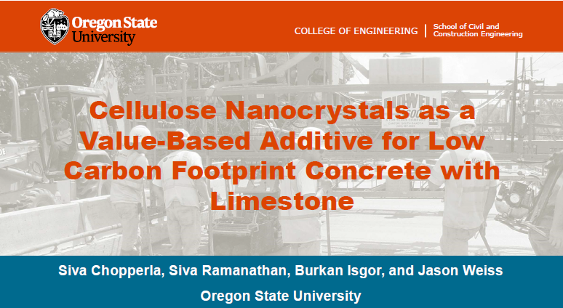
Concrete Industry to Reduce GHG to Net Zero by 2045
Cellulose Nanocrystals (CNCs) in Concrete
+ Ordinary Portland limestone cement = 19.4% lower GHG emissions
Concrete strength and service life of steel in concrete unchanged
Thin-from-below forest management
  Approx 3,100 lbs of CNCs produced/acre
  70 treated acres = 1 paved mi of 4-lane road

Slide 7
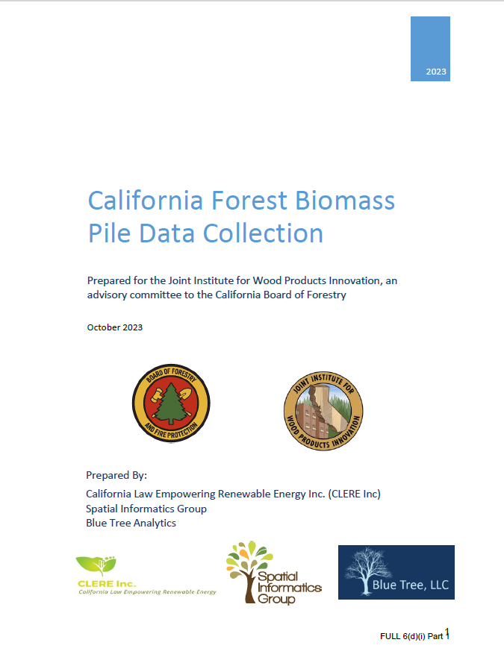
Forest Biomass Piles 2018 – 2021
Potentially 150,000 acres of forest biomass piles
Approx. 1 million tons of material in piles
78% of material on public land
  19% accessible via existing roads

Slide 8
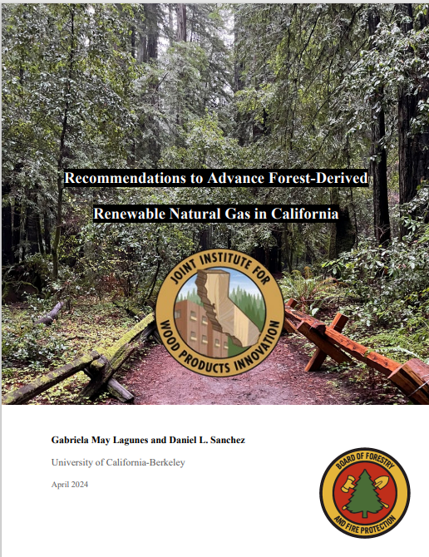
Retrofit 9 Closed or Idled Biomass Power Plants for RNG Production
Use nearly 1 million BDT of woody biomass/year
Produce over 8 million GJ energy/year
Technology Trust and Willing Bioenergy Leadership to Produce RNG from Forest Biomass
Not Financially Viable in the Present Political and Economic Environment

Slide 9
Projects Underway
CEQA Support for Wood Utilization
CEQA Guidebook for Wood Products Businesses
Pros/Cons Proposed Language for CEQA Guideline Amendment
  Recommendations to Expand Wood and Biomass Utilization in CA

Slide 10
Projects Underway
State Purchasing Protocols Related to Innovative Wood Products
Barriers and solutions to updating protocols to facilitate innovative wood product procurement
LCA Model for Biofuel Production from CA Forest Biomass Waste
Develop an LCA calculator to quantify the GHG impact of diverting forest biomass from current practices to bioenergy products
Model the life cycle GHG impact of electricity or hydrogen fuels

Slide 11
Pending Projects
Affordable Workforce Housing with Mass Timber Elements
  Workforce needs in forested community
  Housing plans will meet local permitting requirements
Supporting CA Forest Restoration Through Forest Industry Infrastructure Retention and Development
  Current industry infrastructure
  Volume and type of supply needed to sustain infrastructure

Slide 12

Thank you for your time.
Katie Harrell
Program Administrator
Joint Institute for Wood Products Innovation
Katie.Harrell@bof.ca.gov
(916) 698-1035

Slide 13


Slide 14

Sierra Nevada Conservancy Biomass Update
Presented by:
Emily Blackmer

Slide 15
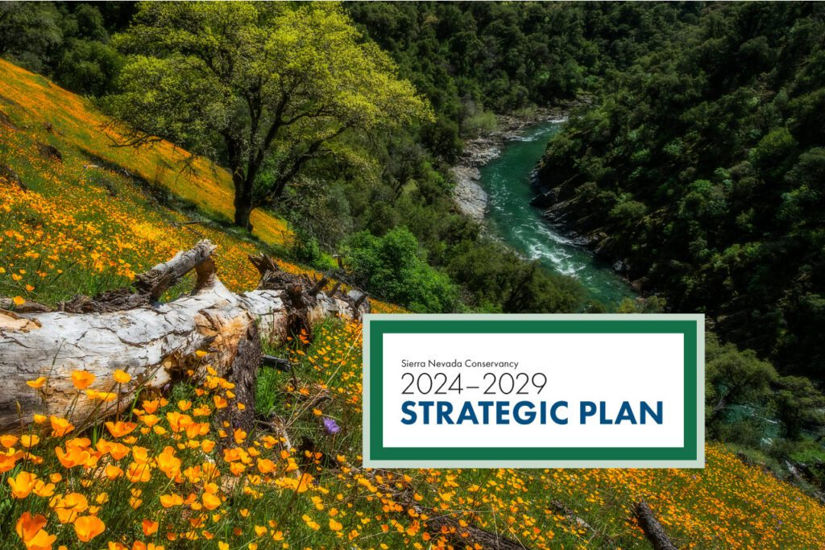
2024-2029 Strategic Plan

Slide 16
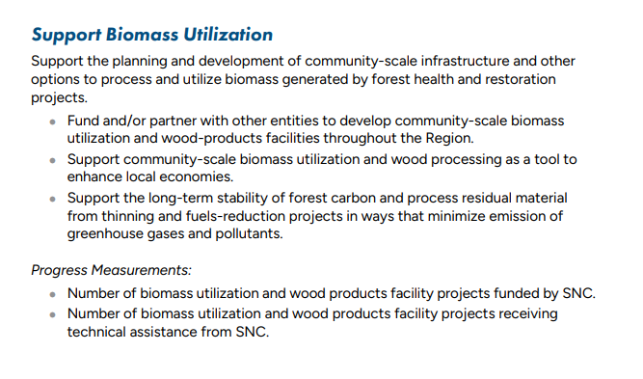
2024-2029 Strategic Plan

Slide 17
Recent Project Investments
June 2024: Hat Creek Lumber
March 2024: Northstar Community Services District Wood Energy Facility
June 2023: Camptonville Community Partnership Bio-Energy Facility
March 2022: Blue Mountain Forest Biomass Plant

Slide 18
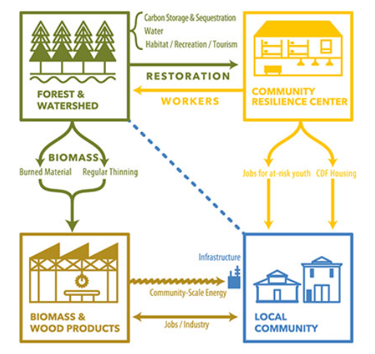
Other Initiatives
Biomass
Utilization Fund (Tuolumne County)
Tahoe-Central Sierra Initiative

Slide 19


